Slide 1
MESH REINFORCEMENT IN MIDLINE INCISIONAL HERNIA PROPHYLAXIS
Manuel López Cano
Hospital Vall d’Hebron, Barcelona
mlpezcano@gmail.com

Slide 2
PROPHYLACTIC MESH REINFORCEMENT DECISION MAKING
SURGEON´S KNOWLEDGE
PATIENT´S
PREFERENCE
EVIDENCE

Slide 3
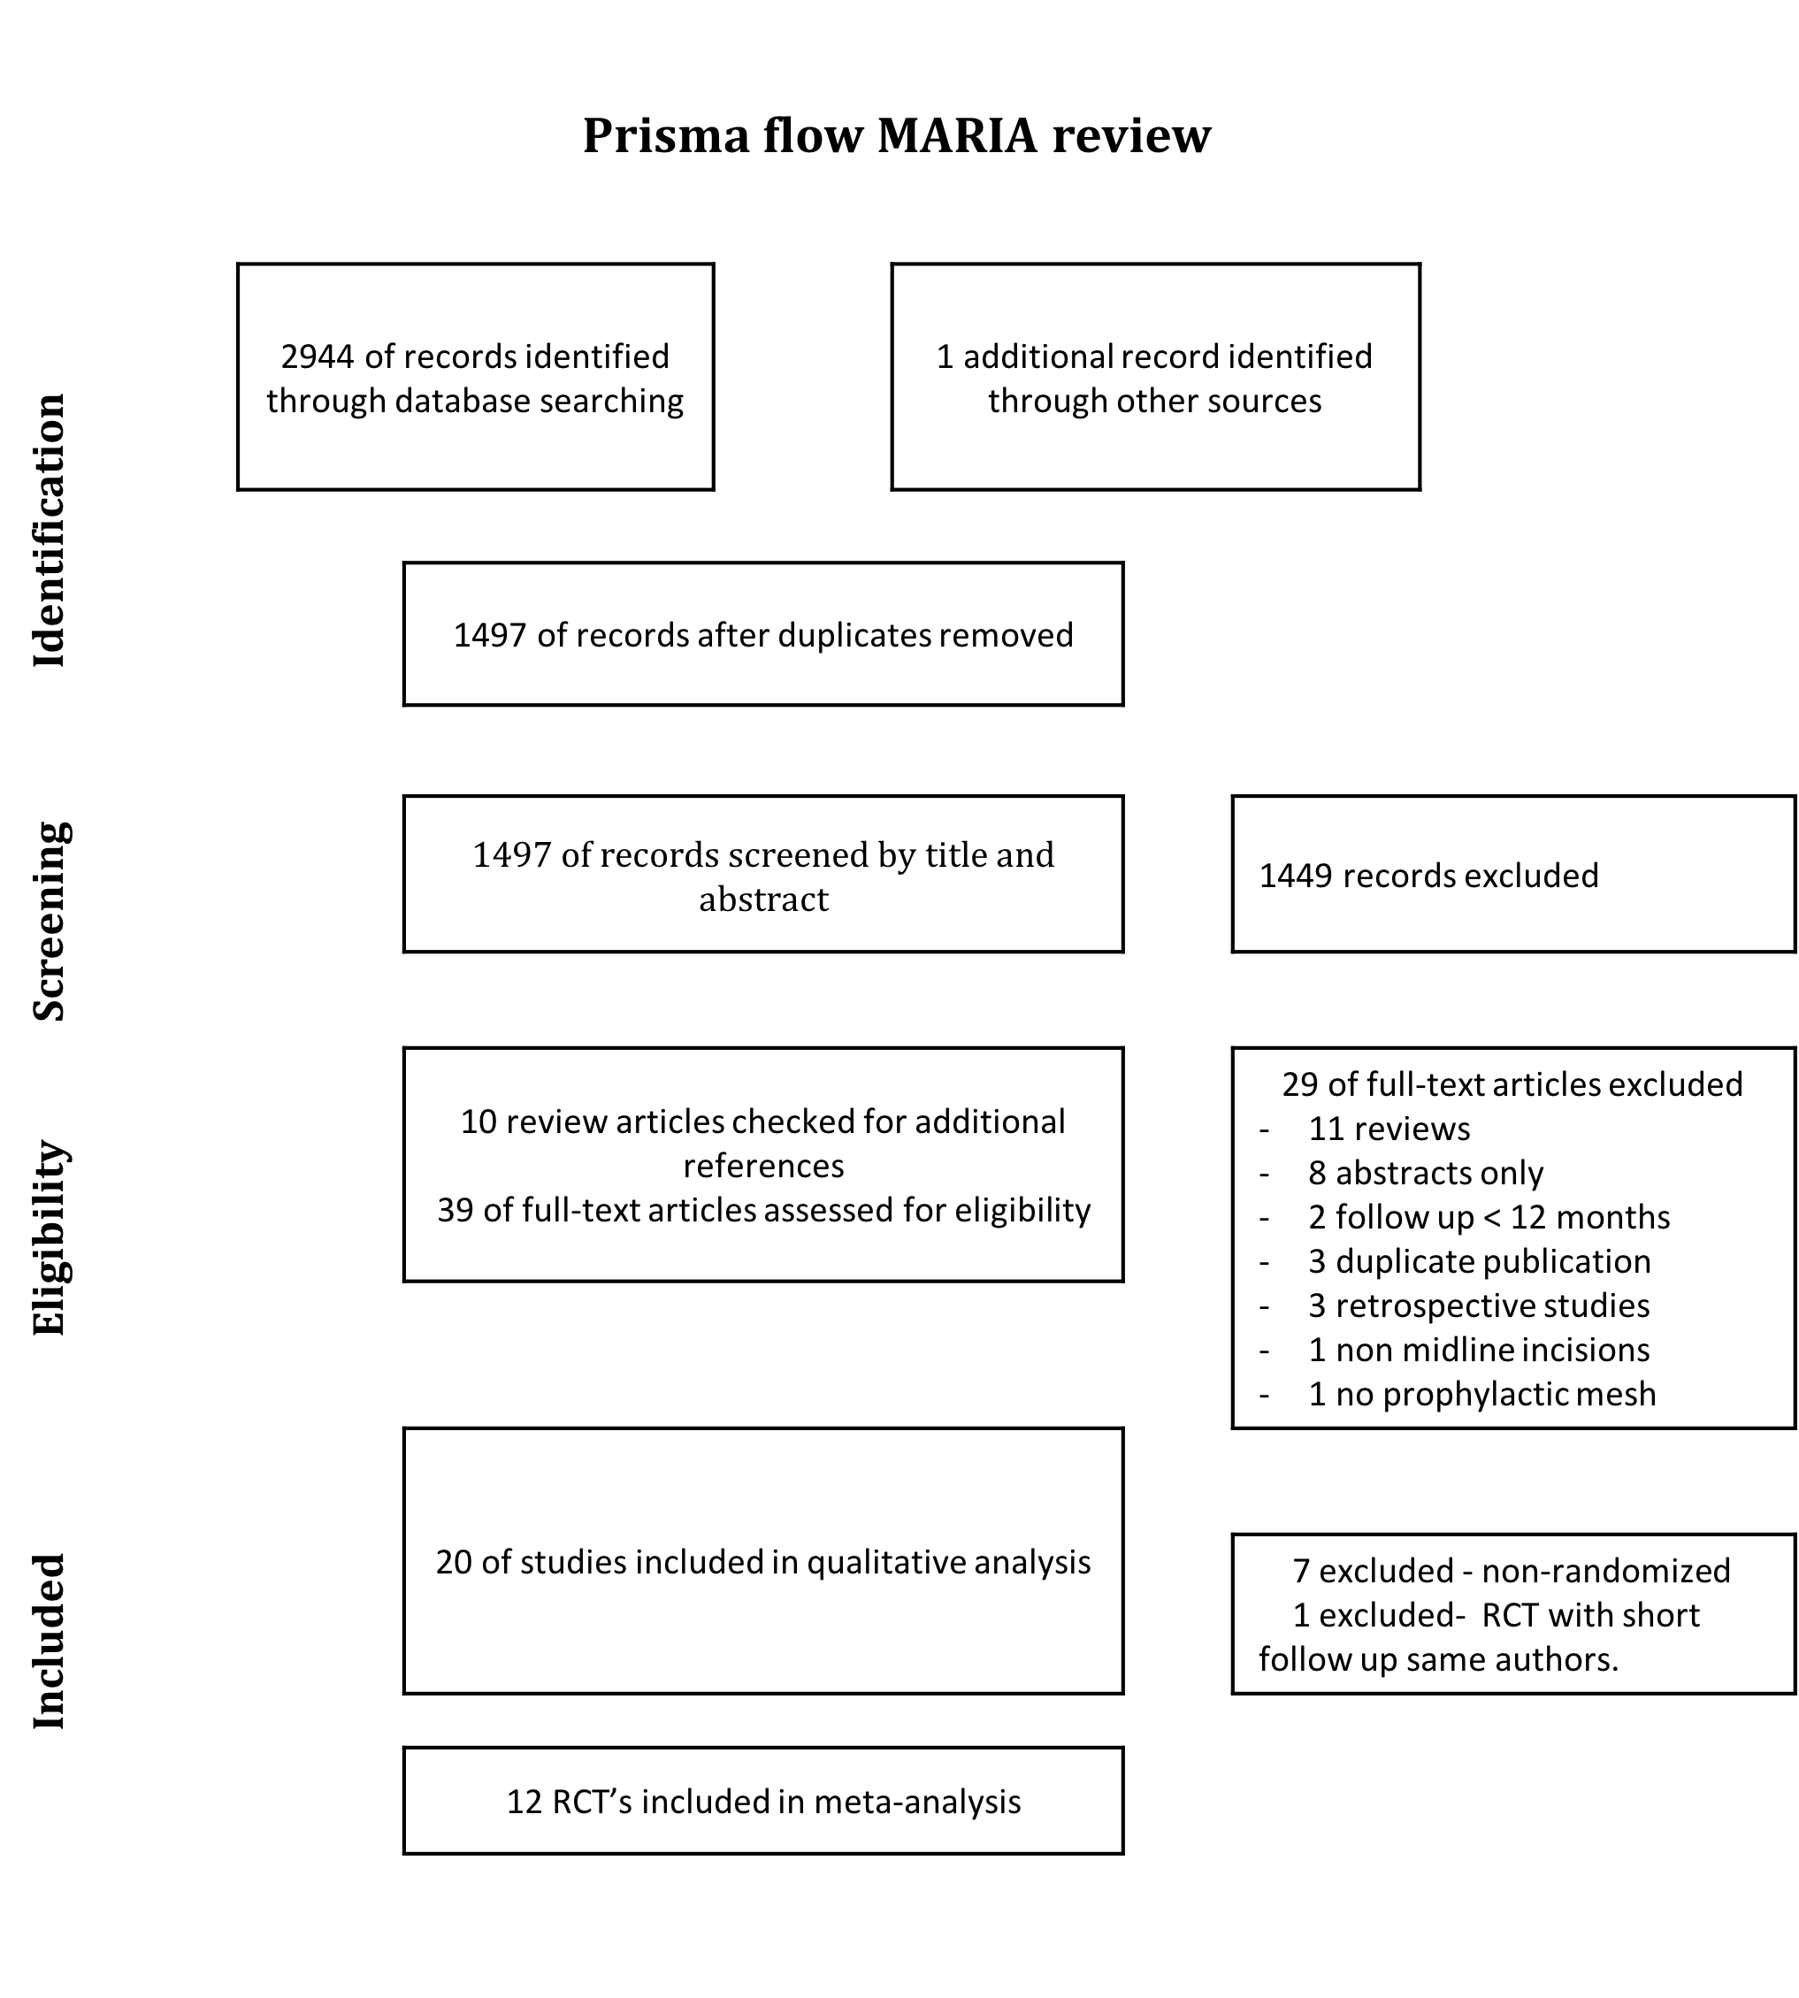
EVIDENCE
LIMITS
Incisional hernia definition
77% reduction in
incidence of incisional
hernia
META-ANALYSIS MIDLINE
LAPAROTOMIES
An Jairam
Manuel López Cano
Josep García Alamino
José Antonio Pereira
Lucas Timmermans
Hans Jeekel
Johan Lange
Filip Muysoms
Poor description suture control group
Short follow up
Only non absorbable mesh
Only elective surgery
65% reduction in
incidence of incisional
hernia
Most AAA
BMI cut-off point ?

Slide 4
EVIDENCE
LIMITS
ONLAY
Retromuscular ideal approach?:
“Violation” of space
Repair in the future
Mesh infection
Chronic pain
Technical barrier
74% reduction in
incidence of incisional
hernia
RETROMUSCULAR
Onlay ideal approach?:
Speed
Simplicity
Retrorectus preservation
Type of fixation?
72% reduction in
incidence of incisional
hernia

Slide 5
EVIDENCE
LIMITS
Seroma-ONLAY
Chronic pain
More detailed data regarding wound complications needed

Slide 6
SURGEON´S KNOWLEDGE
BARRIERS
497 surgeons. USA 47%, EU 40%, Others 13%
General Surgery 75%
>11-15 years experience 72%
Interest in prophylactic mesh
Unfamiliarity/lack of interest/other
40%
Not familiar with evidence 11%
Familiar and not interested 24%
Familiar and interested 45%
Familiar and doing 15%
Other 5%

Slide 7
SURGEON´S KNOWLEDGE
BARRIERS
Adequate patient
Reasons for not using
Lack of knowledge of technique
Other 23%
Concerned by complications 46%
Potentially added time
Not convinced of benefit 23%
Not reimbursement 14%
Too long 6%
No reimbursement.
Not familiar with tecnique 12%
Not apply to my patients 13%
Uncertainty of benefit
Potential complications. Litigations?

Slide 8
PATIENT´S PREFERENCE
Fast recovery with return to work and regular daily activities
LACK OF DATA

Slide 9
PROPHYLACTIC MESH A REINFORCEMENT DECISION MAKING
IH definition
Control group
Longer follow-up
Emergencies
Awareness of
prophylactic
mesh potential benefits
High risk (obesity stratified)
Improvement in
Patient-reported
Outcomes
knowledge
Complications (Absorbable?)
Mesh position
IH risk scores
Unfamiliar
Lack of interest
Effective (AAA, obesity)
Adequate patient
Elective surgery
Poor technical knowledge
Non absorbable mesh
Potential complications
EVIDENCE
SURGEON´S KNOWLEDGE
PATIENT´S PREFERENCE

Slide 10
"Sir, -said the knight-, I am in search of that beast and I have followed for a long time, until my horse was killed. I wish I had another horse to continue my search. "
John Steinbeck. The Acts of King Arthur and His Noble Knights. 1976.

