Slide 1
Ambulatory surgery: First experiences in Cracow
Michał Zelek
Department of General and Oncology Surgery
St John Grande Hospital in Cracow

Slide 2
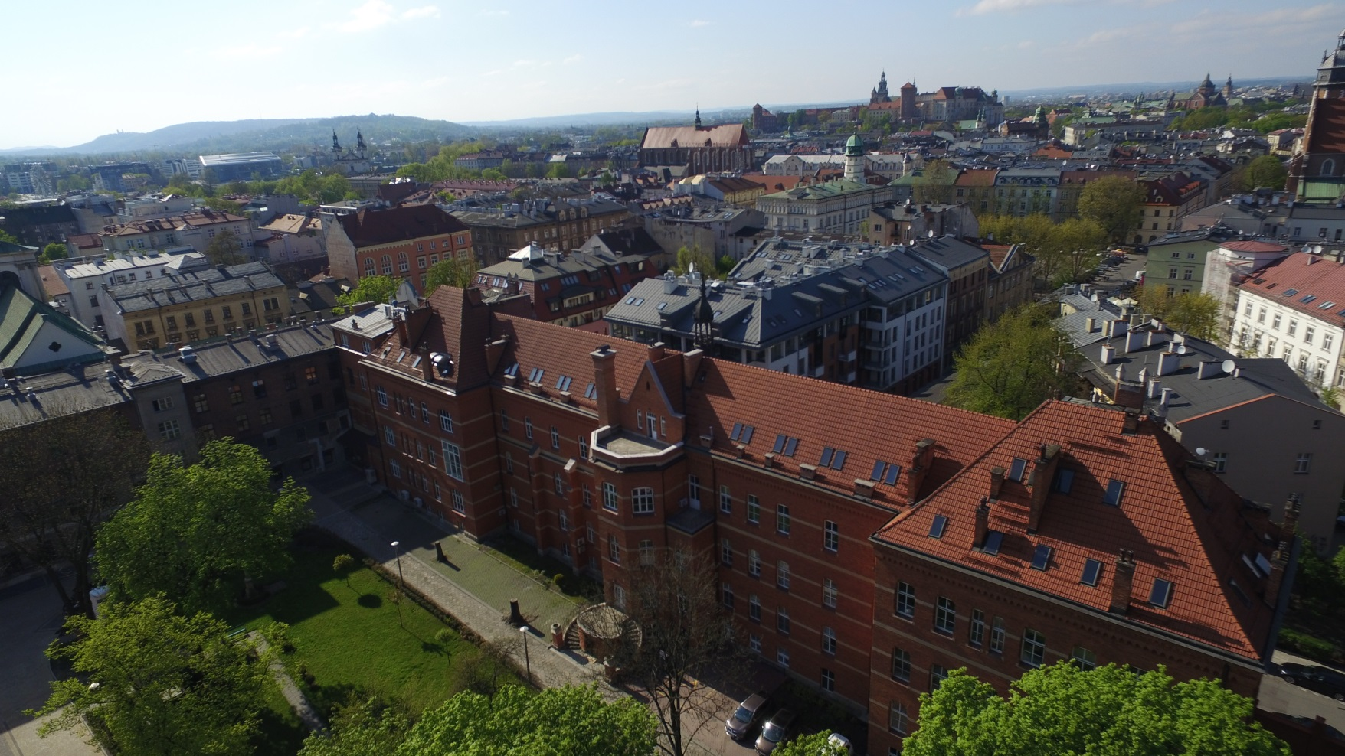

Slide 3
Inguinal hernia repair
One of most common surgical procedures
Over 70 000 procedures in 2016 in Poland
Mainly performed as described by Lichtenstein
Consired to be safe in ambulatory surgery

Slide 4
Inguinal hernia repair
Average hospitalisation time
2015 – 47,6h (+/- 7,6)
2016 – 25,5h (+/- 6,9)
2017 – 7-12h
Admission: 6-6:30
Operation: 7:30-12:30
Dissmission: 16-20
Follow up – after 10-14 days, 3 months

Slide 5
Inguinal hernia repair
 | 2015 | 2016 | 2017
Lichtenstein | 642 M – 578 F – 64 | 663 M - 603 F – 60 | 621 M – 565 F – 56
TAPP | 51 M – 46 F – 5 | 67 M – 61 F – 6 | 73 M – 67 F – 6

Slide 6
Inguinal hernia repair – Lichtenstein group
Notes:
płeć

Slide 7
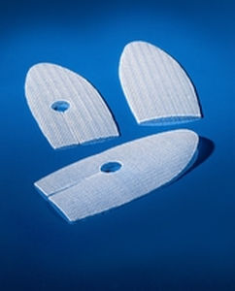
Inguinal hernia repair – Lichtenstein group
No incarcerted hernia
Mesh: Adhesix (59,8%) or Ultra Pro (40,2%)
Fixation: glue (74,2%) or stiches (25,8%)

Slide 8
Inguinal hernia repair - anaesthesia

Slide 9
Inguinal hernia repair - ASA

Slide 10
Inguinal hernia repair – follow up
No unplanned readmission in all groups
No major systemic complications

Slide 11
Inguinal hernia repair – follow up
Notes:
Częściej krwiaki niż nawroty

Slide 12
Inguinal hernia repair
Causes of longer hospitalisation(21,4%)
problems with mobilisation (1,5%)
Nausea and vomiting (3,2%)
Postoperative pain (0,8%)
Haemathoma (4,6%)
Urinary retention (5,1%)
High-risk patients (26,0%)
„family” causes (58,8%)
Psychological comfort

Slide 13
Inguinal hernia repair – ambulatory
Day-case ingunal hernia is safe and feasible
Not common in Polish NHS
Tasks for tomorrow:
Local anaesthesia
Longer follow-up

Slide 14
Thank you for your attention

