Slide 1
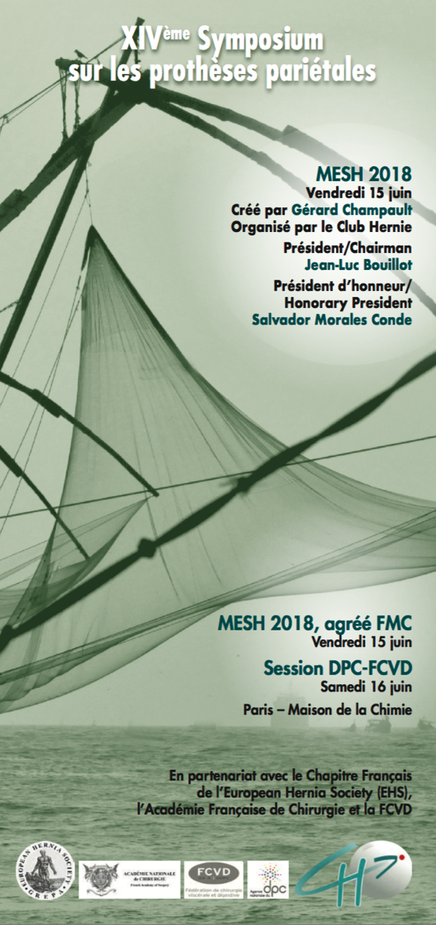


Lars Nannestad Jorgensen
MD DrMSc FACS
Professor
Digestive Disease Center,
Bispebjerg Hospital
University of Copenhagen
Denmark
When and how to fix the mesh in
ventral / incisional hernia repair?

Slide 2
Disclosures
Educational activities & speaker’s fee:
BARD & Medtronic

Slide 3
IPOM
Open repair
Sublay
Onlay
Fixation
Permanent
Tackers
Resorbable
Laparoscopic repair
IPOM
Sutures
Sublay
Glue

Slide 4
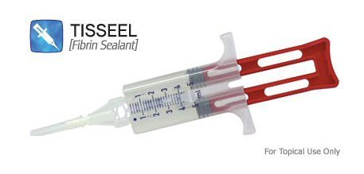
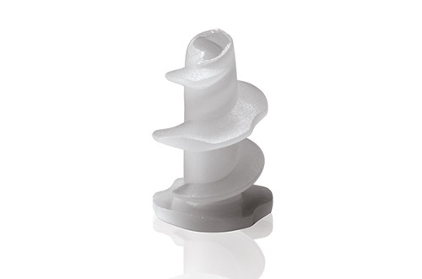
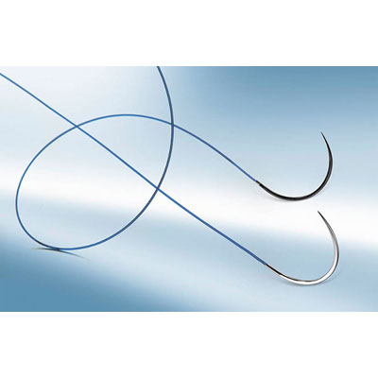
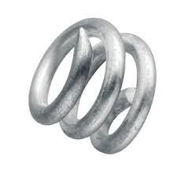
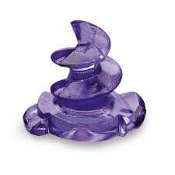
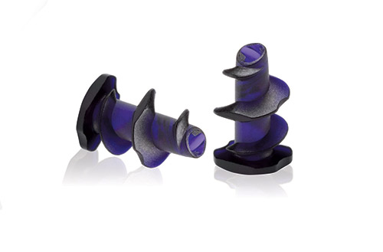
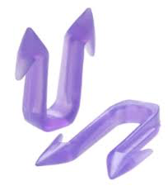
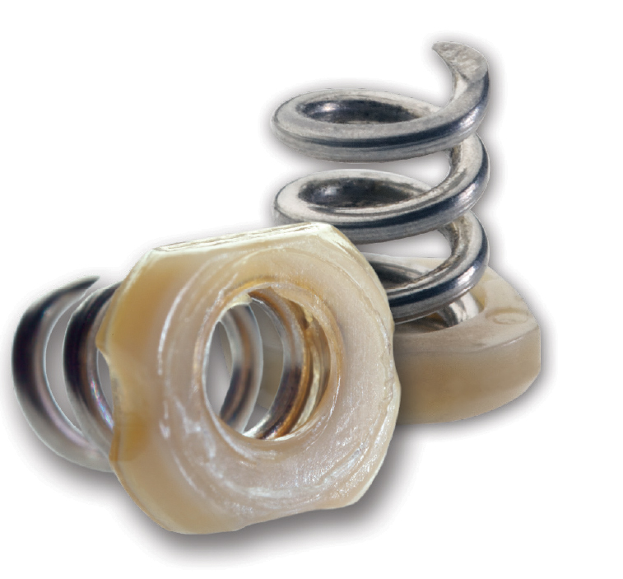
Optimal fixation prevents
recurrence
acute and chronic pain
adhesion formation
mesh migration
shrinkage
infection
fistulae
seroma

Slide 5
Fixation
Permanent
Tackers
Resorbable
Laparoscopic repair
IPOM
Sutures
Glue

Slide 6
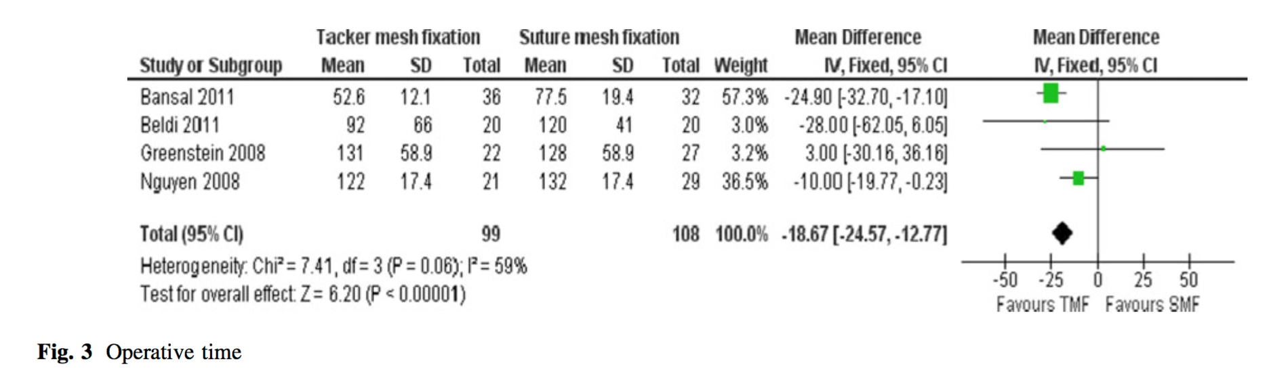
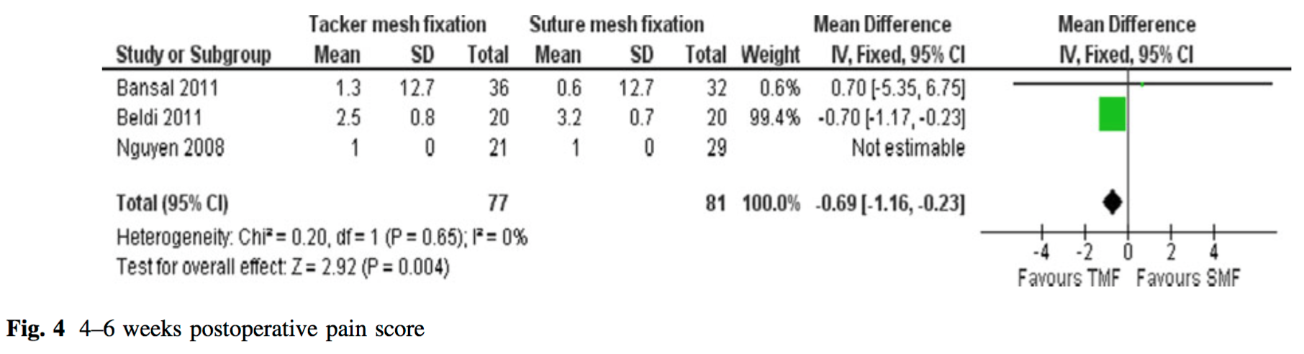
Tack vs. suture fixation
Operative time
Favors tack Favors suture
4-6 weeks postop. pain
Sublay
Favors tack Favors suture
Sajid MS. Hernia 2013;17:159-66

Slide 7
Pain VAS (0 – 100)
Wassenaar E. Surg Endosc 2010;24:1296-302

Slide 8
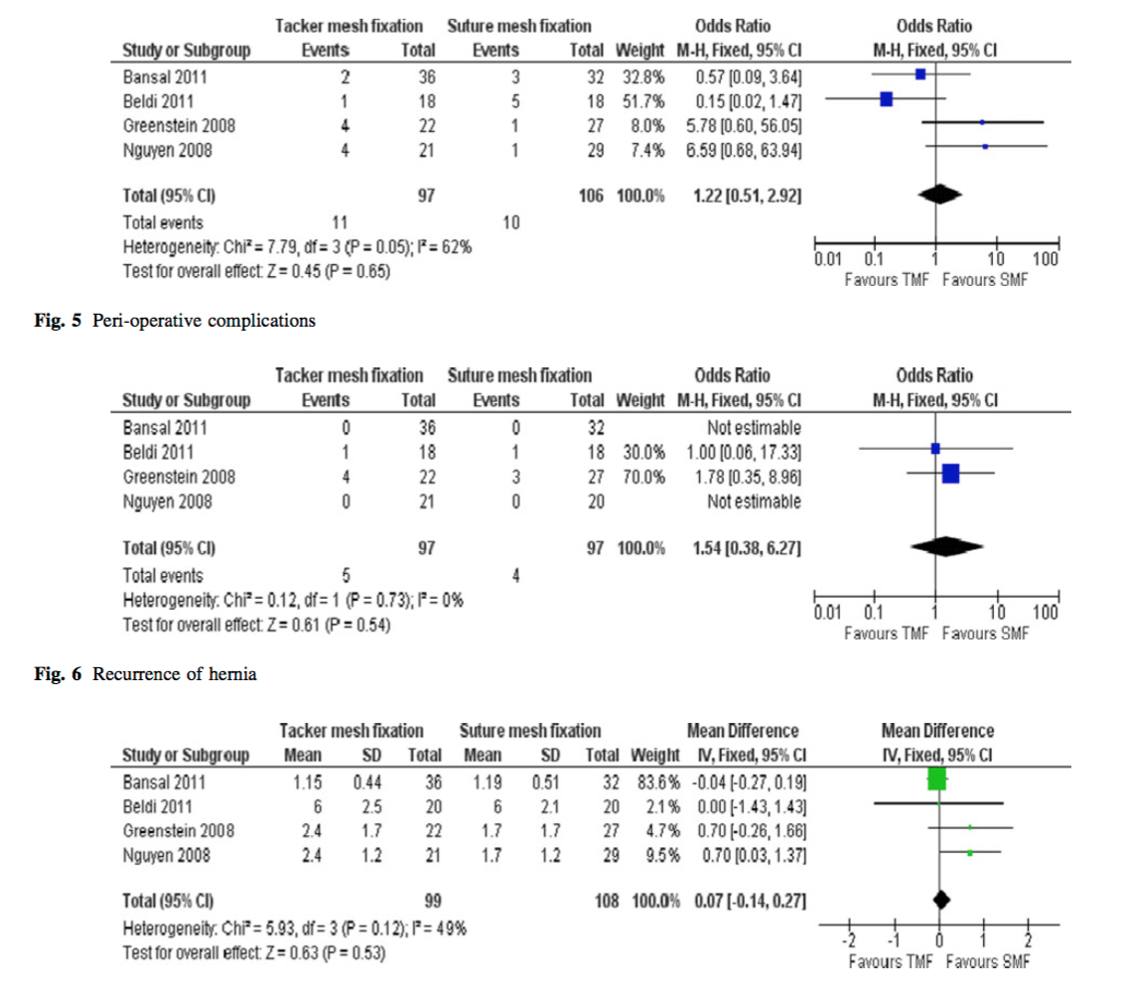
Perioperative complications
Favors tack Favors suture
Recurrence of hernia
Favors tack Favors suture
Recurrence of hernia
Sublay
Favors tack Favors suture
Sajid MS. Hernia 2013;17:159-66

Slide 9
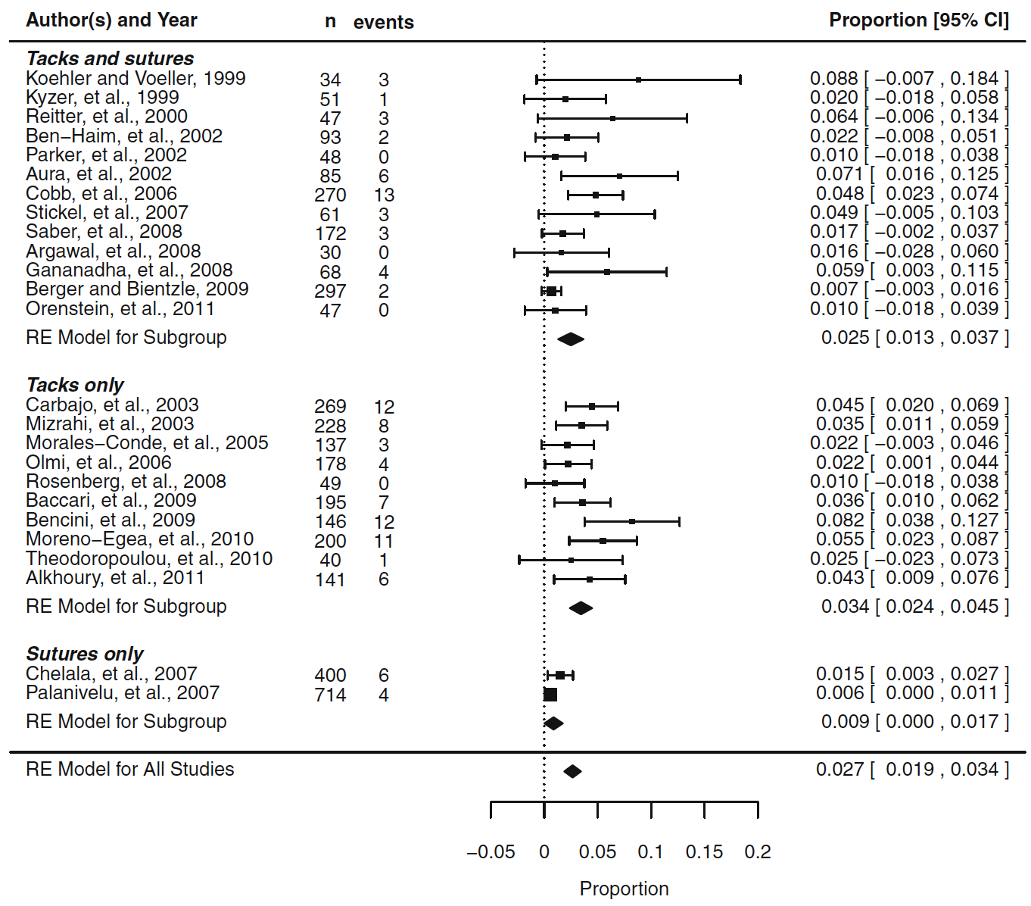
Recurrence rates
Reynvoet E. Langenbechs Arch Surg 2014;399:55-63

Slide 10
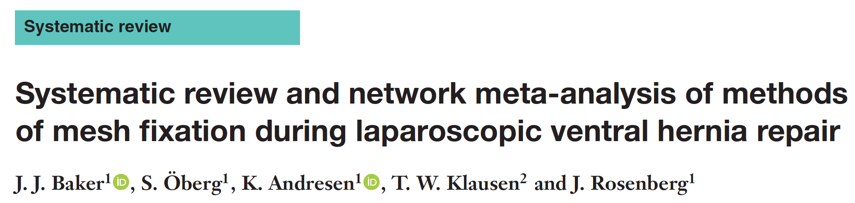
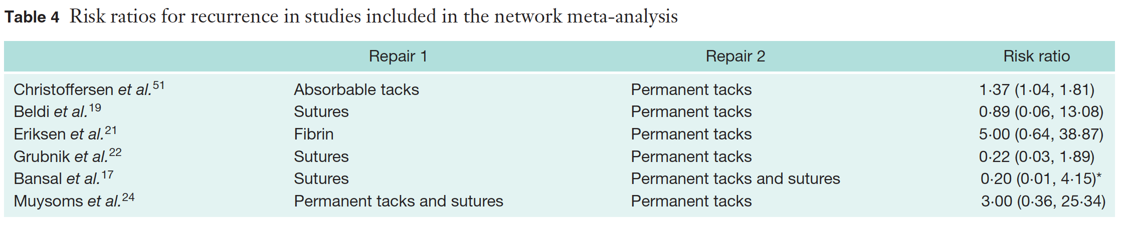
Baker JJ. Br J Surg 2018;105:37-47

Slide 11
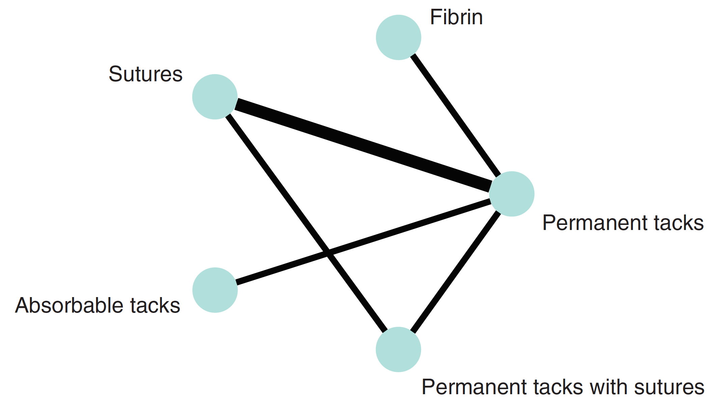
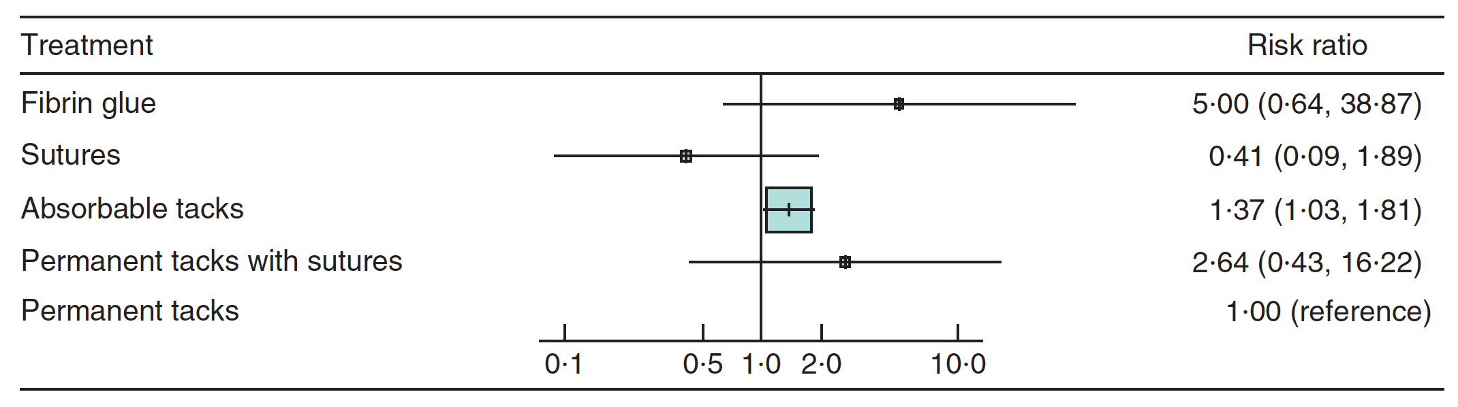
SUCRA values
12%
93%
43%
27%
73%
Baker JJ. Br J Surg 2018;105:37-47

Slide 12
Fixation
Permanent
Tackers
Resorbable
Laparoscopic repair
IPOM
Sutures
Glue

Slide 13
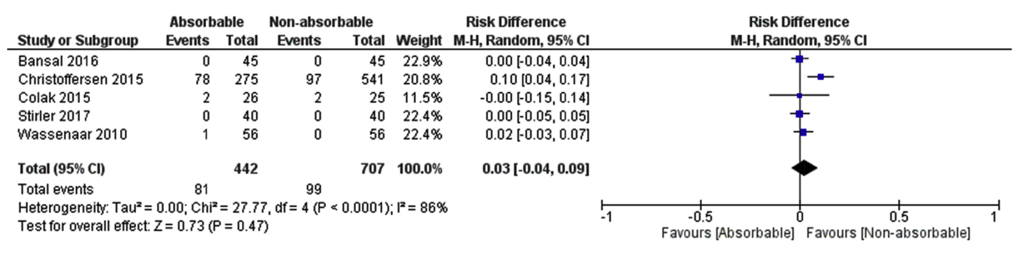
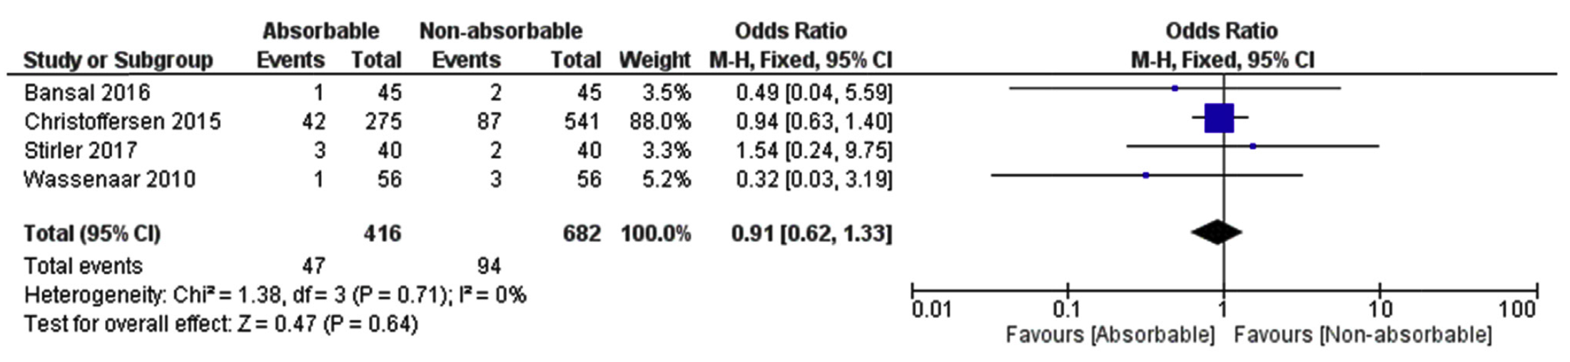
Recurrence
RCT
RCT
RCT
Chronic pain
RCT
RCT
Khan RMA. Int J Surg 2018;53:184-92

Slide 14
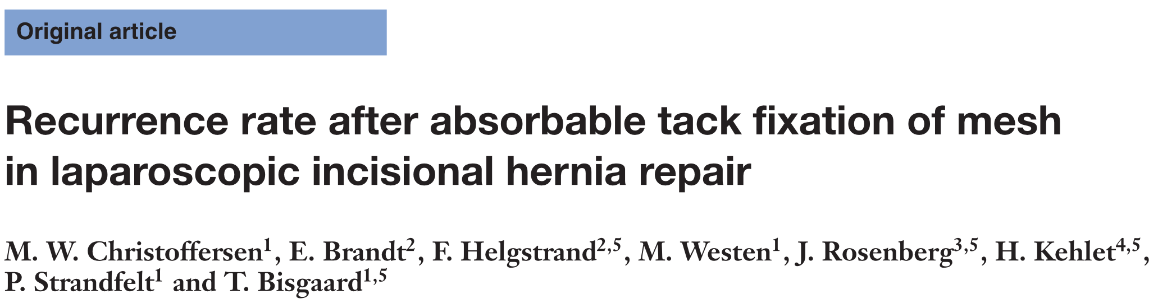
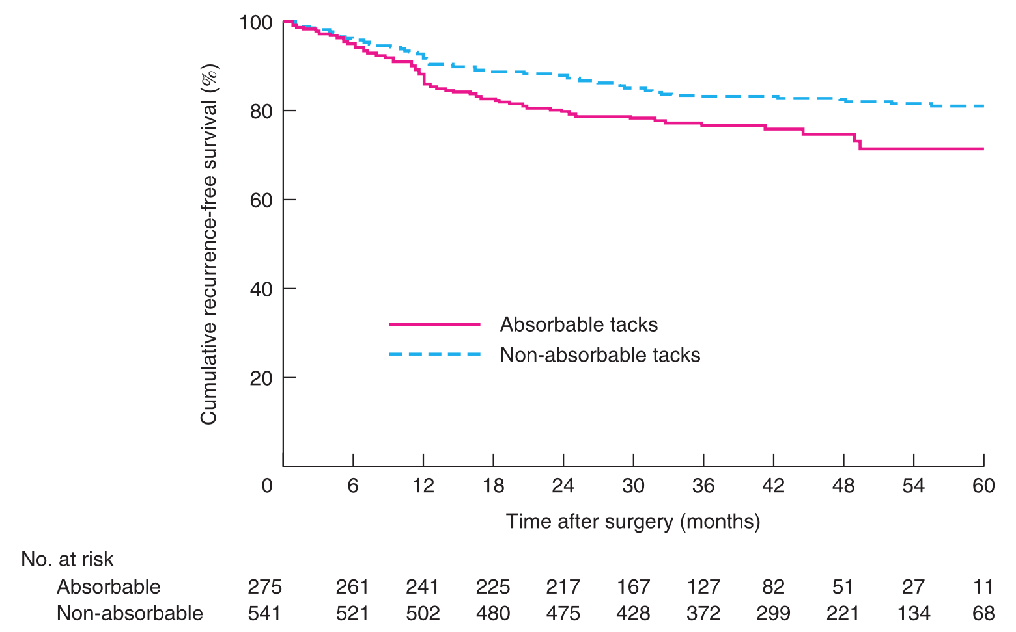
P = 0.007
Christoffersen MW. Br J Surg 2015;102:541-7

Slide 15
Incidencens of chronic (moderate or severe) pain:
15.3% (abs. tacks) vs. 16.1% (non-abs. tacks)
Predictors of chronic pain
young pts
hernia recurrence
Christoffersen MW. Br J Surg 2015;102:541-7

Slide 16
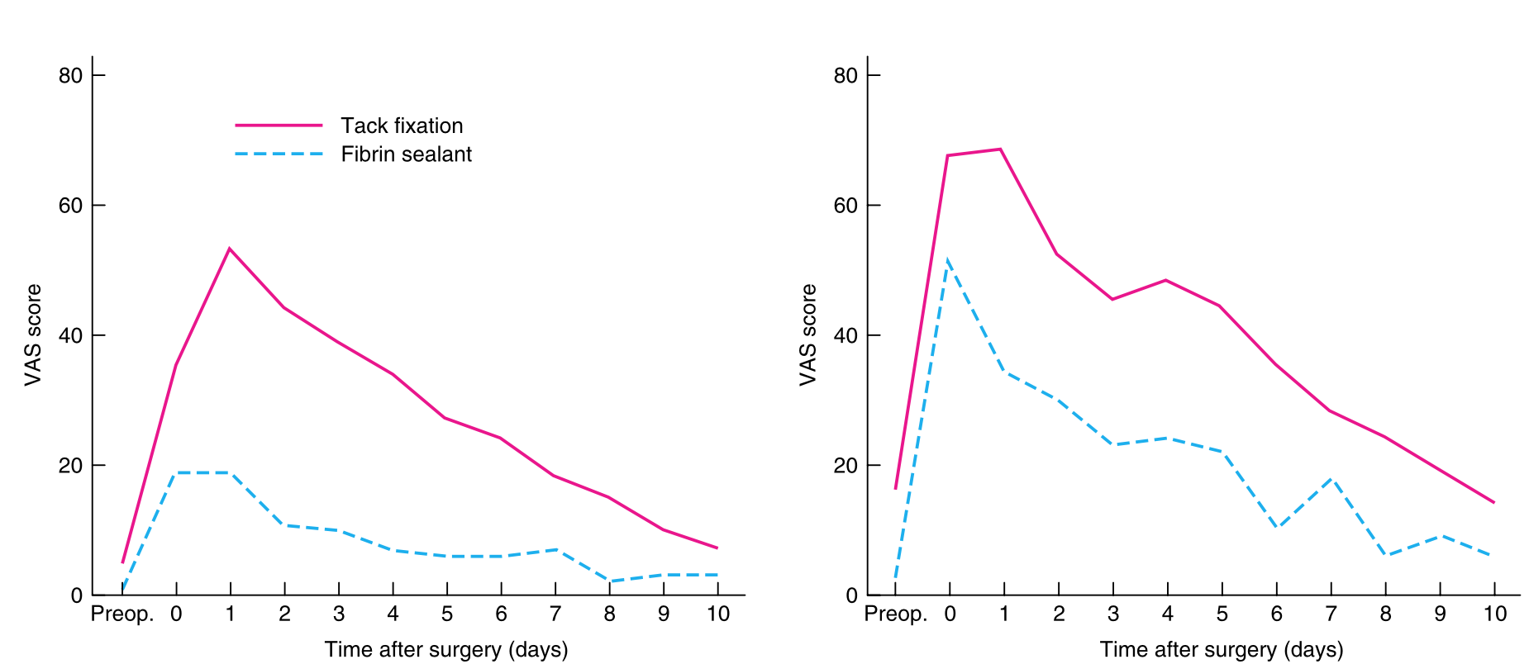
Tack vs. fibrin sealant fixation
Eriksen JR. Br J Surg 2011;98:1537-45

Slide 17
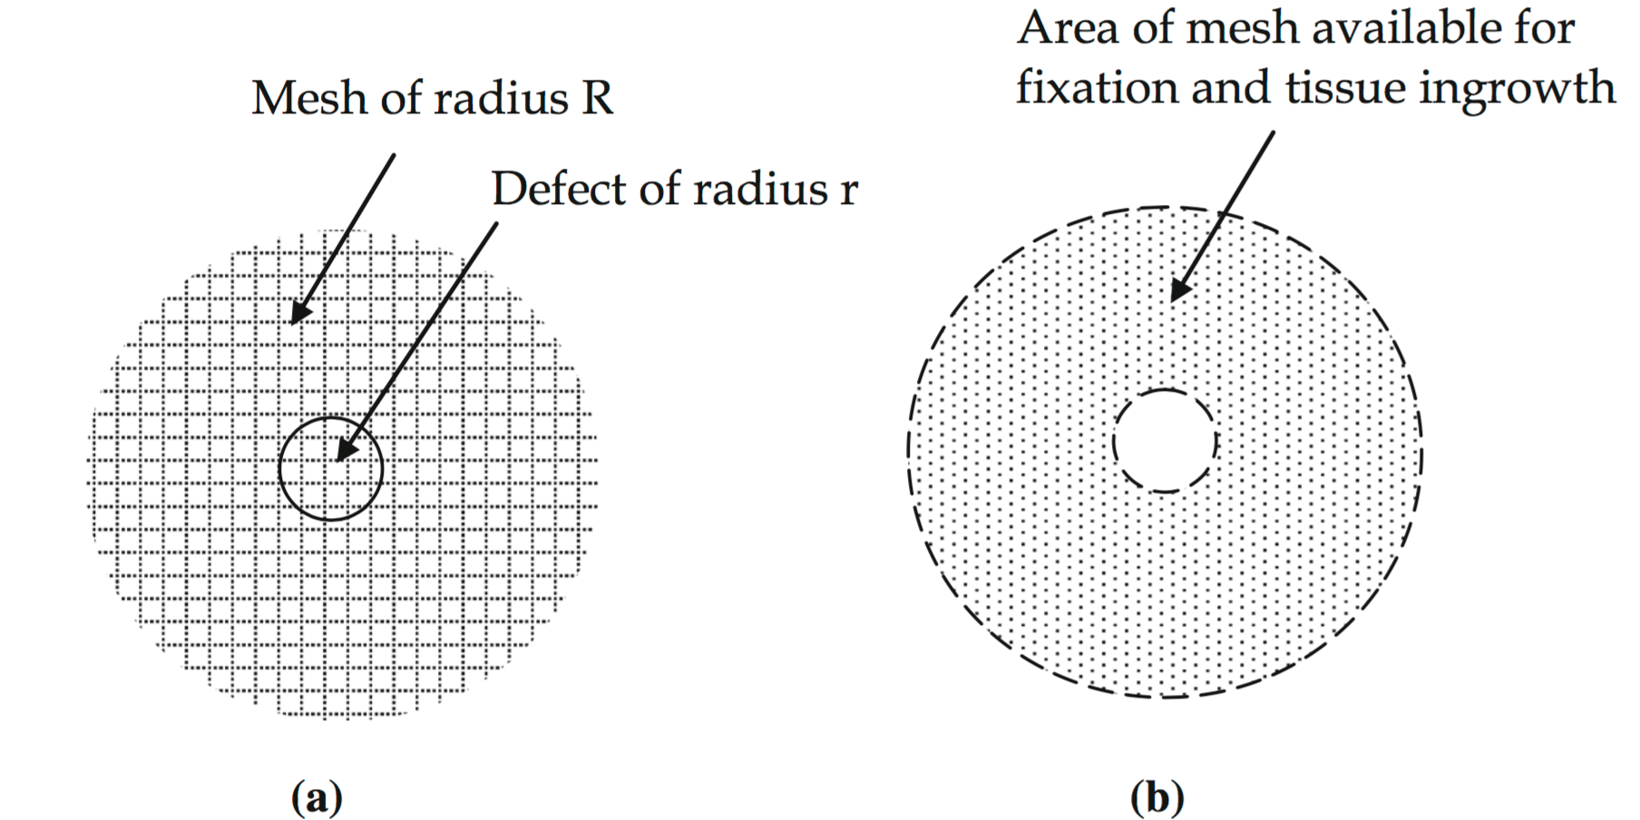
The mesh:defect area ratio
r = 5 cm, R = 20 cm R²/r² = 16
r = 6 cm, R = 24 cm
r = 7 cm, R = 28 cm
r = 8 cm, R = 32 cm
Resisting force/displacing force =
”Donut” area/defect area =
(πR² – πr²)/ πr² ≈
R²/ r²
Tulloh & de Beaux. Hernia 2016;20:893-5.

Slide 18
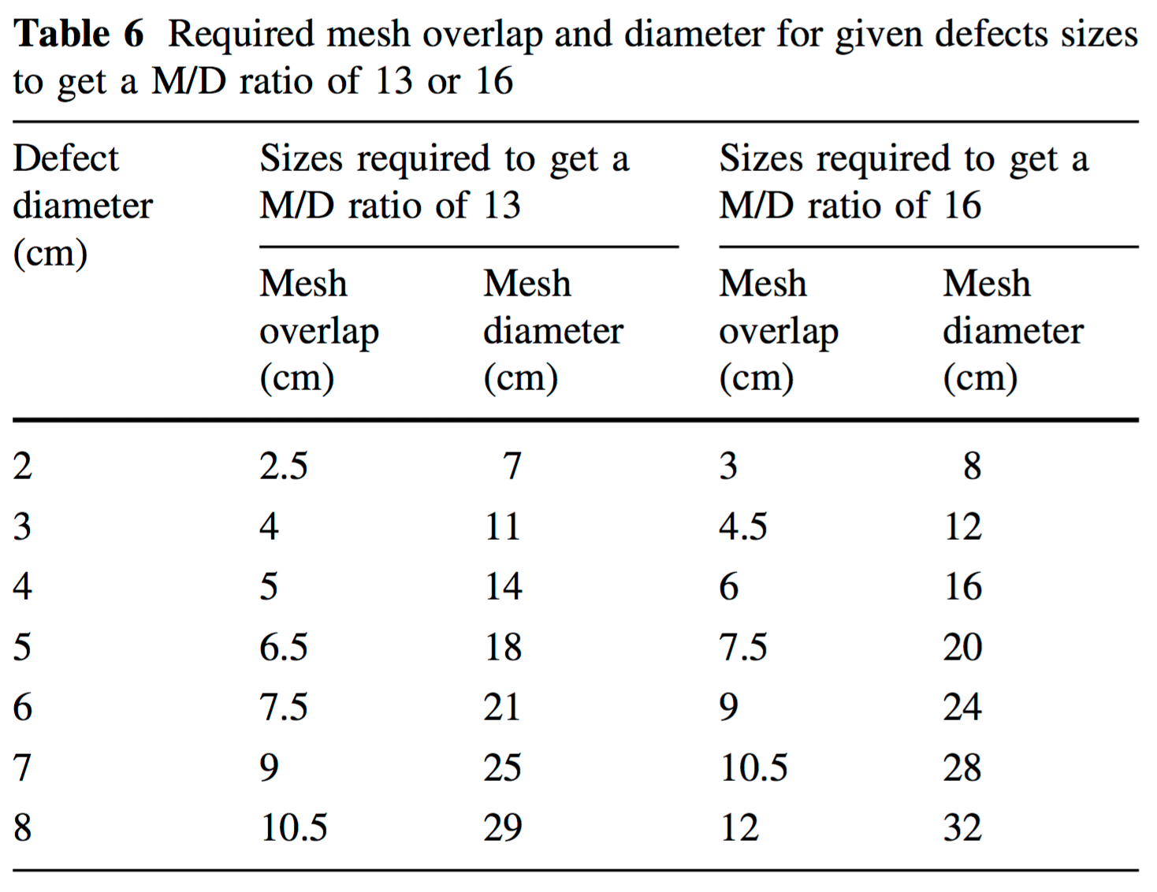
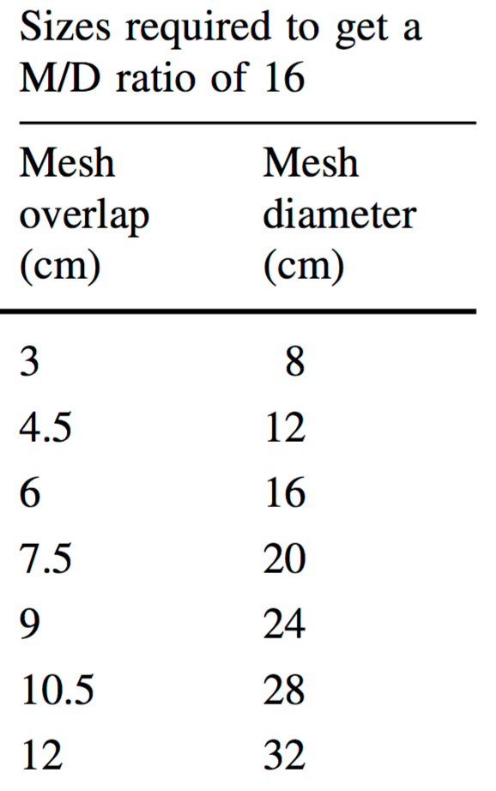
The mesh:defect area ratio
Hauters P. Surg Endosc 2017;31:3656-63

Slide 19
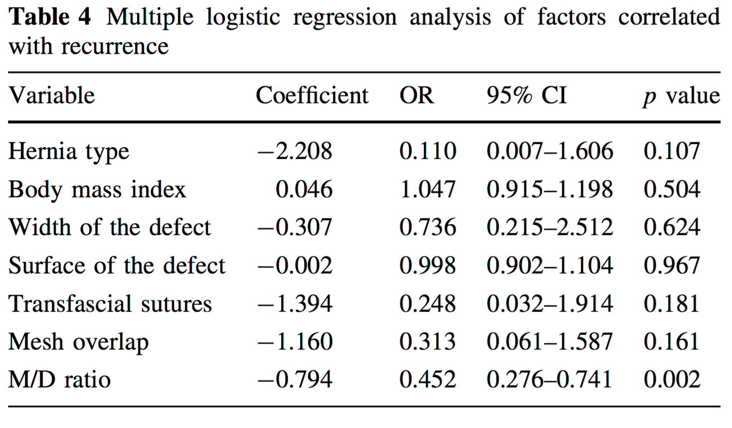
The mesh:defect area ratio
Hauters P. Surg Endosc 2017;31:3656-63

Slide 20
Hernia recurrence and mesh:defect ratio
Incidence of recurrence (%)
Mesh:defect ratio
Hauters P. Surg Endosc 2017;31:3656-63

Slide 21
Hernia recurrence and overlap
Incidence rate of recurrence
Mesh overlap
95 articles, 111 study populations
LeBlanc K. Hernia 2016;20:85-9

Slide 22
Conclusions
Suture fixation vs. double crown tack: effectiveness ⬆, pain ⬆
Abs. tack fixation: recurrence rate ⬆
No difference in pain between abs. and non-abs. tack fixation
Glue fixation: pain ⬇, recurrence ⬆
Mesh overlap: mesh size 4 times the hernia defect!!!

Slide 23

Denmark
Sweden

