Slide 1


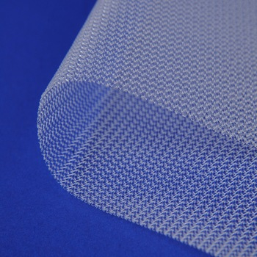
Department of General Surgery “Paride Stefanini”
Abdominal Wall Surgery Unit (Chief: Prof. F. Gossetti)
Mesh-related visceral complications
following Abdominal Wall Hernia Surgery
Prof. Paolo Bruzzone
Paolo Bruzzone declares no conflict of interest

Slide 2
Mesh migration is a possible complication of hernia repair surgery. Not only it can be a painful experience, but it is also a cause for other complications and injuries, known as…
MESH-RELATED VISCERAL COMPLICATIONS

Slide 3
MRVCs can occur when foreign body reaction, triggered by a surgical mesh, involves the intra-abdominal organs.
This could happen when an incorrectly fixed device migrates along an adjacent path of minor resistance or when the mesh is displaced by external forces (primary mesh migration).
As an alternative inflammatory granulation tissue at the site of the implanted mesh might gradually involve the surrounding viscera through transanatomic spaces (secondary mesh migration).
Agrawal, A., & Avill, R. (2000). Mesh migration following repair of inguinal hernia: a case report and review of literature. Hernia doi:10.1007/s10029-005-0024-8

Slide 4
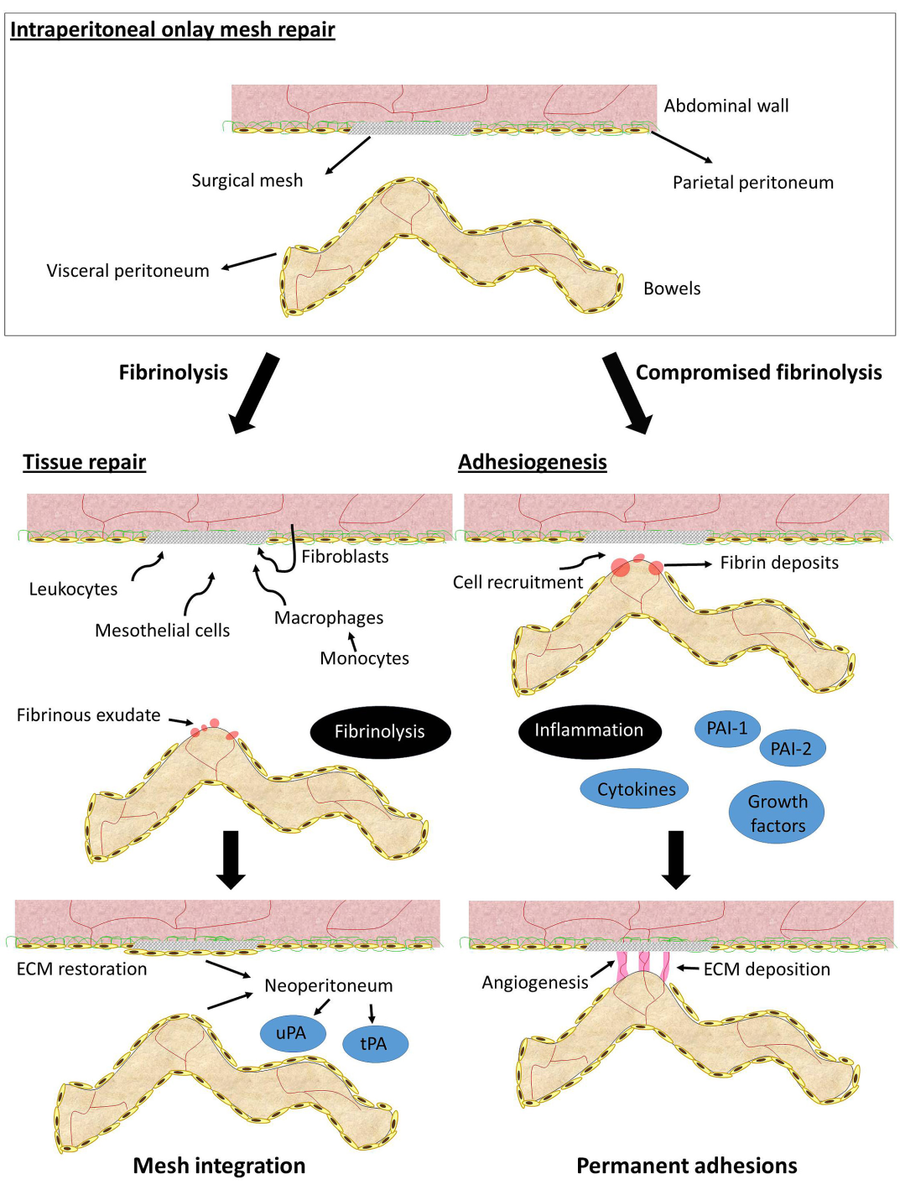
Biomaterial Implants in Abdominal Wall Hernia Repair: A Review on the Importance of the Peritoneal Interface
Verónica Gómez-Gil,Gemma Pascual and Juan M. Bellón.
Processes (2019) doi: 10.3390/pr7020105

Slide 5
structure fiber pore size profile
The direct contact between the MESH and VISCERA is at the basis of MRVCs.
Mesh
Inguinal
Hernia
Ventral
Hernia
ileum
Viscera
caecum
sigmoid
bladder
The tissue response can vary from one person to another.

Slide 6
structure fiber pore size profile
The direct contact between the MESH and VISCERA is at the basis of MRVCs.
Mesh
Inguinal
Hernia
Ventral
Hernia
ileum
Viscera
caecum
sigmoid
bladder
The tissue response can vary from one person to another.

Slide 7
* What is the occurrence of MRVCs following
inguinal hernia surgery?
* Is there a lifetime risk for MRVCs?
* What viscera are involved?
* What are the symptoms or signs of mesh migration?
* Will the patient need another surgery?
* Are there surgical techniques more frequently followed
by MRVCs than others?
* Can we decrease the risk of MRVCs?
Inguinal
Hernia

Slide 8

Endorsed by
World Guidelines for Groin Hernia Management
Chapter 10 - Meshes
There is a lifetime risk for mesh migration.
Mesh migration has been reported with all current polymers and following all hernia repair.
Most reports described early plug migration (two or three years after operation).
Flat mesh migration is uncommon.
Chapter 18 - Complications
MRVCs are not included.

Slide 9



*
Case Rep Surg (2017) doi: 10.1155/2017/3617476.
Mesh Migration into the J-Pouch in a Patient with Post-Ulcerative Colitis Colectomy: A Case Report and Literature Review.
Ghanin A, Smood B, Martinez , Morris MS, Porterfield JR.
Results - 79 articles (1990-2015) yielded 86 cases ( ALL TYPES of AW HERNIAS)
*
HERNIA (2019) doi: 10.1007/s10029-019-01898-9.
Mesh migration following abdominal hernia repair: a comprehensive review.
Cunningham HB, Weis JJ, Taveras LR, Huerta S.
Results - 84 articles (1996-2017) yielded 89 cases (ALL TYPES of AW HERNIAS)
It is likely that more cases of mesh migration will appear in the literature.
Reports are heterogeneous and highlight the diversity of this complication.

Slide 10
HERNIA (2019) doi: 10.1007/s10029-019-01905.
Mesh-related visceral complications following inguinal hernia repair: an emerging topic.
Gossetti F, D’Amore L, Annesi E, Bruzzone P, Bambi L, Grimaldi MR, Ceci F, Negro P.
Jan 1992 – May 2018
PubMed, Medline, Scopus search
Manual search of reference lists
Author contact for additional data
Inclusion criteria:
101 Reports
82
(19 excluded)
95 MRVCs
97 MRVCs *
surgical technique
time to event
clinical presentation
visceral involvement
treatment
* including 2 personal cases

Slide 11

It’s been suggested that these complications might be more frequent than those reported in literature.
MRVC
The number of MRVCs has tripled in the last decade (2007-2017) if compared to the previous one (1992-2002).
medico-legal reasons
author indifference
non recognition
During the publication of this article, 3 more case reports were published in the literature, after May 2018.

Slide 12
 | Group A | Group B |  | Group C |  | Group D
Technique | L | MP | PHS | S | TIPP | TAPP | TEP | IPOM | N/A
Reports (Literature) | 8 | 25 |  | 10 |  | 39
MRVC (*) | 8 | 25 | 3 | 8 | 3 | 29 | 9 | 3 | 9
Time to event (median) | 3-20y (10.7y) | 10d – 26y (6.3y) |  | 9m – 6y (2.8y) |  | 3w – 16y (5.0y)
L-Lichtenstein; MP- Mesh & plug; PHS- Prolene Hernia System; S- Stoppa; TIPP- Transinguinal preperitoneal; TAPP - Transabdominal preperitoneal; TEP- Total extraperitoneal; IPOM- Intraperitoneal; N/A- Not available. y- years; m- months; w- weeks; d- days; MRVC – Mesh related visceral complication (*) Two personal cases included

Slide 13
 | Group A | Group B |  | Group C |  | Group D
Technique | L | MP | PHS | S | TIPP | TAPP | TEP | IPOM | N/A
Reports (Literature) | 8 | 25 |  | 10 |  | 39
MRVC (*) | 8 | 25 | 3 | 8 | 3 | 29 | 9 | 3 | 9
Time to event (median) | 3-20y (10.7y) | 10d – 26y (6.3y) |  | 9m – 6y (2.8y) |  | 3w – 16y (5.0y)
L-Lichtenstein; MP- Mesh & plug; PHS- Prolene Hernia System; S- Stoppa; TIPP- Transinguinal preperitoneal; TAPP - Transabdominal preperitoneal; TEP- Total extraperitoneal; IPOM- Intraperitoneal; N/A- Not available. y- years; m- months; w- weeks; d- days; MRVC – Mesh related visceral complication. (*) Two personal cases included

Slide 14

 | Group A | Group B |  | Group C |  | Group D
Technique | L | MP | PHS | S | TIPP | TAPP | TEP | IPOM | N/A
Reports (Literature) | 8 | 25 |  | 10 |  | 39
MRVC (*) | 8 | 25 | 3 | 8 | 3 | 29 | 9 | 3 | 9
Time to event (median) | 3-20y (10.7y) | 10d – 26y (6.3y) |  | 9m – 6y (2.8y) |  | 3w – 16y (5.0y)
L-Lichtenstein; MP- Mesh & plug; PHS- Prolene Hernia System; S- Stoppa; TIPP- Transinguinal preperitoneal; TAPP - Transabdominal preperitoneal; TEP- Total extraperitoneal; IPOM- Intraperitoneal; N/A- Not available. y- years; m- months; w- weeks; d- days; MRVC – Mesh related visceral complication (*) Two personal cases included

Slide 15
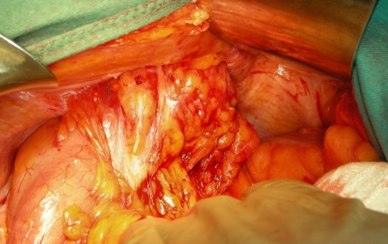
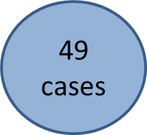

LARGE BOWEL
The sigmoid colon was the commonest site.
Rectal bleeding, colonic obstruction and sigmoiditis were the most frequent clinical signs.
The coexistence of diverticular disease of the sigmoid can act as a trigger event for the development of mesh migration.
The clinical presentation of caecum involvement was variable and included persistent diarrhea and haematochezia, the presence of a right lower quadrant mass or colocutaneous fistula.
Malignancy was often suspected on CT scans.
Mesh migration into the large bowel following inguinal hernia repair. A new task for the colorectal surgeon? Bruzzone P, D’ Amore L, Ceci F, Negro P, Gossetti F.
Colorectal Dis (2019) 21:120. doi: 10.1111/codi.14479

Slide 16
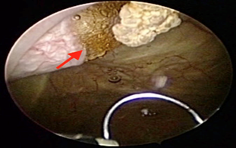

31
cases
URINARY TRACT
According to what is published in the literature, mesh erosion or migration into the urinary bladder is the second group of MRVCs based on frequency.
Bladder involvement mainly occurred after preperitoneal both laparoscopic or open IHR.
Hematuria and recurrent UTI were the most frequent symptoms.
Bladder lesion can be associated with bowel involvement (colovesical fistula).
Clinical presentation of bladder involvement was similar to malignancy in many cases.
Mesh erosion into the following laparoscopic inguinal hernia repair. Is this the tip of the iceberg?
Hamouda A, Kennedy J, Grant N, Nigam A, Karanjia N.
HERNIA (2010) 14:317-9
Mesh erosion into urinary bladder, rare condition but important to know.
Li.J,Cheng T.
HERNIA doi 10.1007/s10029-019-01966-0

Slide 17


:
MRVCs – Prevention
MPR
Proper indications
Paying attention to technical details should include:
avoiding excision of the sac
identifying and repairing any tears of peritoneum
securing the plug with a number of sutures
choosing the proper size of the plug
Avoiding MPR in colonic diverticular disease
Innovating 3-D meshes:
new profiles
new materials
new fixing/anchoring tools
HERNIA (2012) 16: 495-496
Mesh plug repair: can we reduce the risk of plug erosion into the sigmoid colon?
D’Amore L, Gossetti F, Manto O, Negro P.

Slide 18
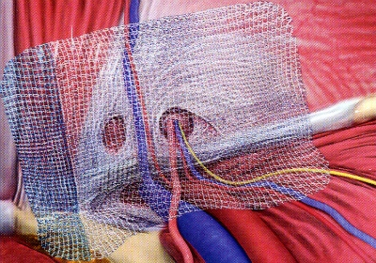

MRVCs – Prevention
LAP
Complete suturing closure of well vascularized
peritoneal flaps (TAPP).
Repair of any peritoneal gap (TEP).
Fixation of the mesh with fibrin sealant.
Particular attention in presence of sliding left inguinal hernias, which may contain the sigmoid colon.
Jiang ZP, Wang DY, Lai DM et al. Variations of urinary bladder and urogenital fatty fascial compartment with different filling of the bladder are notable factors relevant to hernia repair-related bladder injury. Am Surg (2013) 79:167-174

Slide 19

WHAT DO WE
NEED TO
KNOW?
MRVCs are uncommon, probably underestimated, late sequelae of prosthetic groin hernia surgery
All prosthetic IHRs can be followed by MRVCs , but these are more frequent after laparoscopic than open herniorraphy
Proper indications, proper surgical technique, and updated knowledge of biomaterials may help to reduce the risk of MRVCs
Surgeons should be aware of the possibility of MRVCs, and inform the patient about this uncommon but severe complication before IHR
Surgeons, gastroenterologists, endoscopists, urologists and radiologists should be suspicious and familiar with patient’s surgical history
MRVCs should be taken into account more seriously following the guidelines on groin hernia surgery

Slide 20


WHAT DO WE
NEED TO
KNOW?
Ventral
Hernia
Chirurg (1995) 66:739-41.
Enterocutaneous fistula after Marlex net implantation. A rare complication after incisional hernia repair
Seeling MH, Kasaperk R, Tietze L, Schumpelick V.
50 MRVCs
Int J Surg Case Rep (2018) 53:54-57. Chronic anemia due to transmural e-PTFE anti-adhesive barrier mesh migration in the small bowel after open incisional hernia repair: A case report
Ceci F, D’Amore, Annesi E, Bambi L, Grimaldi MR, Gossetti F, Negro P.

Slide 21

WHAT DO WE
NEED TO
KNOW?
Ventral
Hernia
Beyond Literature
“I am referring to anecdotic but frequent stories of colleagues who in the corridors of conferences or other hospitals secretly whisper to you about a case that went wrong
for some reason or those cases in which unfortunately the surgeon is involved in
some legal action”.
F. Corcione
 |  | %
Mesh adhesion | 37/37 | 100
Recurrence | 13/27 | 35.1
Bowel occlusion (secondary to recurrence) | 4/37 | 11
Infection | 19/37 | 52
Enterocutaneous fistula | 8/37 | 18.5
Seroma | 4/37 | 11
Mesh migration | 2/37 | 7.4
Mesh shrinkage | 36/37 | 96
Redo-surgery
after intraperito-neal mesh repair of ventral hernia

Slide 22
WHAT DO WE
NEED TO
KNOW?
Ventral
Hernia
There is an increasingly evident “mesh problem” on AW hernia repair
MRVCs after ventral/incisional hernia repair are more frequent in case of intraperitoneal open or laparoscopic placement of mesh
It is important to pay attention to the choice of a proper implantation site, avoiding direct contact between the mesh and viscera, and to select a proper device
All meshes can be responsible for viscera involvement but some more than others

Slide 23

Thank you for your attention

