Slide 1
Incisional hernia prevention in emergency laparotomy
José A. Pereira
Abdominal Wall Unit
Department of General Surgery
Hospital del Mar
University Pompeu Fabra
Barcelona (Spain)
Notes:
Thank you very much to Prof. Gillion and the club hernie for their kind invitation. In this nice place and this excellent meeting. It’s a privilege to me to be here taking part of this fantastic panel of experts. My talk is about the use of prophylactic meshes in emergencies to prevent incisional hernia.

Slide 2
A prophylactic mesh in emergency?
Why not?
Risk of infection
Contamination
Why?
Higher complexity of patients and situations
Risk of burst abdomen
High risk of incisional hernia
Longer operations
Risk of litigation
Avoid Litigation
Notes:
Usually many surgeons are worried about using meshes in emergencies and tried to avoid its use. At minimum using a mesh is controversial. But, Which are the pros and cons? The main reason against is the risk of infection, due to the high frequency of contamination in emergencies, also prophylaxis may leeds to longer operations and the worry of litigation. On the other hand in the emergencies we have complex patients and complex situations, the risk of burst abdomen, more tan 5%, and associated mortality, incisional hernia is more frequent (around 50% in peritonitis), also the risk of litigiation is present.

Slide 3
Meshes, are they a real risk?
Notes:
But meshes are they a real risk as some of low profile social media informs. Do we have real scientific arguments against a prophylactic mesh?

Slide 4
Meshes, are they a real risk?
95% Mesh repair
Are commonly used in emergency hernia repair
Have been used successfully in contaminated surgery (colon resection)
EHS guidelines suggest using a prophylactic mesh in high risk patients
Not all the patients in emergencies have a peritonitis nor contamination
Notes:
In fact mesh repair is the most prevalent technique in abdominal Wall emergencies (95% or mesh repair in this paper). And prophylactic meses have been successfully used in contaminated surgery as colon resection, as demostrated Garcia-Ureña group in this paper. The EHS guidelines suggest using a prophylactic mesh in high-risk patients in elective setting. And finally, not all patients in emergencies have a peritonitis or contamination.

Slide 5
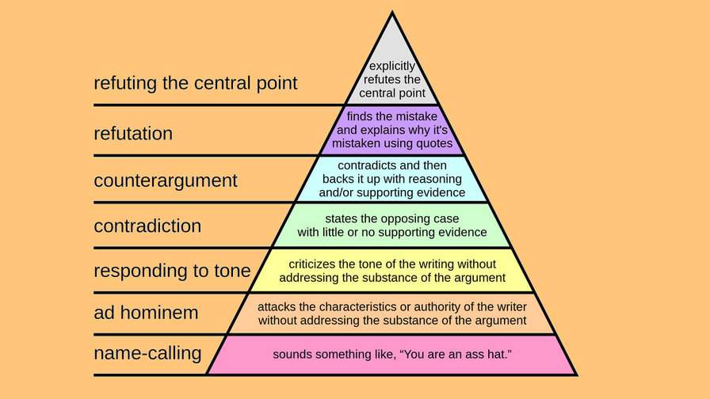
Do we have enough evidence to avoid using a mesh?
Notes:
So, we don’t have enough evidence refuting the hypothesis that a prophylactic mesh may be useful in emergencies beyond that low quality evidence or “We’ve always done it this way”.

Slide 6
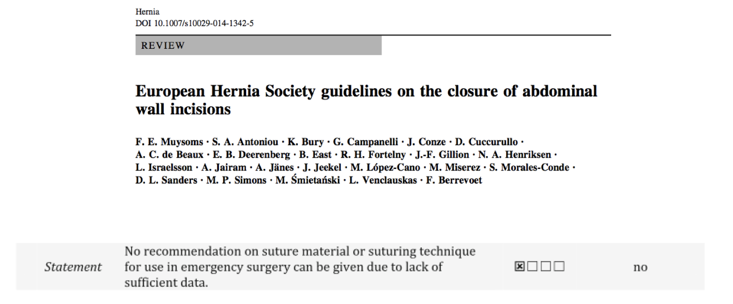
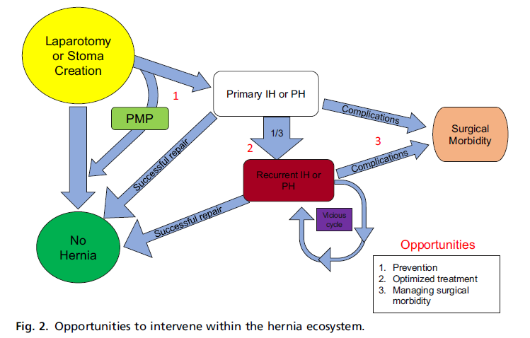
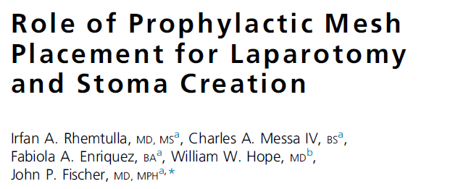
The most frequent situation
Notes:
And in emergencies we have the Patient on the table. We need a solution. No guidelines. We have a problem, we need a solution and is mandatory to act now.

Slide 7
What do we have to do?
"If in the first act you have hung a pistol on the wall, then in the following one it should be fired. Otherwise don't put it there." From Gurlyand's Reminiscences of A. P. Chekhov, in Teatr i iskusstvo 1904, No. 28, 11 July, p. 521
Hippocrates (Cos, c. 460 b. C.-Tesalia c. 370 b. C)
Notes:
So as Hippocrates estates “desperate times call for desperate mesasures…” And following the Chejov principle, if you show a gun in the first act, in the following one it should be fired.” I have shown a mesh and I have to use it.

Slide 8
Our experience
Notes:
Our experience was published some years ago in Surgery

Slide 9
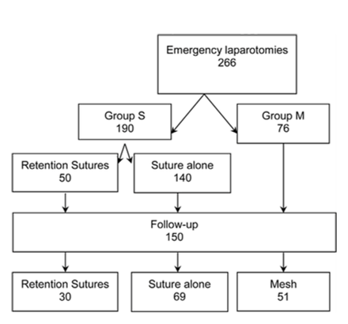
Patients and methods
From January 2009 to July 2010
Notes:
We have analysed all the emergency midline laparotomies including reoperations of elective surgery during the period from January 2009 to July 2010. Patients were divided in groups depending the use or not of a prophylactic suprafascial mesh.
Without an specific protocol. Using or not a mesh was a decision of the surgeon in charge of the operation

Slide 10
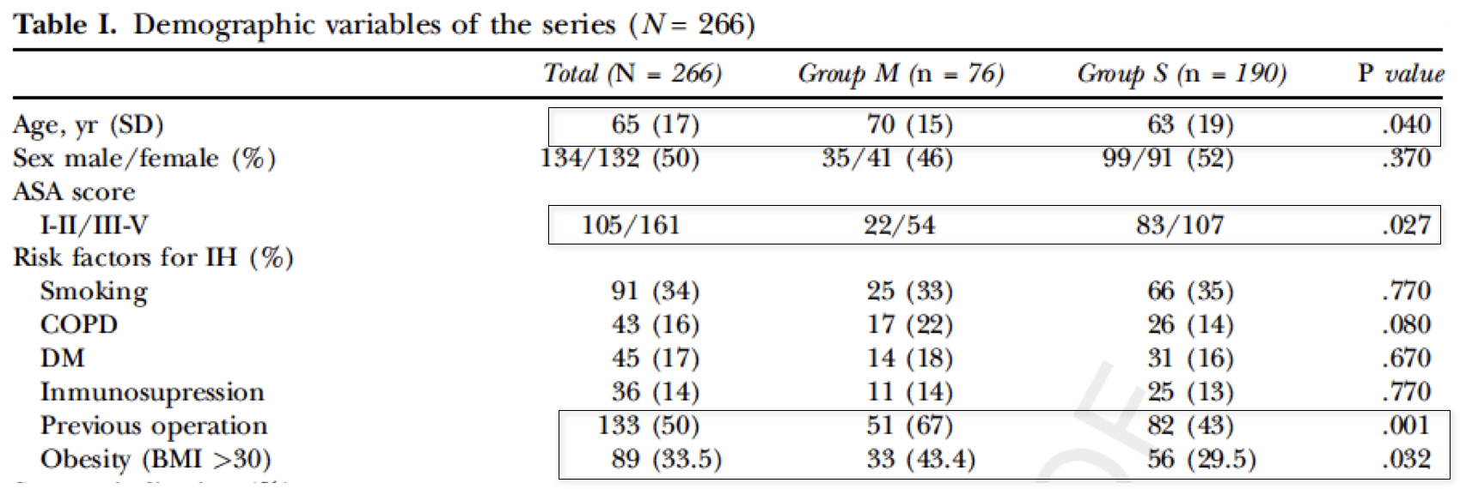
Patients and methods
Older
Obese
More Complications
Previous surgery
Comorbidities
Notes:
These are the demographic charatecistics of the patients. Patients receiving a mesh were older, more frequently obese, have previous surgery and higher number of comorbidities. All of these characteristics could predicts more complications.

Slide 11
Patients and methods
Notes:
These are the type of operations performed, very similar in both groups except a higher frequency of perforated ulcer in the sutured patients and higher percentage of reoperations after elective surgery in the mesh group..

Slide 12
Patients and methods
Notes:
The grade of contamination was similar in both groups but a higher percentage of highly contaminated surgery appears in the mesh group.

Slide 13
Postoperative complications
A mesh was safe
 | Total | Group M | Group S | P value
Wound infection (%) | 54 (20.3) | 20 (26.3) | 34 (17.9) | 0.13
Burst abdomen (%) | 4 (1.5) | 0 (0) | 4 (2.1) | 0.58
Notes:
Comparing postoperative results, the index of complications classified with Clavien-Dindo grade was similar in both groups. Although a higher frequency of complications and wound infection was present in the mesh group. And it’s very important to point that any burst abdomen was diagnosed in the mesh group. Both situations without statistical significance. Therefore these data points that using a mesh was safe

Slide 14
Results Incisional hernia
Median follow-up = 16.7 months
p<0,002
p<0,001
A mesh was effective
p<0,02
p<0,001
p<0,09
p<0,001
p<0,01
(N=44)
(N=44)
(N=56)
Notes:
During follow-up only 6% of patients in the mesh group developed an incisional hernia. Analysing different risk factors, all of them showed the same differences. Not significantly in the obese patients probably due to the sample size. The situations with higher grade of contamination also showed low rate of incisional hernias in the mesh group. Therefore a mesh was effective to prevent incisional hernia in high risk patients and situations.
We dont have any chronic infection and we dont have needed to explant any mesh in these patients since then.

Slide 15
Anything else?
Notes:
I have more data for you

Slide 16
Using a protocol - July 2016 – March 2018
YES
REOPERATION
NO
MESH + SHORT STITCH
RISK FACTORS >2
YES
Age >70
Malnutrition
Obesity (BMI)
COPD
Anaemia
Diabetes
Corticoids
CRF
Cancer
Immunosupresion
Obstruction
Peritonitis
NO
MESH+SHORT STITCH
SHORT STITCH
Notes:
During the last years we have been using a protocol combining short stitch closure and prophylactic meshes in high risk patients. This is our algorithm and these are the risk factors that we have considered.

Slide 17
A protocol for Emergency midline laparotomy
N=318
Excluded
N=153
Excluded
N=39
Analysed
N=165
Analysed N=126
Total registered operations
Postoperative
Reoperation=29
Previous mesh=57
Elective surgery=17
Postoperative exitus=42
Minimum 6 months follow-up
Exitus =1
Lost to follow-up=38
Notes:
During this period we have registered 318 operations. The postoperative analysis was done in 165 and 126 have completed a mínimum six months follow-up

Slide 18
Characteristics of patients
Age (SD) | 62,9 (17,1)
Age >70 y. (%) | 67 (40.6)
Gender (M/F) (%) | 101 (61,2)/64 (38,8)
BMI Kg/m² (SD) | 26,0 (6,0)
ASA III/IV (%) | 105 (65,4)
Comorbidities (%) | 106 (64,2)
Notes:
These are the characteristics of the sample. Very similar to our previous series. Older patients, mainly male with high frequency of comorbidities and a relevant percentatge of high risk patients.

Slide 19
Burst abdomen
FULL PROTOCOL
ONLY MESH PROTOCOL
ONLY SUTURE PROTOCOL
NOR MESH NOR SUTURE
1 (0,9%)
N=1 (0,6%)
Notes:
These are the results of burst abdomen classified according with the fulfillment of the protocol. The protocol was complete using short stitch and a mesh when was indicated in 69% of the patients, 17% receive properly a mesh but the closure was other than short stitch, the rest does’nt fulfill the protocol. Only one burst abdomen was diagnosed during the first month. That means a 0,6% of burst abdomen.

Slide 20
Incisional hernia
Six months follow-up
FULL PROTOCOL
ONLY MESH PROTOCOL
ONLY SUTURE PROTOCOL
NOR MESH NOR SUTURE
Following the protocol has better results
P=0.001
Notes:
During a six months follow-up, we have detected five incisional hernias. Four in the groups with the lowest fulfillment of the algorithm. That was statistically signficant.
Following the protocol has better results.

Slide 21
More than anything else?
Notes:
And still I have more data on emergecies for you

Slide 22
Prevention in emergency transverse unilateral laparotomy
Emergency surgery 2011-2017 N= 6500
Emergency subcostal laparotomy 2011-2017 n= 283 (4.35%)
Suture n=203 (71.7%)
Mesh n=80 (28.3%)
 | All | Suture | Mesh | P
Burst abdomen | 6 (2.1%) | 6 (3%) | 0 (0%) | 0.19
Follow-up 12 months n = 202 ( 71.37%)
Incisional hernia | 31(10.9) | 29 (19.1%) | 2(3.8%) | 0.008
Chronic pain | 11 (3.9%) | 6 (3.0%) | 5 (6.2%) | 0.302
Chronic infection | 0 (0%) | - | 0 (0%) | NA
Mesh removal | 0 (0%) | - | 0 (0%) | NA
IH Repair | 7 (22.6%) | 7 (24.1%) | 0 (0%) | NA
Suture n=150 (76.3%)
Mesh n=52 (65%)
Notes:
We have reviewed all the transverse unilateral incisions in emergencies during six years. A sample of 283 patients, 202 of whom have complete one year follow-up. Burst abdomen was absent in the mesh group again without reaching significance. Incisional hernia was significantlly lower in patients receiving a prophylactic mesh. Any chronic infection has been diagnosed and any mesh has been removed. The fourth part of patients with incisional hernia needed a repair.

Slide 23
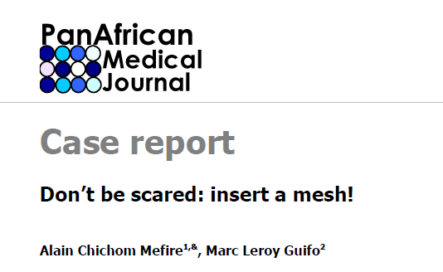
Conclusions
Using a prophylactic suprafascial polypropylene mesh in the closure of emergency laparotomies is feasible and safe for the prevention of incisional hernia and burst abdomen without adding a substantial rate of morbidity, even if high contamination or infections are present
Notes:
In conclusion:

Slide 24
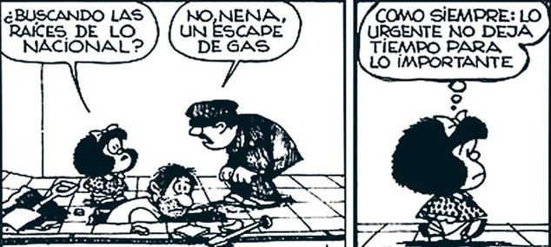
Closing remarks
We need urgently a study in emergencies
“As usual, emergencies don’t leave time for the important”
Notes:
Obviously the quality of evidence is low so we need urgently a study in emergencies. But, as usual, emergencies don’t leave time for the important.

Slide 25
Notes:
Thank you very much again for the invitation and congratulations for this great meeting and organisation.

