Slide 1
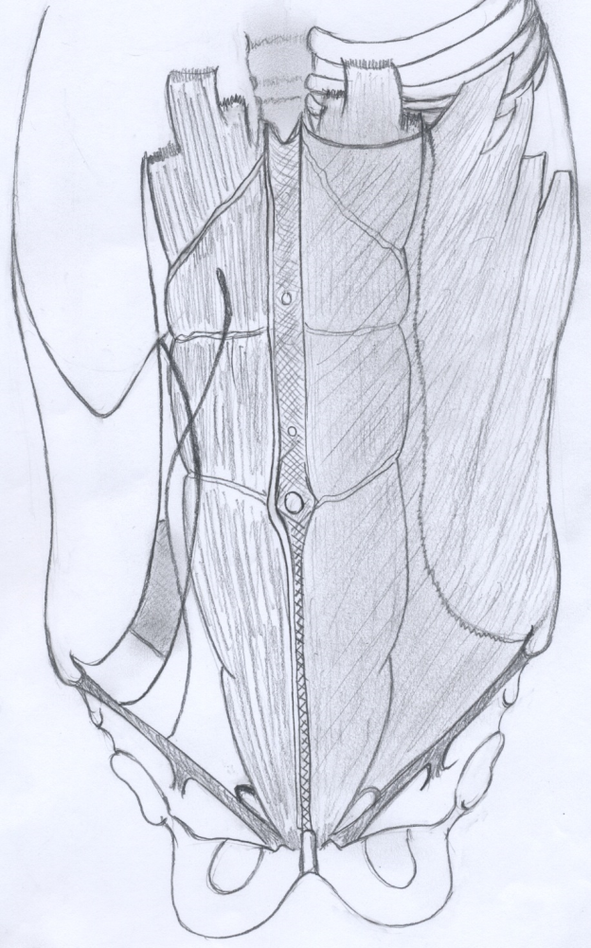
International Ventral Guidelines
Y. RENARD
CHU Reims

Slide 2
Disclosure of interest
Bard® : consulting
Medtronic® : fees

Slide 3
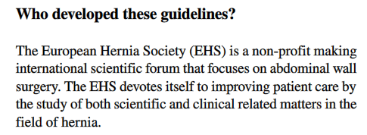
GUIDELINES
“The guideline are made for surgeons, general practioners and patients”

Slide 4
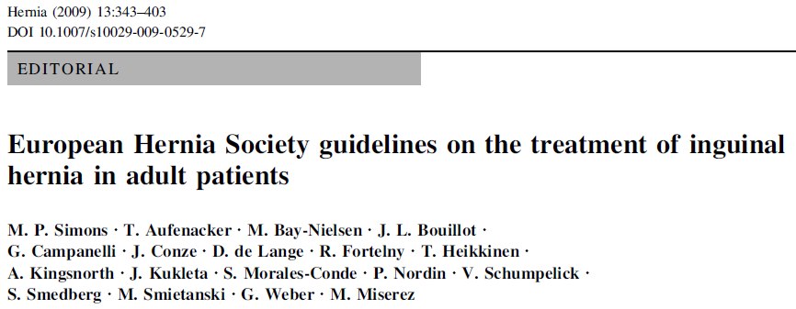
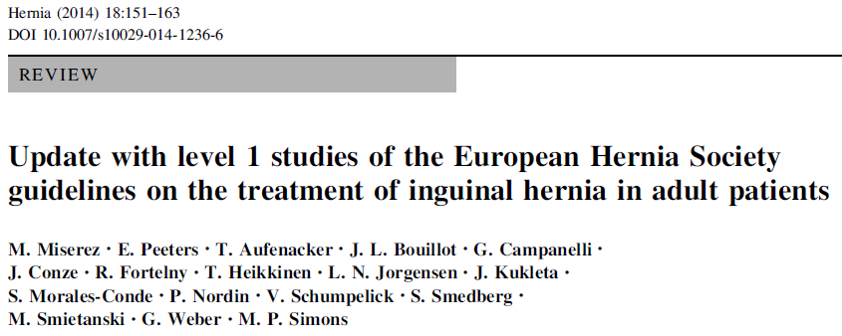
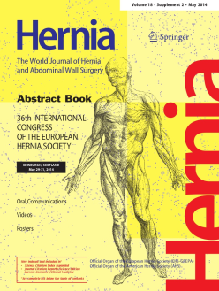
AUTRES GUIDELINES

Slide 5
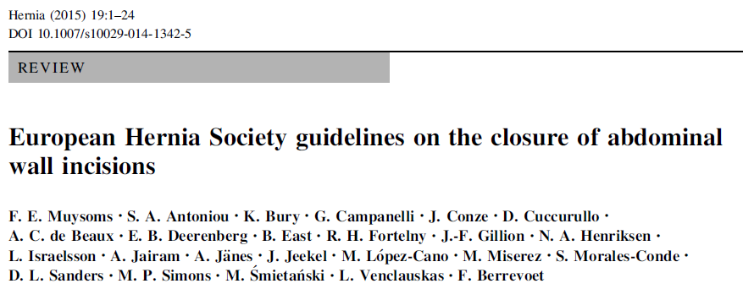
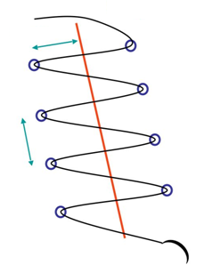
AUTRES GUIDELINES

Slide 6
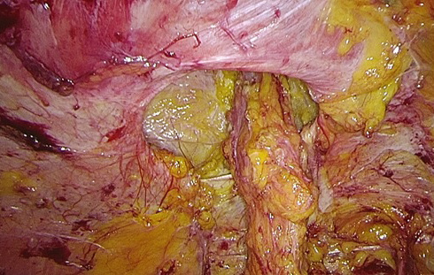
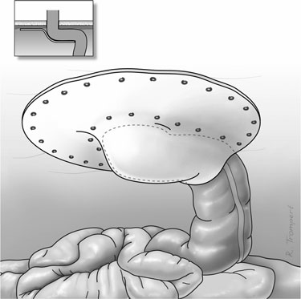
AUTRES GUIDELINES

Slide 7
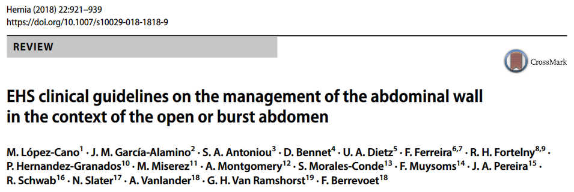
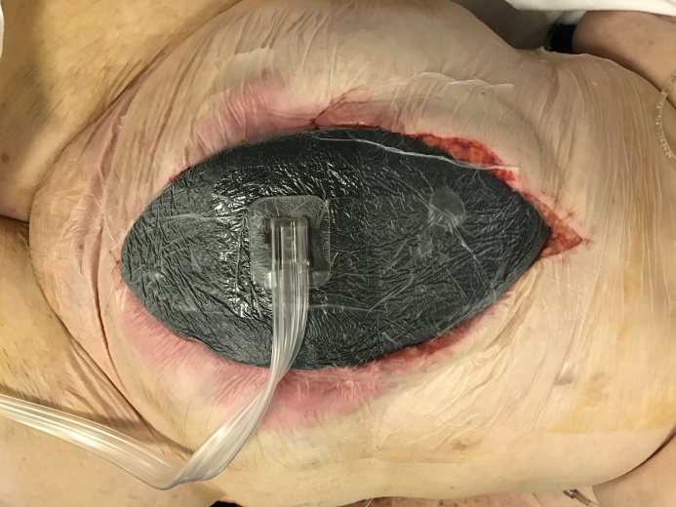
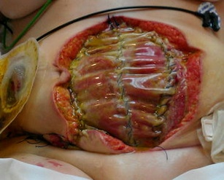
AUTRES GUIDELINES

Slide 8
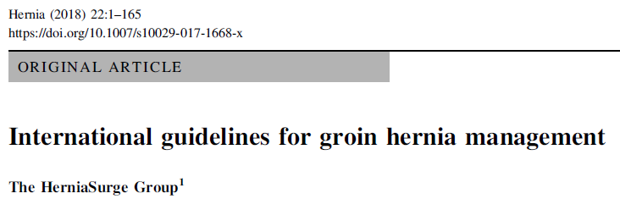
AUTRES GUIDELINES

Slide 9
AUTRES GUIDELINES

Slide 10
METHODOLOGIE
TEAM
Agneta Montgomery (Sweden)
Frederik Berrevoet (Belgium)
Ralf Lorenz (Germany)
Yohann Renard (France)
Miguel Garcia Urena (Spain)
Maarten Simons (Netherlands)
Nadia Henriksen (Denmark)
Ruth Kaufmann (Netherlands)
Barbora East (Czeck Republic)
William Hope (US)
John Fischer (US)
Sergio Roll (Brazil)
Dennis Klassen (Canada)

Slide 11
METHODOLOGIE
Key-Questions
Introduction, diagnostic, risk factors …
Surgical technique and emergency repair
Open repairs
Laparoendoscopic repairs
Complications and special conditions
Spigellian hernias
Lumbar hernias
Cost, quality, research, training and dissemination
Laparoendoscopic repairs of umbilical and epigastric hernia
Which is the preferred method ?
Which is the preferred layer for mesh placement ?
Which is the preferred mesh overlap ?
Is it beneficial to close the defect ?
Which type of suture is preferred if closing the defect when ?
Which is the preferred method of mesh fixation ?
Is there a place for robot-assisted repair?

Slide 12
METHODOLOGIE
Key-Questions
Team 1. Barbora and Frederik
Team 2. Ruth and Sergio
Team 3. John and Miguel
Team 4. Yohann and William
Team 5. Nadia and Agneta
Team 6. Dennis and Ralph
Team 7. Barbora, John and Maarten
Laparoendoscopic repairs of umbilical and epigastric hernia
Which is the preferred method ?
Which is the preferred layer for mesh placement ?
Which is the preferred mesh overlap ?
Is it beneficial to close the defect ?
Which type of suture is preferred if closing the defect when ?
Which is the preferred method of mesh fixation ?
Is there a place for robot-assisted repair?

Slide 14
METHODOLOGIE
Grading of Recommendations Assessment, Development, and Evaluation
www.gradeworkinggroup.org

Slide 15
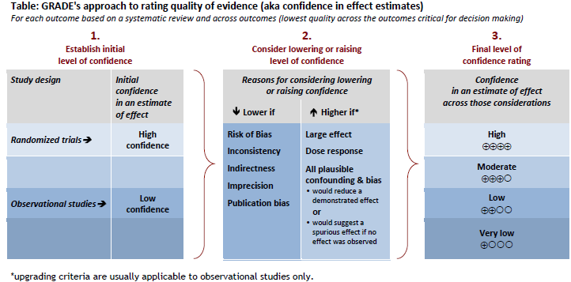
METHODOLOGIE GRADE
Définir des niveaux de preuve
Guyatt et al. BMJ. 2008
Notes:
Grade : 2000

Slide 16
METHODOLOGIE GRADE
Niveau de preuve
Pubmed
EMBASE
Cinahl
Web-of-Science
Google Scholar
Cochrane Library
Études | Niveau de preuve
Review & Meta-analyses | High
RCT | High
Cohort – observationnel | Low
Case-series, | Very low
?
?
ALGORITHME SIGN
(checklist)
http://www.sign.ac.uk/methodology/checklists.html Accessed 9 June 2019
Notes:
SIGN : 1993

Slide 17
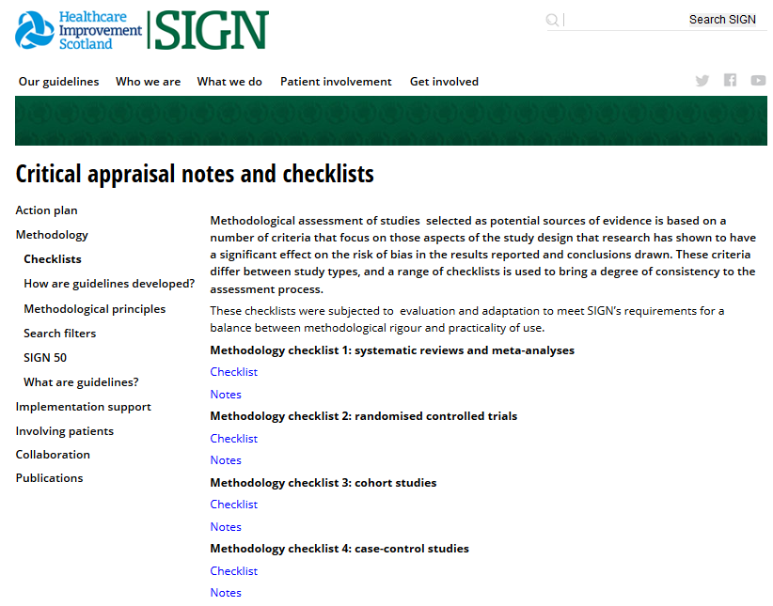
Niveau de preuve de chaque étude
http://www.sign.ac.uk/methodology/checklists.html Accessed 9 June 2019

Slide 18
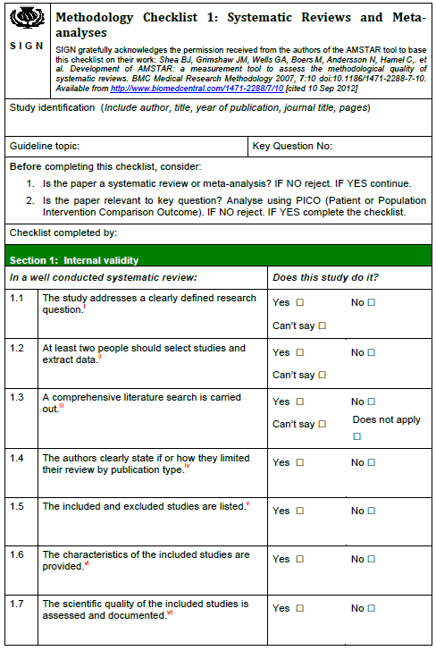
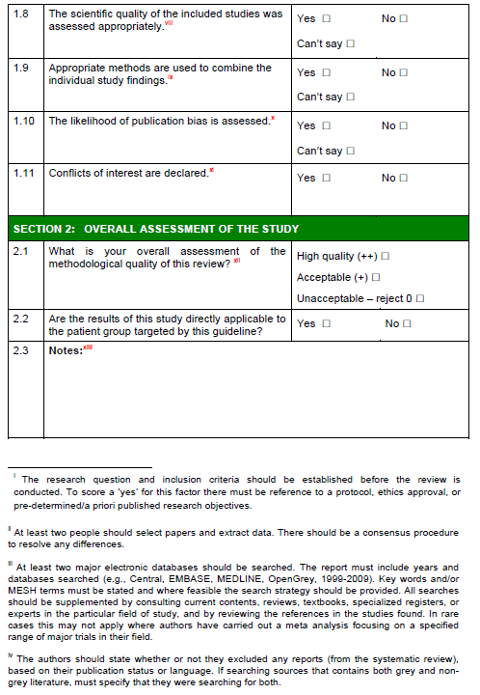

Slide 20
AMSTERDAM, Septembre 2018
Confirmation des évaluations SIGN
1er manuscript sur les Key-questions simples
Débat sur les key-questions difficiles

Slide 21
METHODOLOGIE GRADE
Définir des niveaux de preuve aux recommandations

Slide 22
Rédaction recommandations
High
Moderate
Low
Very Low
Balshem et al. Epidemiol. 2011

Slide 23
Rédaction recommandations
High
Moderate
Low
Very Low

Slide 24
EBM
Expérience
clinique
Rédaction recommandations
Préférence
patient
 | Upgrade | Downgrade
Type d’étude | RCT | Observationnelle
Risque de biais |  | Sérieux
Hétérogénéité des résultats |  | Importante
Caractère direct des données |  | Incertitude
Imprécision |  | Sérieuse
Biais de publication |  | Probable
Force de l’association | Risque relatif Significatif > 2
Prise en compte des facteurs de confusion | Oui
High
Moderate
Low
Very Low
Atkins et al. BMJ. 2004

Slide 25
Rédaction recommandations
High
Moderate
Low
Very Low

Slide 26
MALMÖ, Février 2019

Slide 27
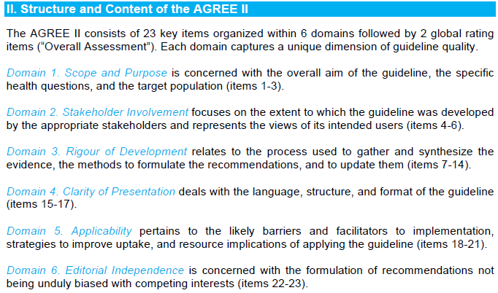
METHODOLOGIE AGREE
Brouwers et al. CMAJ. 2010

Slide 28
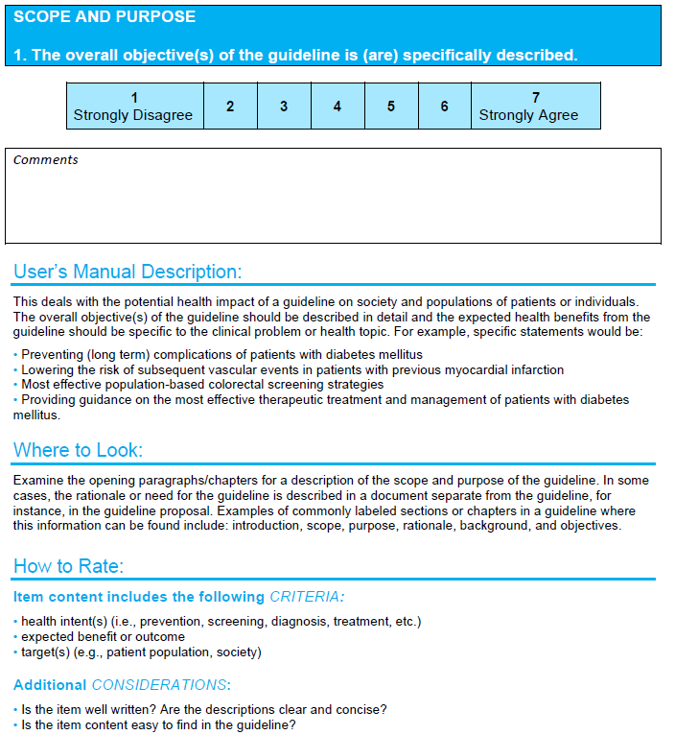
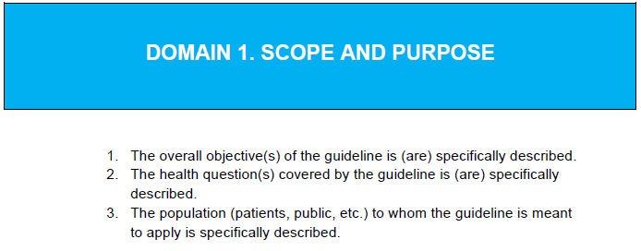
METHODOLOGIE AGREE

Slide 29
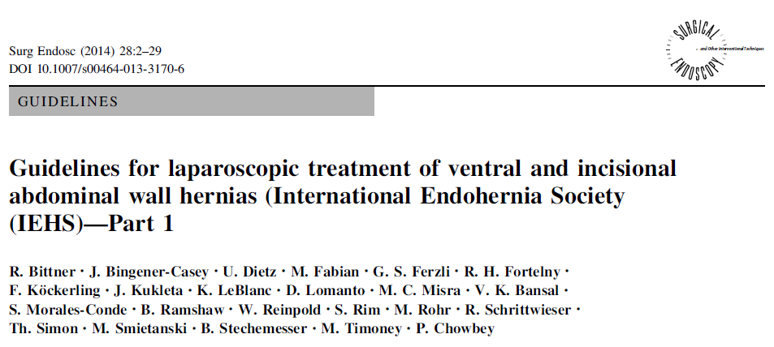
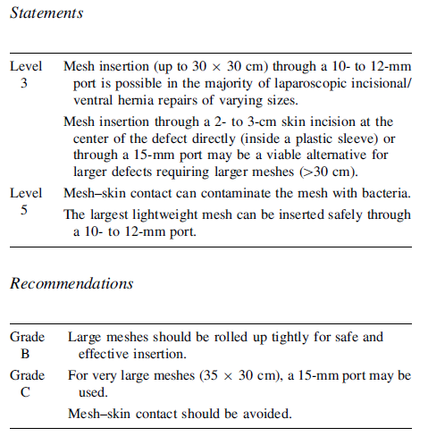
AUTRES GUIDELINES

Slide 30
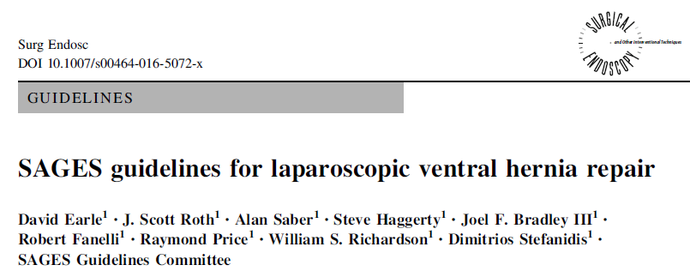
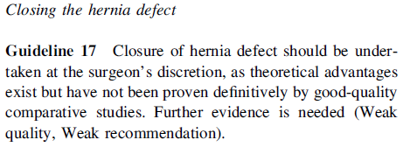
AUTRES GUIDELINES
2016

Slide 31
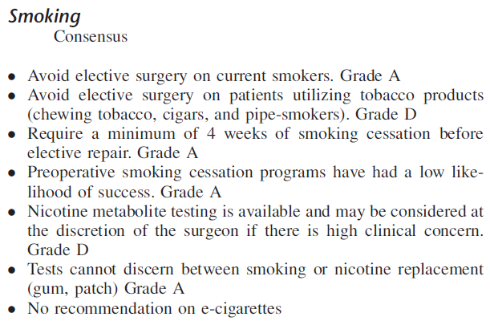
AUTRES GUIDELINES
Ebell et al. Am Fam Physician. 2004

Slide 33
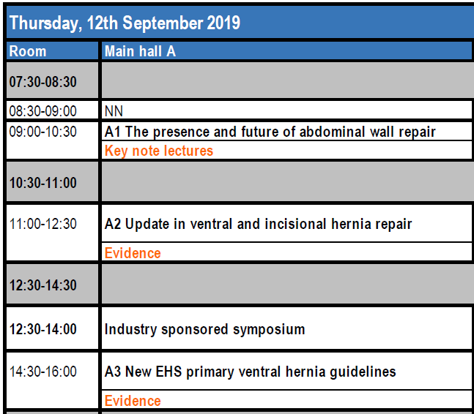
SECRET !
Notes:
For many of the Key Questions that were researched, there were no high quality studies available. While some strong recommendations could be made according to GRADE, the guidelines also contain good practice statements and clinical expertise guidance which are distinct from recommendations that have been formally categorized using GRADE

