Slide 1
Club Hernie MESH congres December 3rd, 2021
Outcomes of incisional hernia repair surgery after multiple re-recurrences
A propensity score matched analysis
G.H.J. de Smet, D. Sneiders, F. den Hartog, Y. Yurtkap, A.G. Menon, J. Jeekel, G-J Kleinrensink, J.F. Lange, J-F Gillion, and the Hernia-Club

Slide 2
Disclosure
Nothing to disclose
Notes:
I have nothing to disclose

Slide 3
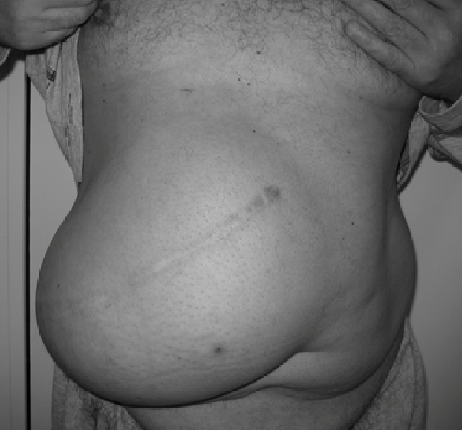
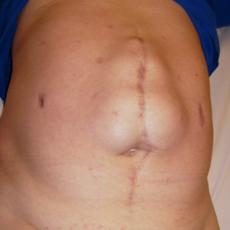
Introduction
Incisional hernias
Incidence: 5 - 30% ^{1, 2}
Re-recurrence rates incisional hernia (IH) repair: 20% ^{3, 4}
Overall risk of re-recurrence ventral and IH repair is 8-37% ⁵
¹ van ‘t Riet et al. Br J Surg. 2002 ⁴ Poulose et al. Hernia. 2012
² Bosanquet et al. PLoS One. 2015 ⁵ Helgstrand et al. Ann Surg. 2012
³ Kockerling et al. Front Surg. 2019
Notes:
Incisional hernia (IH) remains a frequent complication after open abdominal surgery [1]. The results of IH repair have improved due to standardized use of a mesh, nevertheless, re-recurrence rates remain high, up to 20% [2, 3].
The overall risk of re-recurrence after ventral and IH repair after a median follow-up time of 41 months is estimated between 8 and 37%

Slide 4
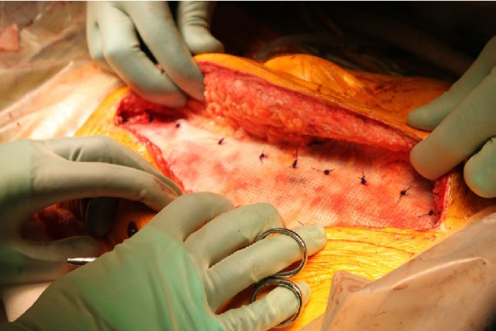
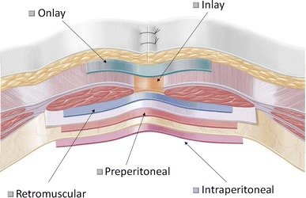
Introduction
Repair of IH after multiple re-recurrences is technically challenging:
Previous use of different techniques
Damaged anatomical planes Limited reconstructive options → unfavorable outcomes?
Altered tissue quality
Outcomes of IH repair studied thoroughly
Outcomes of IH repair after two or more re-recurrences remain unknown
Notes:
Although techniques and results of abdominal wall reconstruction are improving, hernia surgeons continue to be faced with patients presenting after multiple IH re-recurrences. Repair of IH after multiple re-recurrences can be technically challenging due to previous use of different techniques, which may result in damaged anatomical planes and altered tissue quality, and therefore gives more limited reconstructive options leading to unfavorable surgical outcomes. Outcomes after IH repair have been studied thoroughly. However, outcomes and utility of IH repair in patients who present after two or more re-recurrences remain unknown.

Slide 5
Objectives
Aim
Assess outcomes of IH repair by dedicated hernia surgeons in patients with two or more recurrences
Outcomes:
Postoperative complications
Relief of pre-operative symptoms
Recurrence
Notes:
This study aimed to assess outcomes of IH repair by dedicated hernia surgeons in patients with to or more previous re-recurrences.
Outcomes of repair in this population was assessed, considering postoperative complications, relief of pre-operative symptoms and IH recurrence rate.

Slide 6
Methods
Hernia Club Registry
Prospective
Patients operated for primary or incisional hernia
Surgeons specialized in abdominal wall surgery
191 variables
Inclusion of patients
Repair after >2 recurrences
Between 2011 – 2018
One year follow-up required
Control patients: primary hernia repair with similar follow-up
Notes:
To answer these questions, we used the hernia club registry database. This is a collaborative, prospective, anonymized online database of all surgical procedures for primary and incisional hernias. French surgeons specialized in abdominal wall surgery performed the surgical procedures, 191 variables are collected by the operated surgeon and the blinded independent, clinical research associates before, during and after the surgery.
Patient who underwent IH repair after two or more re-recurrences operated between 2011 and 2018, were selected from the Club-Hernie database. Only patients who fulfilled their 1-year follow-up visit were included.
Control patients with similar follow-up who underwent primary IH repair were selected.

Slide 7
Methods
Extracted parameters
Age, sex, BMI, ASA class, diabetes mellitus, no. of recurrences, smoking
IH location, EHS width classification, mesh location
Emergency surgery, synchronous repair of multiple defects, wound classification
Follow-up time
At 1 year: functional outcomes (non-solid scar, bulging, pain, discomfort, daily life inhibition)
Notes:
We extracted several parameters of which 12 were used for matching.
The extracted parameters included patient characteristics, hernia characteristics, surgical characteristics, follow-up time and the outcomes so discomfort, pain and IH recurrence.

Slide 8
Methods
Propensity score matched to primary IH repair
Ratio 1 : 3 (re-recurrent : primary), nearest neighbor method
Multiple imputation (10 iterations) for missing data
Twelve variables used for matching:
Age, sex, BMI, ASA classification, hernia location, EHS width classification, mesh location, emergency surgery, synchronous repair of multiple defects, diabetes mellitus, wound class, and smoking status
Notes:
We performed a propensity score matched analyses where cases (patients operated after two or more previous re-recurrences) were matched 1:3 to control patients. Cases were matched according to the nearest neighbor method, matching from the highest to lowest propensity scores.
Multiple imputations were perfomered to allow the use off all available data.
The following 12 variables were used for matching: age, sex, BMI, ASA classification, hernia location, EHS width classification, mesh location, emergency surgery, synchronous repair of multiple defects, diabetes mellitus, wound class, and smoking status.

Slide 9
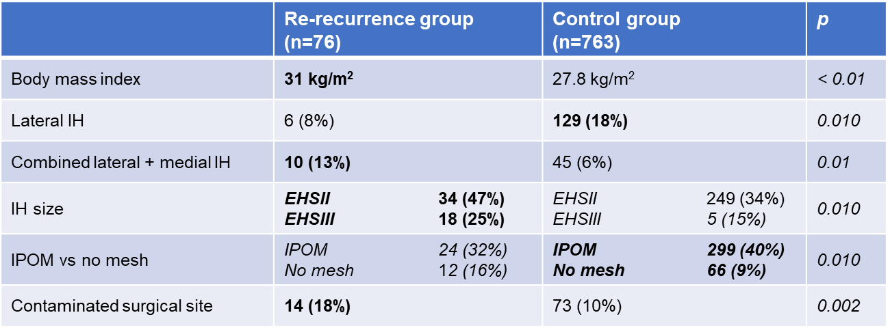
Results - Baseline
Re-recurrence versus control, unmatched sample
Notes:
76 patients operated after two or more IH re-recurrences were available in the database, and 763 patients who underwent primary IH repair were available.
This table shows the baseline characteristics of the re-recurrence group versus the controle group for only the significant different characteristics. So in the raw unmatched data BMI was higher among re-recurrence group. In the primary group there were more patients with lateral IH. In the re-recurrence group there were more lateral and medial combined hernias. Patients in the re-recurrence group presented with a higher IH. In the re-recurrence group the hernia was repaired more with no mesh reinforcement. The prevalence of contamined surgical site was higher in the re-recurrence group.
All other variables were not significantly different.

Slide 10
Results - Baseline
Notes:
This figure shows the love plot of covariates with the unmatched group en de propensity score matched group
12 variables which you see on the right siden
For all variables included in the propensity model, the performance of the matching model was assessed visually by plotting the mean of each covariate against the propensity score.

Slide 11
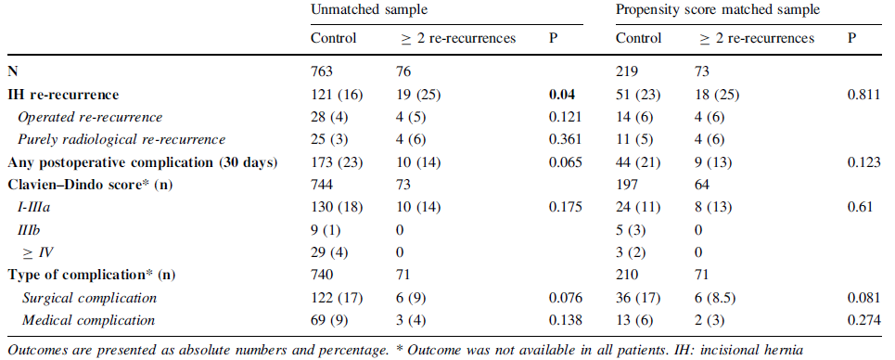
Results - Surgical outcomes
Notes:
This tables shows us that after a median follow-up of 12.4 months, 121 (16%) control patients and 19 (25%) patients operated after two or more re-recurrences had been diagnosed with a re-recurrent IH in the unmatched sample (p = 0.04, Table 2). In the propensity score matched sample, the re-recurrence rates among the re-recurrence group and control group were equal.

Slide 12
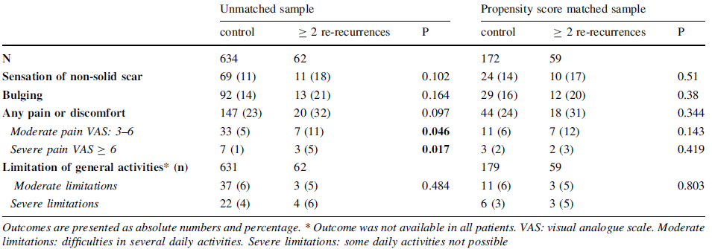
Results - Functional outcomes
Notes:
Once again: Left side unmatched sample (significant difference pain and discomfort), right ride matched sample (). But now for the functional outcomes.
In the unmatched sample, more patient in the re-recurrence group reported frequent complaints of moderate to severe pain compared to the control groups. However, in the propensity score matched sample the outcomes regarding pain and discomfort were comparable between the two groups

Slide 13
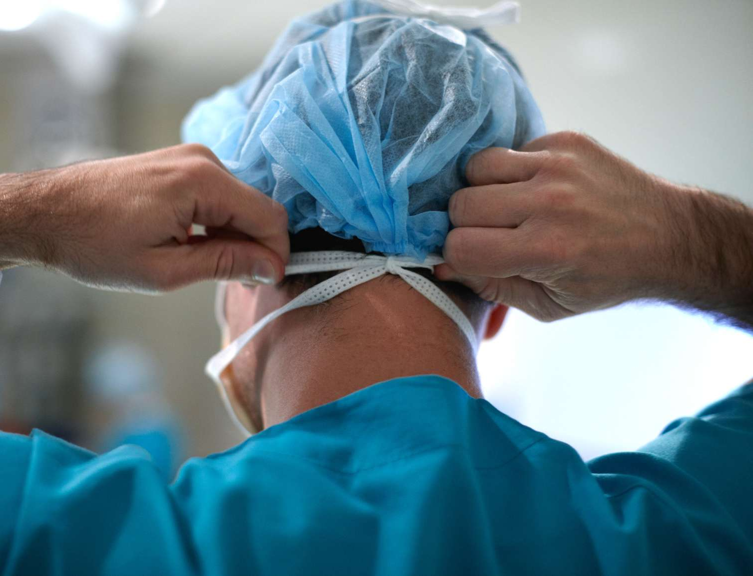
Conclusion
Surgical and functional outcomes comparable to primary IH patients with a similar risk profile
Symptomatic patients, reasonably fit for surgery, further surgery may very well be justifiable, if performed by a dedicated hernia surgeon
Notes:
IH repair surgery in patients who experienced multiple (≥ 2) re-recurrences results in outcomes comparable to patients operated on a first IH repair with a similar risk profile.
If performed by a dedicated hernia surgeon, further surgery in patients who already experienced multiple IH re-recurrences results in good outcomes and is a justifiable treatment.

Slide 14
Discussion
Hernia re-recurrence is generally considered an important risk factor for an unfavorable outcome → influence surgeon to refrain from hernia repair
No recommendation can be made on the preferable technique for re-recurrent IH repair
Limitations
Caution is warranted: observational data, influenced by pre-inclusion selection bias and (good) clinical decision-making
Propensity score matching balances baseline variables, but does not solve this bias
Notes:
To our knowledge, no previous data on the currently studied population of patients, with multiple previous re-recurrences of IH, is available in literature. However, a hernia re-recurrence is generally considered an important risk factor for an unfavorable outcome after IH repair, both with reference to complications and risk for re-recurrence. This can influence the surgeon and patient to refrain from a third or even a fourth hernia repair
Based on current and available published data, no recommendation can be made on the preferable technique for re-recurrent IH repair. Usually, it is preferred to use a different anatomical plane compared to the previous procedure
When interpreting results of this study, the clinical workup of patients must be taken into account. It is likely that only a minority of patients with multiple re-recurrences undergo further surgery, either due to comorbidity, technical concerns, or the wish of the patient. Currently, the relatively favorable results will in part reflect the clinical decision-making process of operating surgeons.
Propensity score matching balances baseline variables, but does not solve this bias. Therefore, on a per case basis differences could still be present between the studied populations. Also, unknown risk factors, or factors not included in the propensity score model may still be unbalanced

Slide 15
Acknowledgement: The Hernia Club
Ain J-F (Polyclinique Val de Saone, Macon, France), Beck M (Clinique Ambroise Paré, Thionville, France), Barrat C (Hôpital Universitaire Jean Verdier, Bondy, France), Berney C (Bankstown-Lidcombe Hospital, Sydney, Australia), Berrod J-L (Groupe Hospitalier Paris St Joseph, Paris, France), Binot D (MCO Côte d’Opale, Boulogne sur Mer, France), Boudet M-J (Clinique Alleray-Labrouste, Paris, France), Bousquet J (Hôpital Privé de la Chataigneraie, Montpellier, France), Blazquez D (Clinique Jeanne d’Arc, Paris, France), Bonan A (Hôpital Privé d’Antony, Antony, France), Cas O (Centre Médico Chirurgical–Fondation WALLERSTEIN, Arès, France), Champault-Fezais A (Groupe Hospitalier Paris St Joseph, Paris, France), Chastan P (Bordeaux, France), Cardin J-L (Polyclinique du Maine, Laval, France), Chollet J-M (Hôpital Privé d’Antony, Antony, France), Cossa J-P (CMC Bizet, Paris, France), Dabrowski A (Clinique de Saint Omer, Saint Omer, France), Démaret S (Clinique Saint Vincent, Besançon, France), Drissi F (CHU Nantes, Nantes, France), Durou J (Clinique de Villeneuve d’Ascq, Villeneuve d’Ascq, France), Dugue T (Clinique de Saint Omer, Saint Omer, France), Faure J-P (CHRU Poitiers, Poitiers, France), Framery D (CMC de la Baie de Morlaix, Morlaix, France), Fromont G (Clinique de Bois Bernard, Bois Bernard, France), Gainant A (CHRU Limoges, Limoges, France), Gauduchon L (CHRU Amiens, France), Genser L (CHU Pitié-Sampétrière, Paris, France), Gillion J-F (Hôpital Privé d’Antony, Antony, France), Guillaud A (Clinique du Renaison, Roanne, France), Jacquin C (CH du Prado, Marseille, France), Jurczak F (Clinique Mutualiste, Saint Nazaire, France), Khalil H (CHRU Rouen, Rouen, France), Lacroix A (CH de Auch, Auch, France), Ledaguenel P (Clinique Tivoli, Bordeaux, France), Lepère M (Clinique Saint Charles, La Roche-sur-Yon, France), Lépront D (Polyclin- ique de Navarre, Pau, France), Letoux N (Clinique Jeanne d’Arc, Paris, France), Loriau J (Groupe Hospitalier Paris St Joseph, Paris), Magne E (Clinique Tivoli, Bordeaux, France), Ngo P (Hôpital Américain, Neuilly, France), Oberlin O (Croix St Simon Diaconesses, Paris, France), Paterne D (Clinique Tivoli, Bordeaux, France), Pavis d’Escurac X (Strasbourg, France), Potiron L (Clinique Jules Verne, Nantes, France), Renard Y (CHRU Reims, Reims, France), Soler M (Polyclinique Saint Jean, Cagnes-sur-Mer, France), Rignier P (Polyclinique des Bleuets. Reims), Roos S (Clinique Claude Bernard, Albi, France), Thillois J-M (Hôpital Privé d’Antony, Antony, France), Tiry P (Clinique de Saint Omer, Saint Omer, France), and Zaranis C (Clinique de La Rochelle, France).
Notes:
We would like to thank all surgeons and research associates of the hernia club for collecting all the data. And special thanks to dr. Gillion for the fruitful collaboration with us for several years now.

Slide 16
Love plot of covariates
Notes:
Propensity score model was assessed visually by plotting mean of covariates vs propensity score

Slide 17
Matching
Notes:
Propensity score model was assessed visually by plotting mean of covariates vs propensity score

Slide 18
Matching
Notes:
Propensity score model was assessed visually by plotting mean of covariates vs propensity score

