Slide 1
PMSI & Big data :
Incidence and risk factors of Incisionnal Hernia in France.
B. Gignoux, B Darnis Clinique de la Sauvegarde, Lyon, France
MC Blanchet, V Frering
Y Bayon Medtronic
D Martin, R Phan, Ecole des mines de St Etienne, France
V Augusto, M Sarazin
Notes:
As digestive surgeonS, we only have a vAgue idea of IH after laparotomy.
I propose you to have a look at the REAL FIGURES

Slide 2
SURGEON OPINION ?
Q1 : You have to perform a laparotomy for acute bowel obstruction in an obese patient. You estimate the risk of incisional hernia is :
5%
10%
20%
30%
50%
Notes:
Let’s start with a quick survey
Please RAISE YOUR HAND if you think it is …
Most of my colleagues that I interveiwed estimated the risk between

Slide 3
SURGEON OPINION ?
Q2 : You program a repair of incisional hernia in an obese patient. You announce the patient a risk of second repair for recurrence of :
5%
10%
15%
20%
No figure
Notes:
Question 2 : You
Please RAISE YOUR HAND IF YOU THINK

Slide 4
Objective : Truth is in the database
Database – PMSI
Codes CCAM
Every patients had a laparotomy in 2010
Follow up 6 years
Data analysis
Notes:
Le but de ce travail était de connaitre les vrais chiffres d’éventration et de reintervention après laparotomie
Pour ce faire, nous nous sommes servis de cette fantastique base de données francaise que constitue le PMSI
HOW DID WE WORK ?
BASED ON ou WE STUDIED THE FRENCH NATIONAL REGISTER AND WE SELECTED EVERY PATIENTS WHO UNDERWENT A LAPAROTOMY IN 2010
AND WE FOLLOWED THEM DURING THE NEXT 6 YEARS
Programme de médicalisation des systèmes d’information

Slide 5
Truth is in the big data
Every patients had a laparotomy in 2010
549 codes
from C-section to colectomy
Very large population
431 719 patients
Age 42
Females 71%
Notes:
THEN WE GOT 549 CODES FROM C-S TO COLECTOMY
MEANS A VERY LARGE POPULATION OF MORE THAN 400 000 PATIENTS
FOR THOSE PATIENTS (MOSTLY YOUNG FEMALES) FOLLOWED DURING 6 YEARS
THE RATE OF IH WAS 5%
IN THE SAME TIME, WE IDENTIFIED IN THE LITERATURE THE RISK FACTORS OF IH WHICH ARE …

Slide 6
Truth is in the big data
Every patients had a laparotomy in 2010
549 codes
from C-section to colectomy
Very large population
431 719 patients
Age 42
Females 71%
RATE of
Incisional Hernia Repair
21 993 patients
5 %
LMMA004
LMMA010
LMMC015
Notes:
THEN WE GOT 549 CODES FROM C-S TO COLECTOMY
MEANS A VERY LARGE POPULATION OF MORE THAN 400 000 PATIENTS
FOR THOSE PATIENTS (MOSTLY YOUNG FEMALES) FOLLOWED DURING 6 YEARS
THE RATE OF IH WAS 5%
IN THE SAME TIME, WE IDENTIFIED IN THE LITERATURE THE RISK FACTORS OF IH WHICH ARE …

Slide 7
Truth is in the big data
Every patients had a laparotomy in 2010
549 codes
from C-section to colectomy
Very large population
431 719 patients
RATE of
Incisional Hernia Repair
21 993 patients
5 %
RISK FACTORS : HTA, Obesity, COPD, Diabetes
Notes:
THEN WE GOT 549 CODES FROM C-S TO COLECTOMY
MEANS A VERY LARGE POPULATION OF MORE THAN 400 000 PATIENTS
FOR THOSE PATIENTS (MOSTLY YOUNG FEMALES) FOLLOWED DURING 6 YEARS
THE RATE OF IH WAS 5%
IN THE SAME TIME, WE IDENTIFIED IN THE LITERATURE THE RISK FACTORS OF IH WHICH ARE …

Slide 8
What Are the most impactful laparotomies?
SELECTION CRITERIA
Exclusion of rare cases
< 100 patients in 2010
Laparotomy followed by a relevant level of Incisional Hernia Repair
>10% of IHR over 6 years
From 549 codes of laparotomy
From 432,000 patients
with 5% IH rate
65 codes of laparotomy analyzed
71 863 patients
Notes:
But this is a too common population and we decided to focus on more at risk population
Then we excluded rare procedures, that is to say less than 100
And we included only laparotomy with a relevant level of IHR that is to say more than 10%
Then from 549 codes including 432 000 patients, we swished to 65 codes with 72 000 patients

Slide 9
What Are the most impactful laparotomies?
SELECTION CRITERIA
Exclusion of rare cases
< 100 patients in 2010
Laparotomy followed by a relevant level of Incisional Hernia Repair
>10% of IHR over 6 years
From 549 codes of laparotomy
From 432,000 patients
with 5% IH rate
65 codes of laparotomy analyzed
71 863 patients
RATE of
Incisional Hernia Repair
17 %
Notes:
But this is a too common population and we decided to focus on more at risk population
Then we excluded rare procedures, that is to say less than 100
And we included only laparotomy with a relevant level of IHR that is to say more than 10%
Then from 549 codes including 432 000 patients, we swished to 65 codes with 72 000 patients

Slide 10
Total number of patients
72,000
Analysis of the top 65 laparotomies
Notes:
Let’s know more about these top 65 laparotomy.
1st of all we are VERY concerned WITH these patient because the large majority of them (89%) had a digestive surgery.
And if we go deeper in the types of laparotomy, we noticed 72% were colon rectum or small intestine rEsection. (Rissection)
Camembert = PIE CHART

Slide 11
Total number of patients
72,000
Analysis of the top 65 laparotomies
89% of patients in the Top 65
= digestive laparotomy
Notes:
Let’s know more about these top 65 laparotomy.
1st of all we are VERY concerned WITH these patient because the large majority of them (89%) had a digestive surgery.
And if we go deeper in the types of laparotomy, we noticed 72% were colon rectum or small intestine rEsection. (Rissection)
Camembert = PIE CHART

Slide 12
Total number of patients
72,000
Analysis of the top 65 laparotomies
89% of patients in the Top 65
= digestive laparotomy
Majority of patients
= colorectal laparotomy
Notes:
Let’s know more about these top 65 laparotomy.
1st of all we are VERY concerned WITH these patient because the large majority of them (89%) had a digestive surgery.
And if we go deeper in the types of laparotomy, we noticed 72% were colon rectum or small intestine rEsection. (Rissection)
Camembert = PIE CHART

Slide 13
Total number of patients
72,000
Analysis of the top 65 laparotomies
89% of patients in the Top 65
= digestive laparotomy
Majority of patients
= colorectal laparotomy
Notes:
Let’s know more about these top 65 laparotomy.
1st of all we are VERY concerned WITH these patient because the large majority of them (89%) had a digestive surgery.
And if we go deeper in the types of laparotomy, we noticed 72% were colon rectum or small intestine rEsection. (Rissection)
Camembert = PIE CHART

Slide 14
Analysis of RISK FACTORS
RATE of IHR : 17%
72,000 patients
Notes:
So, We know that the rate of IH after laparotomy for digestive surgery is 17%.
Let’s focus on the patients, their comorbidities and risk factors we looked in the literature the comorbidities that can be identifeid in this register
HT, dB, Obesity, COPD
As you can see, we noticed that patients with CoMo had a higher rate oh IH
And we observed the same tendency for dB, HT, COPD
Except for OBISITY where the risk multiplied by 2

Slide 15
Analysis of RISK FACTORS
RATE of IHR : 17%
72,000 patients
Identified risk factors
Hypertension, Diabetes, Obesity,
Chronic Obstructive Pulmonary Disease(COPD)
Notes:
So, We know that the rate of IH after laparotomy for digestive surgery is 17%.
Let’s focus on the patients, their comorbidities and risk factors we looked in the literature the comorbidities that can be identifeid in this register
HT, dB, Obesity, COPD
As you can see, we noticed that patients with CoMo had a higher rate oh IH
And we observed the same tendency for dB, HT, COPD
Except for OBISITY where the risk multiplied by 2

Slide 16
Analysis of RISK FACTORS
72,000 patients
Overall population
Identified risk factors
Hypertension, Diabetes, Obesity,
Chronic Obstructive Pulmonary Disease(COPD)
Notes:
So, We know that the rate of IH after laparotomy for digestive surgery is 17%.
Let’s focus on the patients, their comorbidities and risk factors we looked in the literature the comorbidities that can be identifeid in this register
HT, dB, Obesity, COPD
As you can see, we noticed that patients with CoMo had a higher rate oh IH
And we observed the same tendency for dB, HT, COPD
Except for OBISITY where the risk multiplied by 2

Slide 17
Analysis of RISK FACTORS
72,000 patients
p < 0.0001
Notes:
So, We know that the rate of IH after laparotomy for digestive surgery is 17%.
Let’s focus on the patient, their comorbidities and risk factors.
As you can see, we noticed that patients with CoMo had a higher rate oh IH
And we observed the same tendency for dB, HT, COPD
Except for OBISITY where the risk multiplied by 2

Slide 18
Analysis of RISK FACTORS
72,000 patients
p < 0.0001
Notes:
So, We know that the rate of IH after laparotomy for digestive surgery is 17%.
Let’s focus on the patient, their comorbidities and risk factors.
As you can see, we noticed that patients with CoMo had a higher rate oh IH
And we observed the same tendency for dB, HT, COPD
Except for OBISITY where the risk multiplied by 2

Slide 19
Analysis of RISK FACTORS
72,000 patients
p < 0.0001
Notes:
So, We know that the rate of IH after laparotomy for digestive surgery is 17%.
Let’s focus on the patient, their comorbidities and risk factors.
As you can see, we noticed that patients with CoMo had a higher rate oh IH
And we observed the same tendency for dB, HT, COPD
Except for OBISITY where the risk multiplied by 2

Slide 20
Analysis of RISK FACTORS
72,000 patients
Diabetes
Hypertension
COPD
Rate
Obesity x 2
Notes:
So, We know that the rate of IH after laparotomy for digestive surgery is 17%.
Let’s focus on the patient, their comorbidities and risk factors.
As you can see, we noticed that patients with CoMo had a higher rate oh IH
And we observed the same tendency for dB, HT, COPD
Even more for OBISITY where the risk mUltiplied by 2

Slide 21
Analysis of RISK FACTORS : obesity alone
Total number of patients
72,000
Obesity increases IH rate to 30%
regardless of other factors
Notes:
WHAT IS REALLY INTERESTING IS that obesity alone, w or w/o others comorbidities increases the risk of IH IN 30%

Slide 22
Total number of patients
72,000
IHR occurrence time
Notes:
THE NEXT QUESTION is WHEN does the IH occurr ?
As mentioned before, we followed up the patients during the 6 following years and you can see that the hernia occurr in 56% during the 1st year and for 79% of the patient during the 2 fisrt yearS.

Slide 23
Total number of patients
72,000
IHR occurrence time
21%
56% during 1st year
79% during 1st 2 years
23%
Median occurrence time
9.6months
Tot.
100%
56%
Tot.
79%
Notes:
THE NEXT QUESTION is WHEN does the IH occurr ?
As mentioned before, we followed up the patients during the 6 following years and you can see that the hernia occurr in 56% during the 1st year and for 79% of the patient during the 2 fisrt yearS.

Slide 24
2nd Part : Recurrence after repair
French National Database - PMSI
Every patients had a laparotomy in 2010
Every patients had an Incisional Hernia Repair (IHR)
in 2013
HOW?
Data analysis
Notes:
The goal of the 2nd part of the study was to know more about the recurrence rate after a repair of IH
From the French database, we analysed every patient who had a repair of an IH during the year 2013

Slide 25
Clinical pathway of patient with IHR after laparotomy
Every patients had an
IHR in 2013
22 000 patients
Selection of patients w/o a previous IHR
&
in the Top 65 laparotomy list
7 700 patients
Analysis of the clinical pathway and profile of this
7 700 patients
Notes:
Then we got 22 000 of patients, we selected pa w/o a previous repair and in the top 65 lap list,
Then 7 700 patients remain. (no S)

Slide 26
Clinical pathway of patient with IHR – gender impact
Median time: 13 months
Recurrence rate: 13%
Median time: 9 months
IH repair
IH recurrence
Laparotomy
TIME
IH repair
IH recurrence
Median time: 14 months
Recurrence rate: 15%
Median time: 6 months
Recurrence rate after IHR is 14%
Notes:
If we look at their clinical pathway, regarding the gender impact, we noticed that women had a shorter recurrence
But the rate recurrence after repair was similar it was 14%

Slide 27
Clinical pathway of patient with IHR – obesity impact
Median time: 13 months
Recurrence rate: 13%
Median time: 8 months
IH repair
IH recurrence
Laparotomy
TIME
IH repair
IH recurrence
Median time: 15 months
Recurrence rate: 19%
Median time: 7 months
Recurrence rate after IHR in obese patients is 19 %
Notes:
And if we focus on the obese patients, the rate of recurrence that requires a repair is again higher and reaches 19%

Slide 28
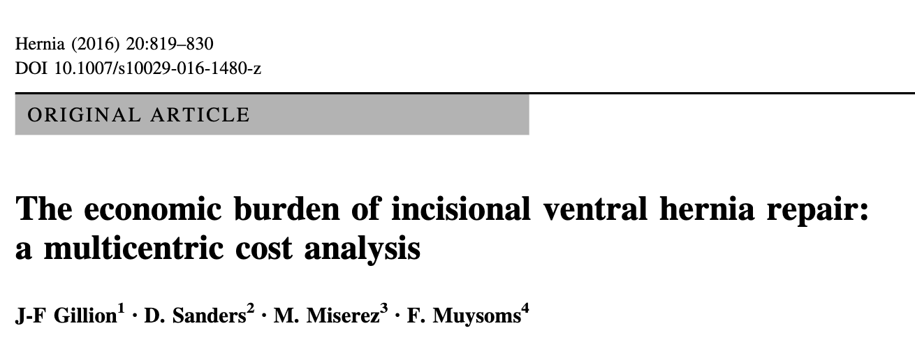
Incisional Hernia : the economic impact
Cost Analysis IHR 6451 €
4731 € unemployed
10 107€ employed
Cost IHR : 140 Million €
Reducing by 5%
Cost Saving 4 Million €
Notes:
Etude Hollandaise Lancet 2015 Deerenberg 560 pa Random db Blind multicentrqiue laparo médiane
Suture points de 5mm / 5mm Versus 1 cm / 1 cm Suivi 1 an
Taux éventration 13% Vs 21%
Small bites suture technique or closure of abdominal wall

Slide 29
Incisional Hernia : Guidelines
Closure techniques 23 RCT
Slowly absorbable suture
small bites techniques
Reduce IH OR 0,41
Notes:
Etude Hollandaise Lancet 2015 Deerenberg 560 pa Random db Blind multicentrqiue laparo médiane
Suture points de 5mm / 5mm Versus 1 cm / 1 cm Suivi 1 an
Taux éventration 13% Vs 21%
Small bites suture technique or closure of abdominal wall

Slide 30
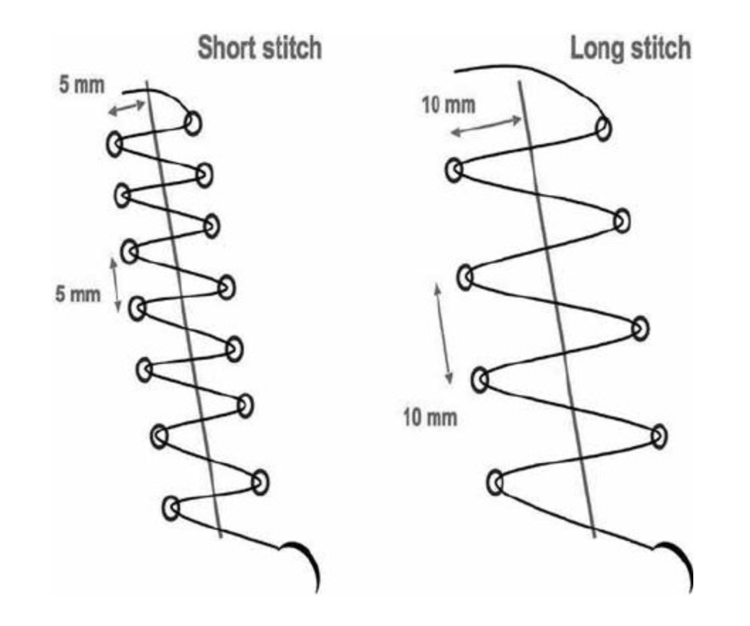
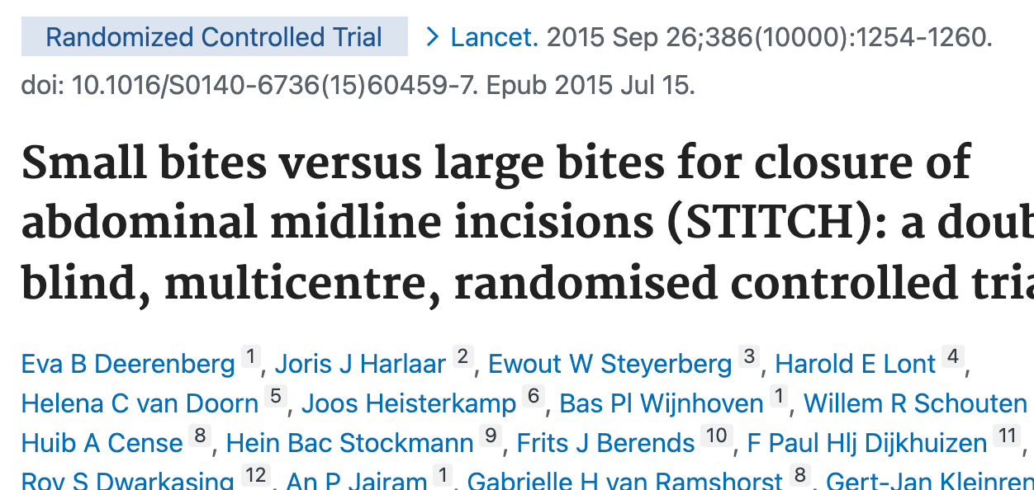
Incisional Hernia : prevention
RCT Multicenter 560 pa
IH 1 year
13 Vs 21%
Notes:
Thanks to the French national database, we can assess the real figures which are higher than expected.
The rate of IH repair after laparotomy for digestive surgery is 17%
Obesity is a major risk factor and the rate for obese patients is 31%
The occurrence time of the repair is mainly during the 1st 2 yearS
The rate of recurence that requires a second repair is 14% and raise to 19% in obese patients
With a huge medico economic impact
Therefor, we recommand to think about new preventive measures.
In addition to well known prehabilitation measures (stop smoking, reduce weight, prevent wound infection)
We may wonder about surgical features like small bites or preventive mesh in order to reduce these hernia and their consequences.
Etude Hollandaise Lancet 2015 Deerenberg 560 pa Random db Blind multicentrqiue laparo médiane
Suture points de 5mm / 5mm Versus 1 cm / 1 cm Suivi 1 an
Taux éventration 13% Vs 21%
Small bites suture technique or closure of abdominal wall

Slide 31
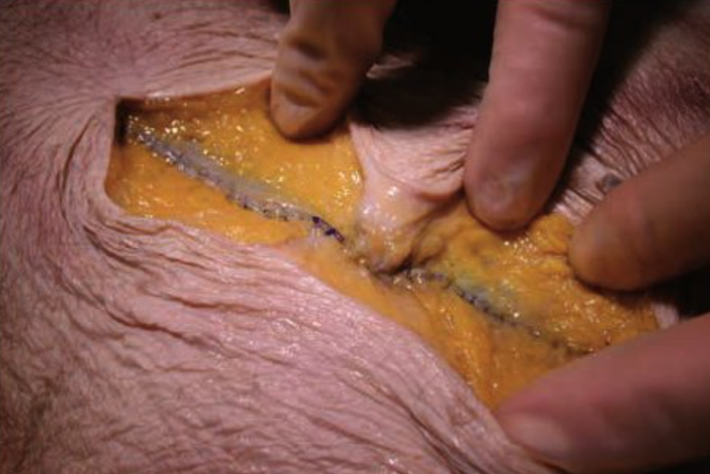
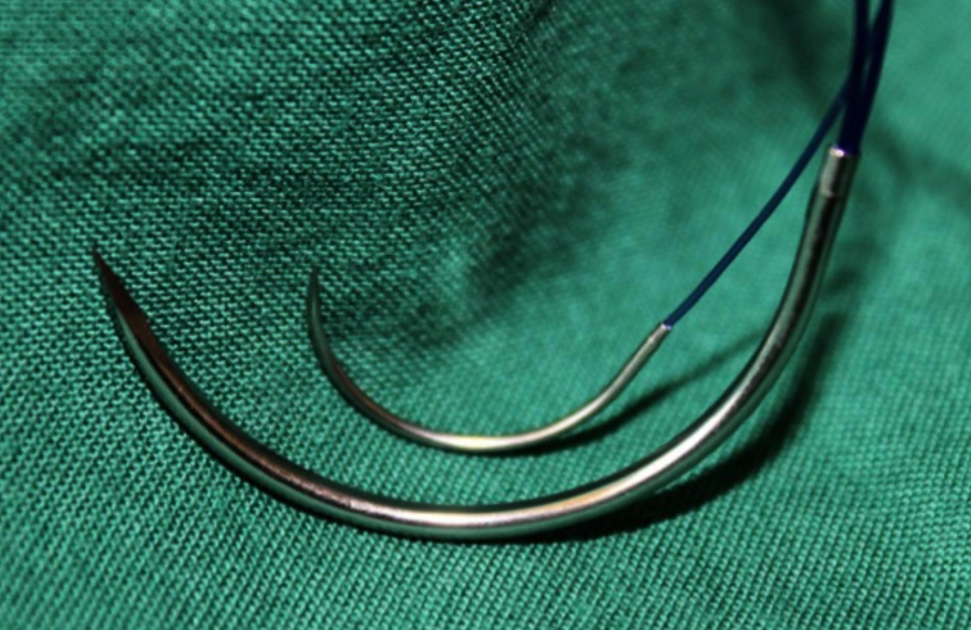
Incisional Hernia : prevention
Notes:
Thanks to the French national database, we can assess the real figures which are higher than expected.
The rate of IH repair after laparotomy for digestive surgery is 17%
Obesity is a major risk factor and the rate for obese patients is 31%
The occurrence time of the repair is mainly during the 1st 2 yearS
The rate of recurence that requires a second repair is 14% and raise to 19% in obese patients
With a huge medico economic impact
Therefor, we recommand to think about new preventive measures.
In addition to well known prehabilitation measures (stop smoking, reduce weight, prevent wound infection)
We may wonder about surgical features like small bites or preventive mesh in order to reduce these hernia and their consequences.
Etude Hollandaise Lancet 2015 Deerenberg 560 pa Random db Blind multicentrqiue laparo médiane
Suture points de 5mm / 5mm Versus 1 cm / 1 cm Suivi 1 an
Taux éventration 13% Vs 21%
Small bites suture technique or closure of abdominal wall

Slide 32
Incisional Hernia : prevention
Closure techniques 23 RCT
Slowly absorbable suture
small bites techniques
Reduce IH OR 0,41
Prophylactic mesh Vs suture closing 9 RCT
Reduce IH OR 0,14
Notes:
Thanks to the French national database, we can assess the real figures which are higher than expected.
The rate of IH repair after laparotomy for digestive surgery is 17%
Obesity is a major risk factor and the rate for obese patients is 31%
The occurrence time of the repair is mainly during the 1st 2 yearS
The rate of recurence that requires a second repair is 14% and raise to 19% in obese patients
With a huge medico economic impact
Therefor, we recommand to think about new preventive measures.
In addition to well known prehabilitation measures (stop smoking, reduce weight, prevent wound infection)
We may wonder about surgical features like small bites or preventive mesh in order to reduce these hernia and their consequences.
Etude Hollandaise Lancet 2015 Deerenberg 560 pa Random db Blind multicentrqiue laparo médiane
Suture points de 5mm / 5mm Versus 1 cm / 1 cm Suivi 1 an
Taux éventration 13% Vs 21%
Small bites suture technique or closure of abdominal wall

Slide 33
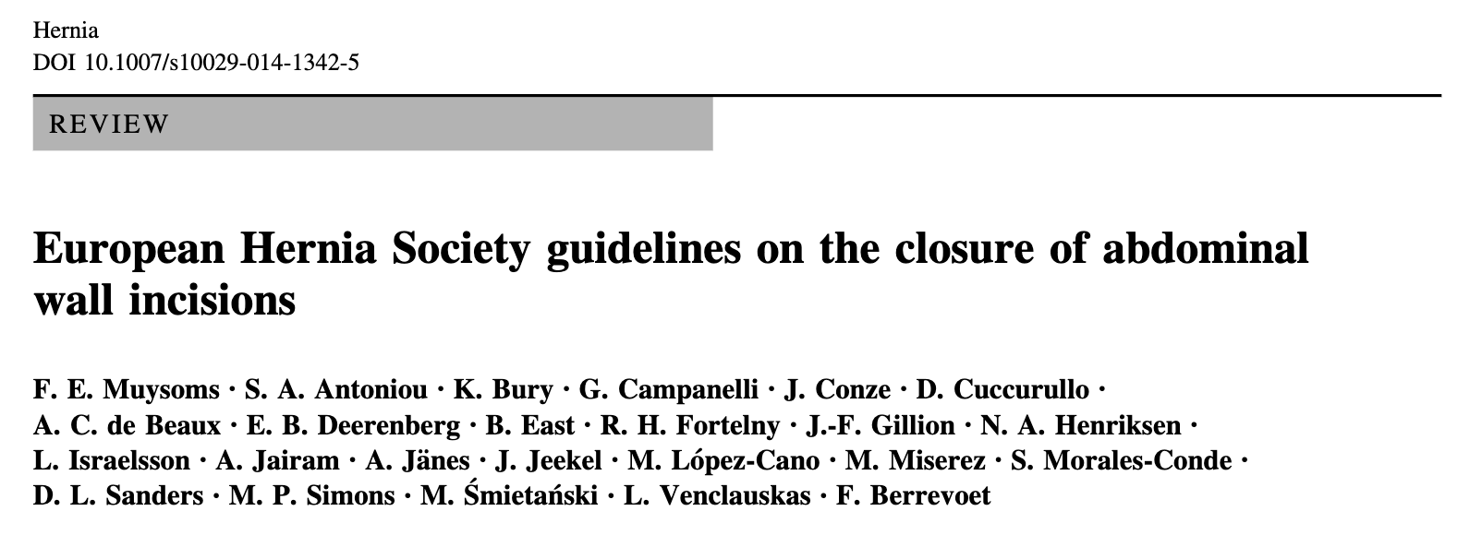
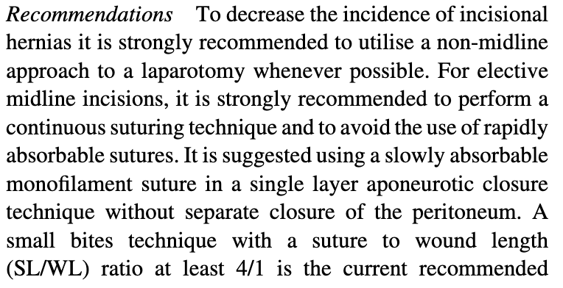
Incisional Hernia : prevention
Notes:
Thanks to the French national database, we can assess the real figures which are higher than expected.
The rate of IH repair after laparotomy for digestive surgery is 17%
Obesity is a major risk factor and the rate for obese patients is 31%
The occurrence time of the repair is mainly during the 1st 2 yearS
The rate of recurence that requires a second repair is 14% and raise to 19% in obese patients
With a huge medico economic impact
Therefor, we recommand to think about new preventive measures.
In addition to well known prehabilitation measures (stop smoking, reduce weight, prevent wound infection)
We may wonder about surgical features like small bites or preventive mesh in order to reduce these hernia and their consequences.
Etude Hollandaise Lancet 2015 Deerenberg 560 pa Random db Blind multicentrqiue laparo médiane
Suture points de 5mm / 5mm Versus 1 cm / 1 cm Suivi 1 an
Taux éventration 13% Vs 21%
Small bites suture technique or closure of abdominal wall

Slide 34
Incisional Hernia : prevention
Notes:
Thanks to the French national database, we can assess the real figures which are higher than expected.
The rate of IH repair after laparotomy for digestive surgery is 17%
Obesity is a major risk factor and the rate for obese patients is 31%
The occurrence time of the repair is mainly during the 1st 2 yearS
The rate of recurence that requires a second repair is 14% and raise to 19% in obese patients
With a huge medico economic impact
Therefor, we recommand to think about new preventive measures.
In addition to well known prehabilitation measures (stop smoking, reduce weight, prevent wound infection)
We may wonder about surgical features like small bites or preventive mesh in order to reduce these hernia and their consequences.
Etude Hollandaise Lancet 2015 Deerenberg 560 pa Random db Blind multicentrqiue laparo médiane
Suture points de 5mm / 5mm Versus 1 cm / 1 cm Suivi 1 an
Taux éventration 13% Vs 21%
Small bites suture technique or closure of abdominal wall

Slide 35
Incisional Hernia : tAKE HOME MESSAGES
Database : laparotomy for digestive surgery
Rate of incisional hernia repair is 17%
Notes:
Thanks to the French national database, we can assess the real figures which are higher than expected.
The rate of IH repair after laparotomy for digestive surgery is 17%
Obesity is a major risk factor and the rate for obese patients is 31%
The occurrence time of the repair is mainly during the 1st 2 yearS
The rate of recurence that requires a second repair is 14% and raise to 19% in obese patients
With a huge medico economic impact
Therefor, we recommand to think about new preventive measures.
In addition to well known prehabilitation measures (stop smoking, reduce weight, prevent wound infection)
We may wonder about surgical features like small bites or preventive mesh in order to reduce these hernia and their consequences.
Etude Hollandaise Lancet 2015 Deerenberg 560 pa Random db Blind multicentrqiue laparo médiane
Suture points de 5mm / 5mm Versus 1 cm / 1 cm Suivi 1 an
Taux éventration 13% Vs 21%
Small bites suture technique or closure of abdominal wall

Slide 36
Incisional Hernia : tAKE HOME MESSAGES
Database : laparotomy for digestive surgery
Rate of incisional hernia repair is 17% 31% in
Notes:
Thanks to the French national database, we can assess the real figures which are higher than expected.
The rate of IH repair after laparotomy for digestive surgery is 17%
Obesity is a major risk factor and the rate for obese patients is 31%
The occurrence time of the repair is mainly during the 1st 2 yearS
The rate of recurence that requires a second repair is 14% and raise to 19% in obese patients
With a huge medico economic impact
Therefor, we recommand to think about new preventive measures.
In addition to well known prehabilitation measures (stop smoking, reduce weight, prevent wound infection)
We may wonder about surgical features like small bites or preventive mesh in order to reduce these hernia and their consequences.
Etude Hollandaise Lancet 2015 Deerenberg 560 pa Random db Blind multicentrqiue laparo médiane
Suture points de 5mm / 5mm Versus 1 cm / 1 cm Suivi 1 an
Taux éventration 13% Vs 21%
Small bites suture technique or closure of abdominal wall

Slide 37
Incisional Hernia : tAKE HOME MESSAGES
Database : laparotomy for digestive surgery
Rate of incisional hernia repair is 17% 31% in
Occurrence time of IHR for high-risk laparotomies is
56% in year 1
79% in 2 1st years
Notes:
Thanks to the French national database, we can assess the real figures which are higher than expected.
The rate of IH repair after laparotomy for digestive surgery is 17%
Obesity is a major risk factor and the rate for obese patients is 31%
The occurrence time of the repair is mainly during the 1st 2 yearS
The rate of recurence that requires a second repair is 14% and raise to 19% in obese patients
With a huge medico economic impact
Therefor, we recommand to think about new preventive measures.
In addition to well known prehabilitation measures (stop smoking, reduce weight, prevent wound infection)
We may wonder about surgical features like small bites or preventive mesh in order to reduce these hernia and their consequences.
Etude Hollandaise Lancet 2015 Deerenberg 560 pa Random db Blind multicentrqiue laparo médiane
Suture points de 5mm / 5mm Versus 1 cm / 1 cm Suivi 1 an
Taux éventration 13% Vs 21%
Small bites suture technique or closure of abdominal wall

Slide 38
Incisional Hernia : tAKE HOME MESSAGES
Database : laparotomy for digestive surgery
Rate of incisional hernia repair is 17% 31% in
Occurrence time of IHR for high-risk laparotomies is
56% in year 1
79% in 2 1st years
Recurrence rate after repair of IH is 14% 19% in Medico-economic impact ++
Notes:
Thanks to the French national database, we can assess the real figures which are higher than expected.
The rate of IH repair after laparotomy for digestive surgery is 17%
Obesity is a major risk factor and the rate for obese patients is 31%
The occurrence time of the repair is mainly during the 1st 2 yearS
The rate of recurence that requires a second repair is 14% and raise to 19% in obese patients
With a huge medico economic impact
Therefor, we recommand to think about new preventive measures.
In addition to well known prehabilitation measures (stop smoking, reduce weight, prevent wound infection)
We may wonder about surgical features like small bites or preventive mesh in order to reduce these hernia and their consequences.
Etude Hollandaise Lancet 2015 Deerenberg 560 pa Random db Blind multicentrqiue laparo médiane
Suture points de 5mm / 5mm Versus 1 cm / 1 cm Suivi 1 an
Taux éventration 13% Vs 21%
Small bites suture technique or closure of abdominal wall

Slide 39
Incisional Hernia : tAKE HOME MESSAGES
Database : laparotomy for digestive surgery
Rate of incisional hernia repair is 17% 31% in
Occurrence time of IHR for high-risk laparotomies is
56% in year 1
79% in 2 1st years
Recurrence rate after repair of IH is 14% 19% in Medico-economic impact ++
New preventive measures : small bites closure
preventive mesh (High risk patient)
Notes:
Thanks to the French national database, we can assess the real figures which are higher than expected.
The rate of IH repair after laparotomy for digestive surgery is 17%
Obesity is a major risk factor and the rate for obese patients is 31%
The occurrence time of the repair is mainly during the 1st 2 yearS
The rate of recurence that requires a second repair is 14% and raise to 19% in obese patients
With a huge medico economic impact
Therefor, we recommand to think about new preventive measures.
In addition to well known prehabilitation measures (stop smoking, reduce weight, prevent wound infection)
We may wonder about surgical features like small bites or preventive mesh in order to reduce these hernia and their consequences.
Etude Hollandaise Lancet 2015 Deerenberg 560 pa Random db Blind multicentrqiue laparo médiane
https://www.thelancet.com/article/S0140-6736(15)60459-7/fulltext
Suture points de 5mm / 5mm Versus 1 cm / 1 cm Suivi 1 an
Taux éventration 13% Vs 21%
Small bites suture technique or closure of abdominal wall

