Slide 1
Prevention of incisional hernia after single incision laparoscopic sleeve gastrectomy
MESH
Dr Hadrien Tranchart
Department of Minimally Invasive Digestive Surgery
Antoine Béclère Hospital, Clamart

Slide 2
Nothing to disclose

Slide 3
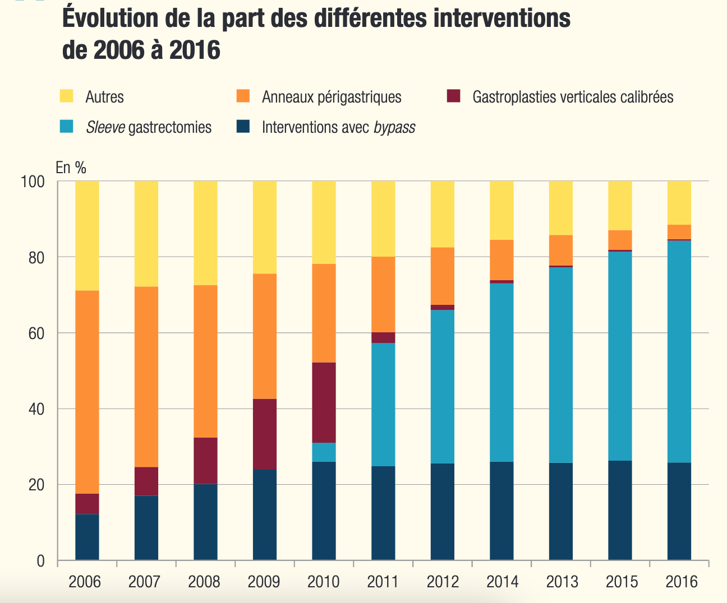
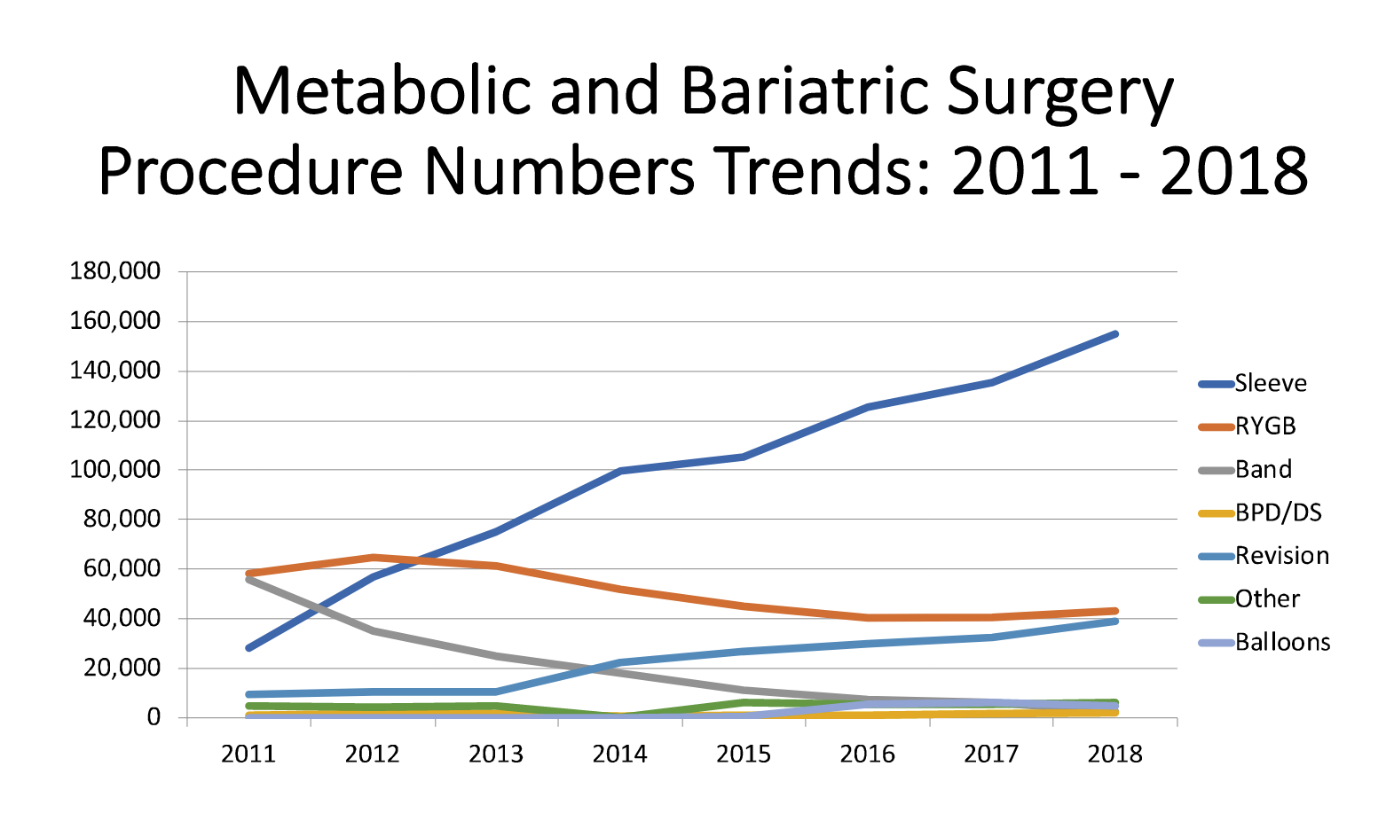
Sleeve gastrectomy: most frequently performed bariatric procedure
Other
Band
Vertical banded gastroplasty
Procedure numbers
Sleeve
Bypass
%
Sleeve
RYGB
Band
ASMBS
English WJ. SOARD 2020

Slide 4
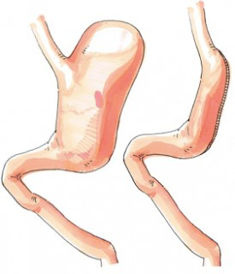
Sleeve gastrectomy
Relatively simple procedure (60 min)
Maintains intestinal continuity
Good weight loss and comorbidities resolution
(comparable to RYGBP)
Low morbidity (≈9%) (inferior to RYGBP, OR = 0.5 )
SM-BOSS trial Perteli R. JAMA 2018
SLEEVEPASS trial Salminen P. JAMA. 2018
Yang P. SOARD 2019
Incisional hernia rate?

Slide 5
Bariatric surgery and incisional hernia risk
Move, there's nothing to see!
23 articles
Owens M. Surgeon 2011
« The lowest incidence of port site herniation was for bariatric surgery with 0.57% while the highest was for laparoscopic colorectal surgery with an incidence of 1.47% »

Slide 6
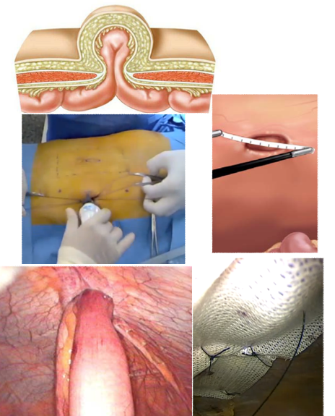
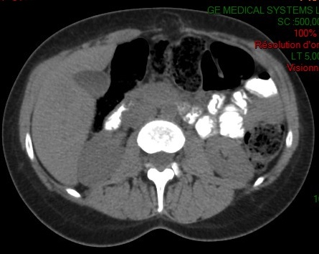
Incisional hernia definition?
Surgery
Physical examination
Imaging

Slide 7
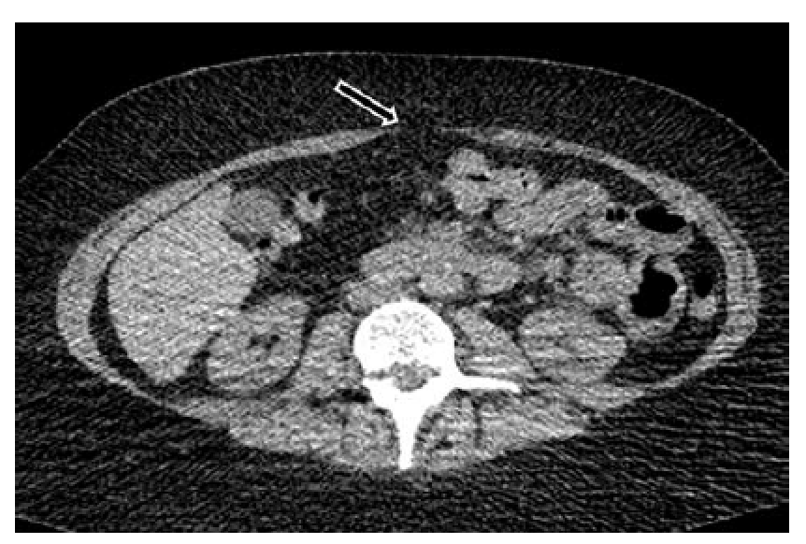
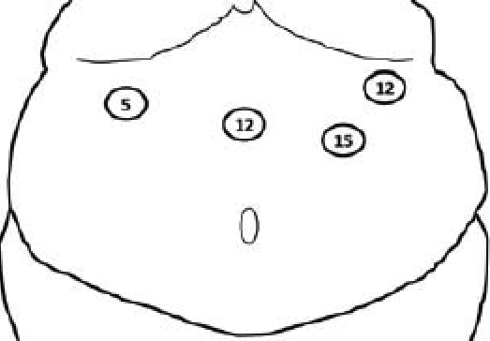
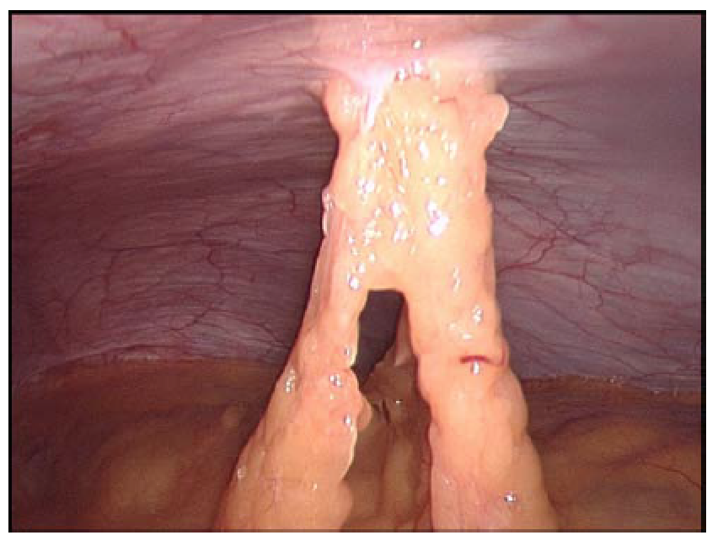
43 hernias (18.8%)
5 symptomatic
38 asymptomatic
16.6%
Rebibo L. SOARD 2015

Slide 8
Studies specifically dedicated
Imaging (CT scan / ultrasound)
Pooled incidence of 24.5%
Karampinis I. Obes Surg 2019
365 Bypass/Sleeve
All trocars ≥ 12mm closed
Systematic parietal ultrasound
(9 months after surgery)
Incidence of 37%
Karampinis I. Obes Surg 2020

Slide 9
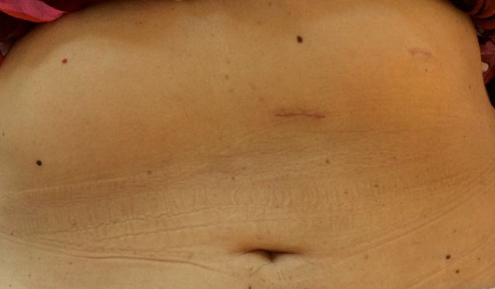
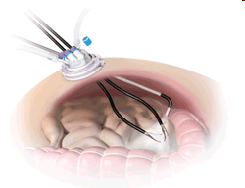
Single-port sleeve gastrectomy
Applicability
One abdominal quadrant / Limited movements
Requires specimen extraction
Potential advantages
Better cosmetic result
Less postoperative pain?
Shorter hospital stay?
Faster return to normal activity?
Criticisms
Complexity of triangulation / Difficult exposure
Suboptimal sleeve construction?
Incisional hernia ?

Slide 10
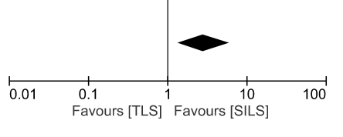
Single-port surgery and incisional hernia risk
Well demonstrated in the literature
OR = 2.83
Connel MB. Hernia 2019
But…
Most included studies (64%) concerned cholecystectomies…
All included studies concerned umbilical single-port surgery…
Connel MB. Hernia 2019

Slide 11
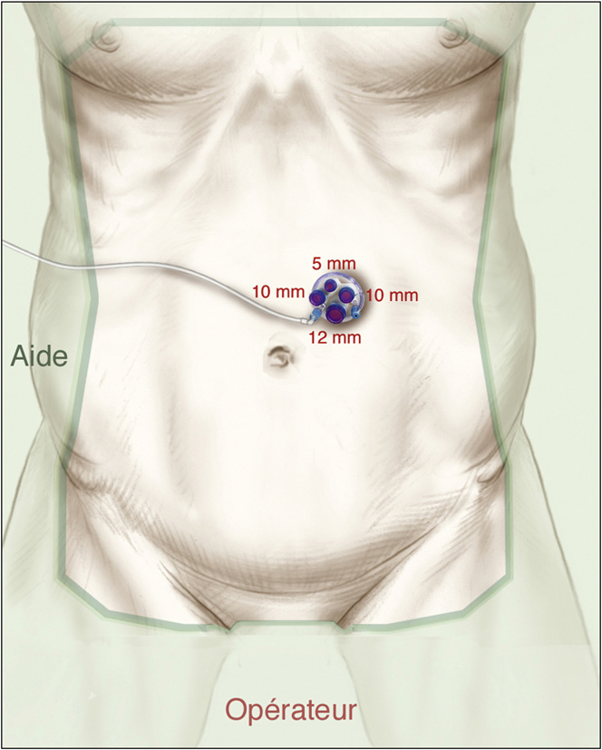
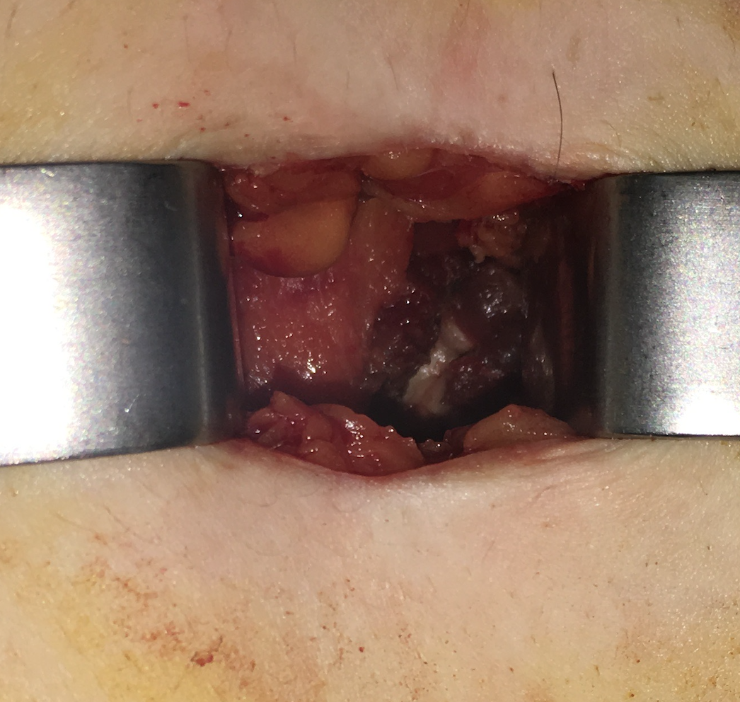
SPSG: Antoine Béclère experience
A standardized and reproducible technique (more than 3000 procedures)
Both rectus muscle aponeuroses closure
Flexible tip laparoscope
Double-curved grasper
Left hypochondrium
Lainas P. Obes Surg 2021
Tranchart H. Surg Endosc 2020
Gaillard M. SOARD 2016
Pourcher G. J Visc Surg 2012

Slide 12
SPSG: Antoine Béclère experience
Systematic CT-scan without contrast injection performed in all patients one year after surgery
Research of any abdominal wall gap with or without bulge in the area of a postoperative scar
184 hernias / 1000 patients (18.4%)
Pooled incidence of 24.5%
Karampinis I. Obes Surg 2019

Slide 13
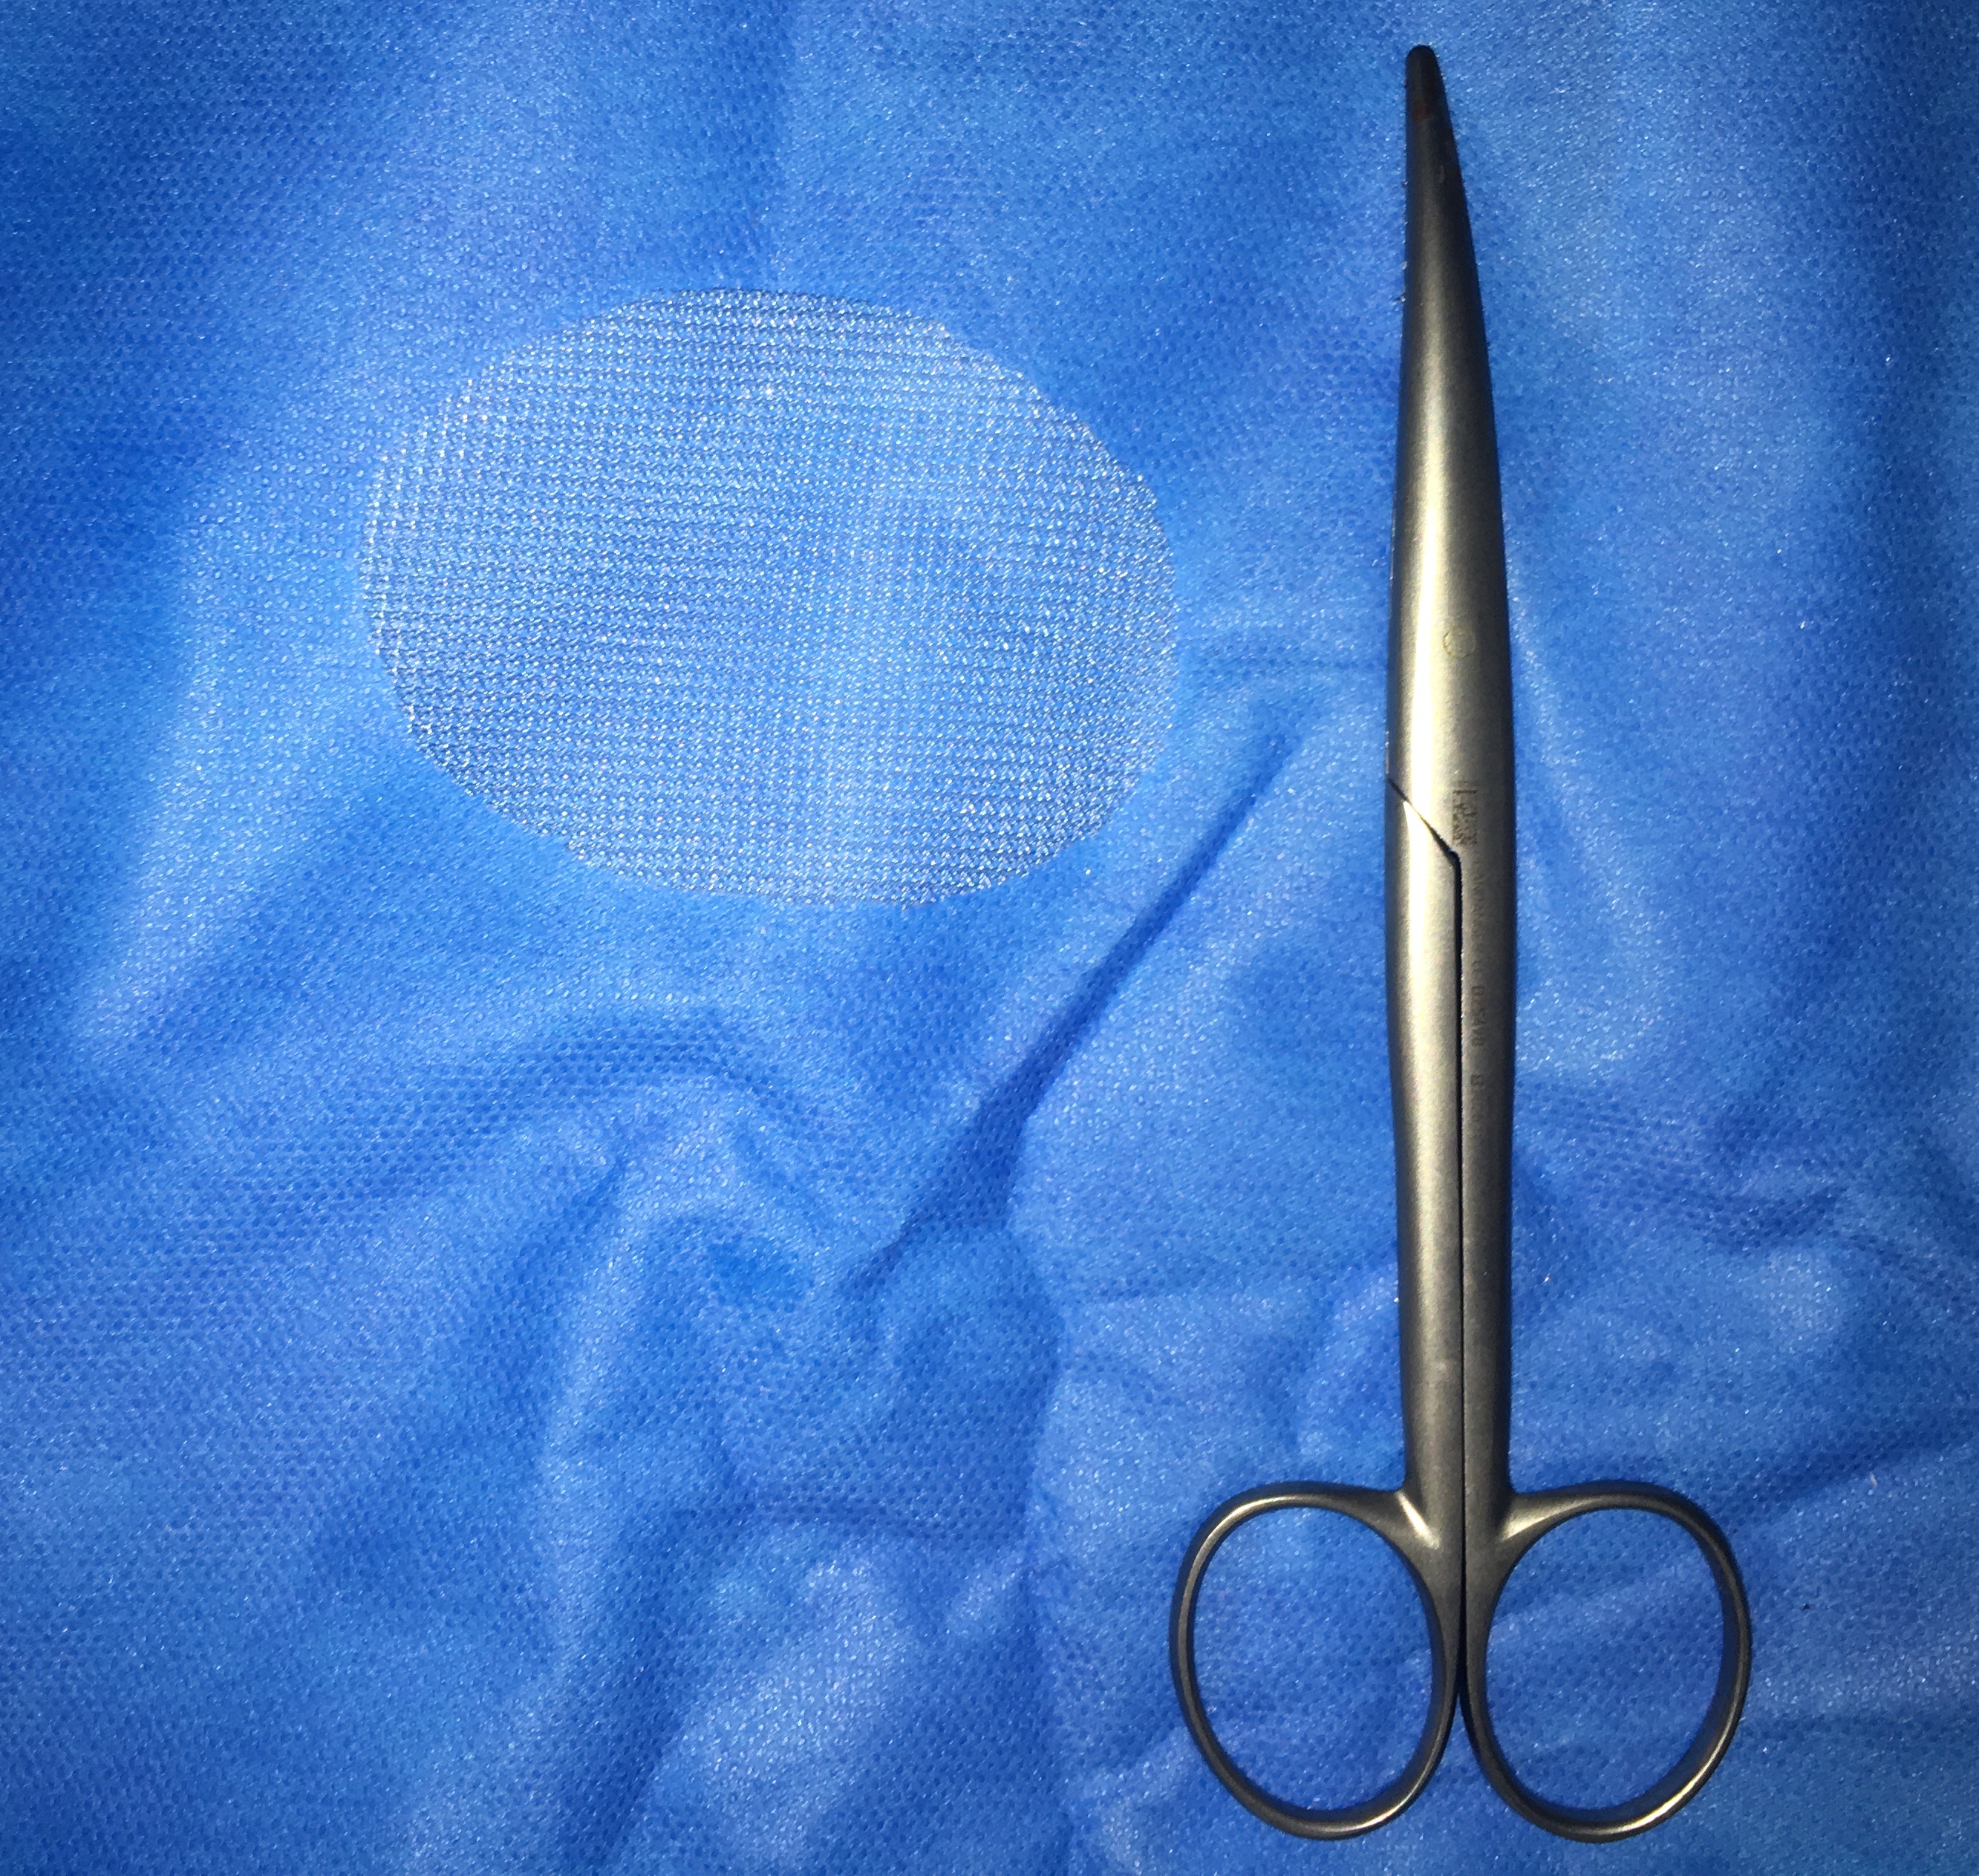
SPSG: Prevention of incisional hernia
Prophylactic mesh placement during parietal closure
Closure of rectus muscle posterior aponeurosis
Retromuscular mesh patch (6x3 cm), no fixation
1,5-cm overlap

Slide 14
SPSG: Prevention of incisional hernia
Prospective comparative cohort study
PRISM (ISRCTN 52462725)
SPSG in high-risk patients
Suture without mesh
Suture with permanent mesh (polypropylene) placement
Suture with absorbable biosynthetic mesh (BioA, Gore) placement
Tranchart H. In press

Slide 15
PRISM
Inclusion criteria | Exclusion criteria
High-risk patients (BMI ≥ 45 kg/m²) Sleeve gastrectomy as a primary bariatric procedure Age at least 18 years | Previous upper abdominal surgery (laparoscopic cholecystectomy excepted) Guardianship and trusteeship Known allergy to mesh component
Primary outcome: occurrence of incisional hernia during one year of follow-up, assessed by imaging with or without clinical suspicion
Secondary endpoints: operative duration, intraoperative difficulties, hospital stay, morbidity...
Tranchart H. In press

Slide 16
PRISM
Inclusion phase: November 2018-November 2019
No mesh technique
n = 85
Permanent mesh technique
n = 85
Absorbable mesh technique
n = 85
Follow-up at 1 year after surgery n = 255
Clinical evaluation
CT-scan
Tranchart H. In press

Slide 17
Baseline Characteristics of Patients
Characteristic | No mesh (n = 85) | Permanent mesh (n = 85) | Absorbable mesh (n = 85) | P
Gender (female/male) | 73/12 | 57/28 | 70/15 | 0.006
Age, y, median (IQR) | 39 (27-46) | 45 (27-51) | 39 (30-51) | 0.297
BMI, kg/m², median (IQR) | 49 (47-52) | 48 (46-53) | 50 (46-60) | 0.609
Co-morbidities
Diabetes, n (%) | 16 (19) | 17 (20) | 27 (32) | 0.089
Hypertension, n (%) | 29 (34) | 33 (39) | 23 (27) | 0.261
Dyslipidemia, n (%) | 9 (11) | 13 (15) | 16 (19) | 0.318
OSAS, n (%) | 53 (62) | 54 (63) | 50 (59) | 0.806
Anti-platelet/-coagulant TTT, n (%) | 3 (3) | 9 (11) | 4 (5) | 0.126
Tobacco use, n (%) | 9 (11) | 2 (2) | 2 (2) | 0.018
Tranchart H. In press

Slide 18
Operative and Postoperative Outcomes of Patients
Characteristic | No mesh (n = 85) | Permanent mesh (n = 85) | Absorbable mesh (n = 85) | P
Operative time, min, median (IQR) | 70 (64-95) | 81 (75-110) | 85 (72-107) | 0.045
90-day postop complications, n (%) | 6 (7) | 4 (5) | 11 (13) | 0.132
Bleeding, n (%) | 0 | 0 | 0 | -
Staple-line leak, n (%) | 3 (3) | 0 | 1 (1) | -
Surgical site infection | 0 | 0 | 1 (1) | -
Parietal hematoma/seroma | 0 | 1 (1) | 0 | -
Length of stay, day, median (IQR) | 3 (2-3) | 3 (3-3) | 3 (3-3) | 0.427
Pain medication > 6 w, n (%) | 0 | 0 | 0 | -
Incisional hernia, n (%) | 17 (20) | 6 (7) | 5 (6) | 0.005
Clinical discovery, n (%) | 0 | 1 (1) | 1 (1) | -
CT-scan discovery, n (%) | 17 (20) | 5 (6) | 4 (5) | -
Return free phys act ≤ 12 w, n (%) | 85 (100) | 83 (98) | 83 (98) | 0.362
Tranchart H. In press

Slide 19
Multivariate analysis on the main independent risk factors for incisional hernia
Factor | Odd ratio | 95%IC | P
Male | 8.695 | [0.831-5.464] | 0.115
Tobacco use | 2.985 | [0.118-2.066] | 0.335
Absence of mesh placement | 3.802 | [1.633-8.849] | 0.002
Tranchart H. In press

Slide 20
Conclusions
The prophylactic placement of a retromuscular mesh patch significantly decreased the rate of incisional hernia during SPSG.
Mesh placement was always easily performed, only requiring approximately 10 minutes longer operative duration.
The use of the mesh did not increase postoperative morbidity.
Absorbable mesh doesn’t seem to be superior to permanent mesh (low contaminated surgery with removal of a stapled gastric specimen through a wound protection, very low rate of SSI).

Slide 21
Prevention of incisional hernia after single incision laparoscopic sleeve gastrectomy
MESH
Dr Hadrien Tranchart
Department of Minimally Invasive Digestive Surgery
Antoine Béclère Hospital, Clamart

