Slide 1
Rives-stoppa (retro-rectus) Mesh Repair
A Systematic Review and Meta-Analysis
Floris P.J. den Hartog, MD & Dimitri Sneiders, MD, PhD, et al.
REsearch Projects for Abdominal surgery Innovation Rotterdam (REPAIR) group
ErasmusMC, University Medical Center, Rotterdam, The Netherlands
Notes:
Introduction (FR?)

Slide 2
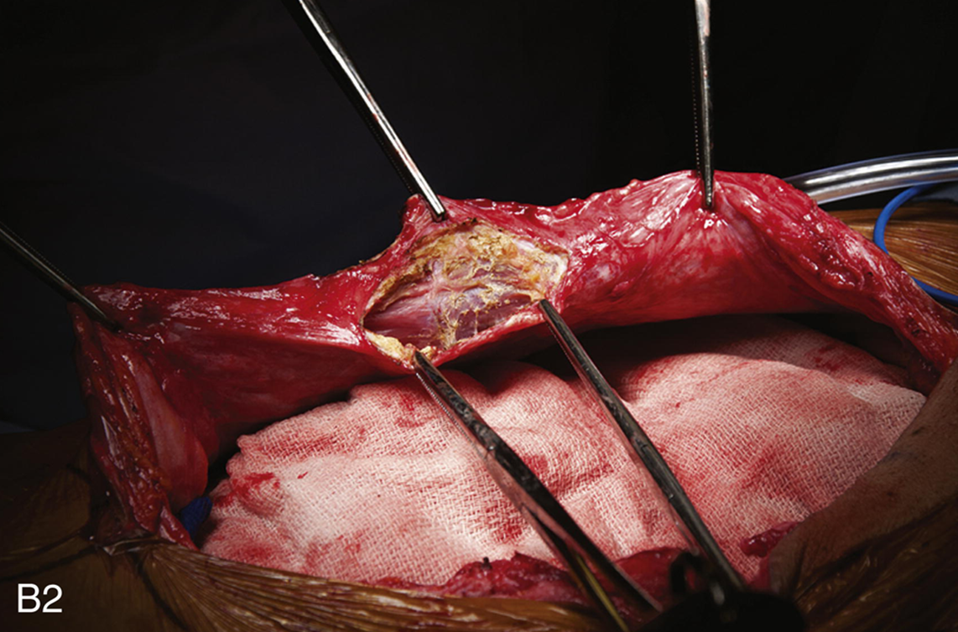

Background
Notes:
Jean Rives and Rene Stoppa
No extensive technique description, familiar
Considered gold-standard (FOR non-complex medium-sized ventral abdominal wall hernia)

Slide 3
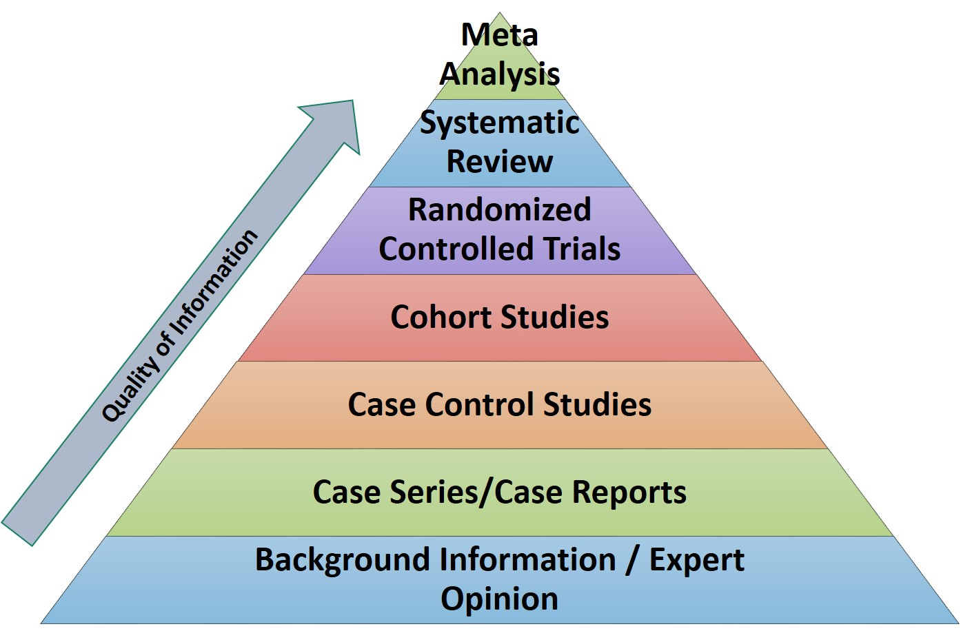
background
Notes:
Lots of publications (rct, cohorts); highest level of evidence is of course meta-analysis

Slide 4

Objective
1. Outcomes
Recurrence
Surgical site infection
Seroma
Serious complications (C-D > 3)
Mortality

Slide 5
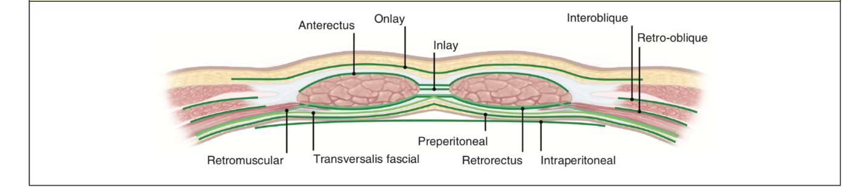
Objective
2. Compare techniques

Slide 6

Literature search
Including
Result (3335 abstracts)
RCT
Prospective cohort
Retrospective cohort
Retro-rectus described
Open & min. invasive
15
36
42
Total: 93

Slide 7

results
Baseline
Demographics
18,572 patients
Male 1 : 3 female
Median defect 7.2 cm
Median follow-up 17 months

Slide 8
Results
1. Outcomes
Retro-rectus (Rives-Stoppa) repair
 | Open | Patients
Recurrence 12 months | 3.2% | 10,787
Recurrence 24 months | 4.1% | 3,770
SSI | 5.2% | 7,030
Seroma | 5.5% | 10,695
Serious complications | 2.7% | 4,844
Mortality | 0.2% | 3,650
Notes:
Based on all study types combined
Pooled hernia recurrence was estimated at
after minimally 12 months 3.2% [95% confidence interval (CI): 2.2%–4.2%,
after minimally 24 months 4.1%, (95%CI: 2.9%–5.5%
SSI 5.2% (95%CI: 4.2%–6.4%,
Seroma 5.5% (95%CI: 4.4%–6.8%

Slide 9
Results
1. Outcomes
Retro-rectus (Rives-Stoppa) repair
 | Open | Patients | Min. invasive* | Patients
Recurrence 12 months | 3.2% | 10,787 | 1.3% | 849
Recurrence 24 months | 4.1% | 3,770
SSI | 5.2% | 7,030 | 1.5% | 982
Seroma | 5.5% | 10,695 | 5.0% | 1,269
Serious complications | 2.7% | 4,844 | 2.9% | 1,366
Mortality | 0.2% | 3,650
*: non-RCT
Notes:
Based on all study types combined
Min invasive retro-rectus had lower quality studies
Pooled hernia recurrence was estimated at
after minimally 12 months 3.2% [95% CI: 2.2%–4.2%,
after minimally 24 months 4.1%, (95%CI: 2.9%–5.5%
SSI 5.2% (95%CI: 4.2%–6.4%,
Seroma 5.5% (95%CI: 4.4%–6.8%

Slide 10
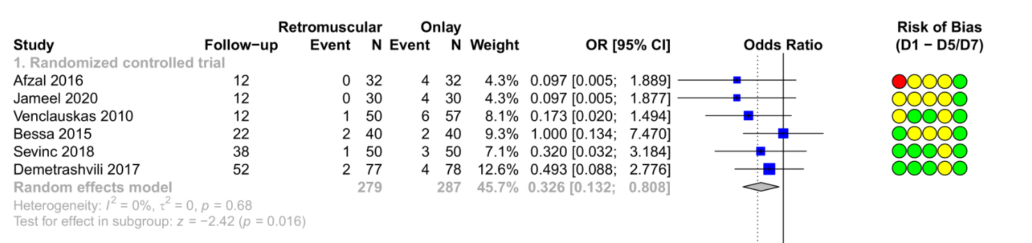
results
2. Compare techniques – Recurrence
Retro-rectus versus onlay
RCTs OR 0.33 566 patients
→ 3.0x higher risk for recurrence with onlay
Notes:
(All studies OR 0.27 = 3.6x 1,217 patients)

Slide 11
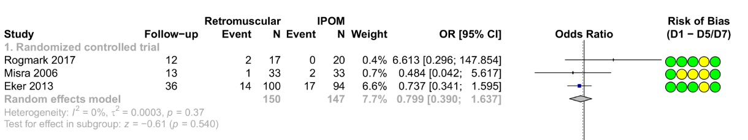
results
2. Compare techniques – Recurrence
Retro-rectus versus IPOM
RCTs Not significant 297 patients
→ no difference in recurrence
Notes:
Regardless of study types used
All studies Not significant 9,186 patients

Slide 12
Results
2. Compare techniques – Complications (all study types)
Retro-rectus (odds ratios)
 | Versus onlay | Patients
SSI | 0.40 | 1,632
Seroma | 0.36 | 1,592
Favouring retro-rectus

Slide 13
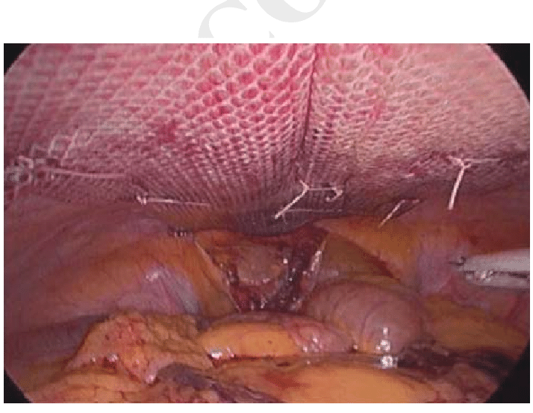
Results
2. Compare techniques – Complications (all study types)
Retro-rectus (odds ratios)
 | Versus onlay | Patients | Versus IPOM | Patients
SSI | 0.40 | 1,632 | 1.8 | 8,216
Seroma | 0.36 | 1,592 | 0.9* | 9,680
Favouring retro-rectus Favouring IPOM
*: not significant

Slide 14
limitations
Methodological concerns of included studies
Underestimated recurrence rate: rarely used ultrasonography/CT-scan
No functional outcomes (pain, QoL, cosmesis)

Slide 15
conclusions
Retro-rectus (Rives-Stoppa) repair
Favourable postoperative and long-term outcomes
Superior to onlay regarding all outcomes
Equal to IPOM, except SSI → minimally-invasive
Initial open repair: retro-rectus (Rives-Stoppa) repair

Slide 16
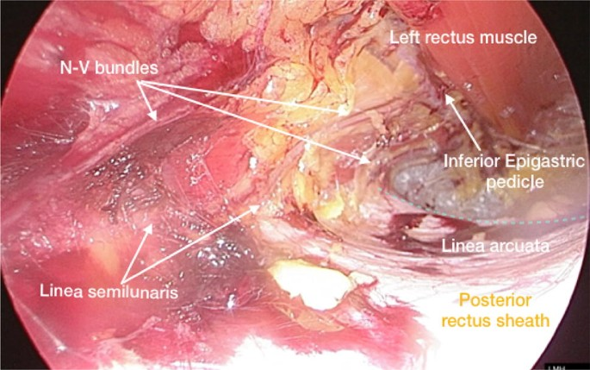
Future?

Slide 17
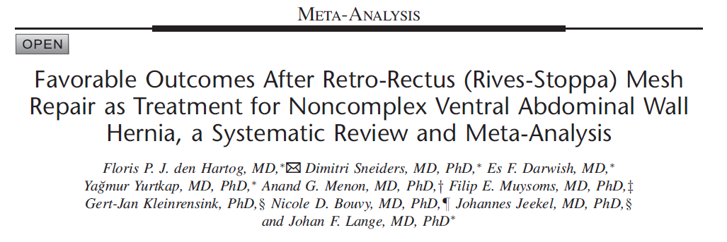
Acknowledgements

Slide 18

Merci à tous
pour votre attention
Contact information
Floris P.J. den Hartog, MD
Institution ErasmusMC University Hospital, Rotterdam, The Netherlands
E-mail f.denhartog@erasmusmc.nl
ORCiD

Slide 20
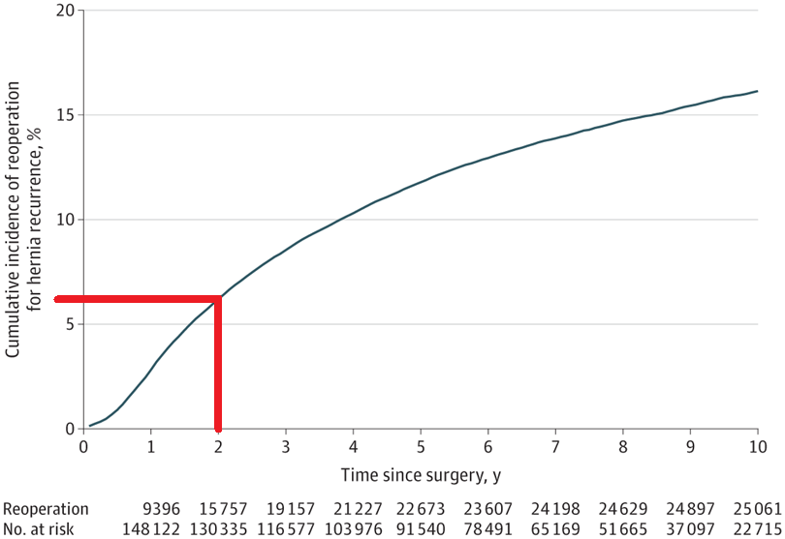
Howard et al. Jama 2022
16%
~6%
2 years

