Slide 1




When and why considering a component separation and which one ?
pablo.ortega-deballon@chu-dijon.fr

Slide 2
Disclosures
Beckton-Dickinson/Bard
Covidien/Medtronic

Slide 3
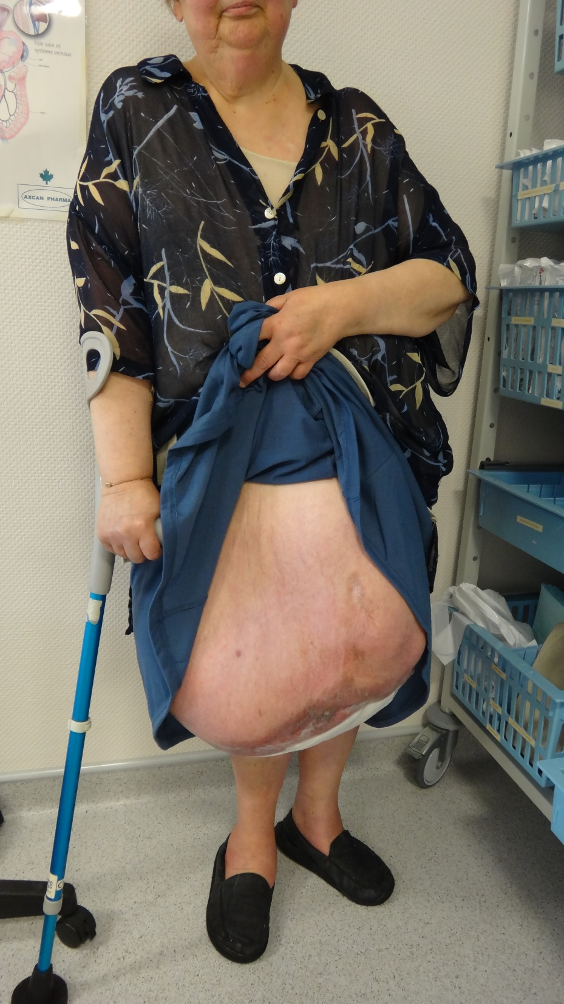
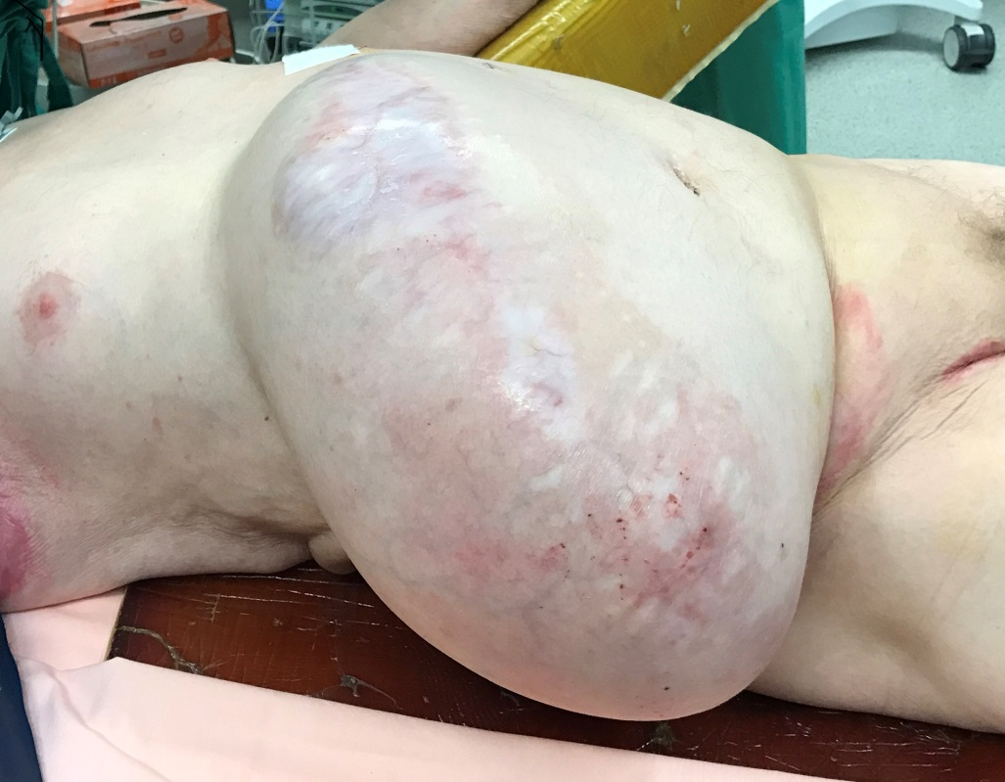
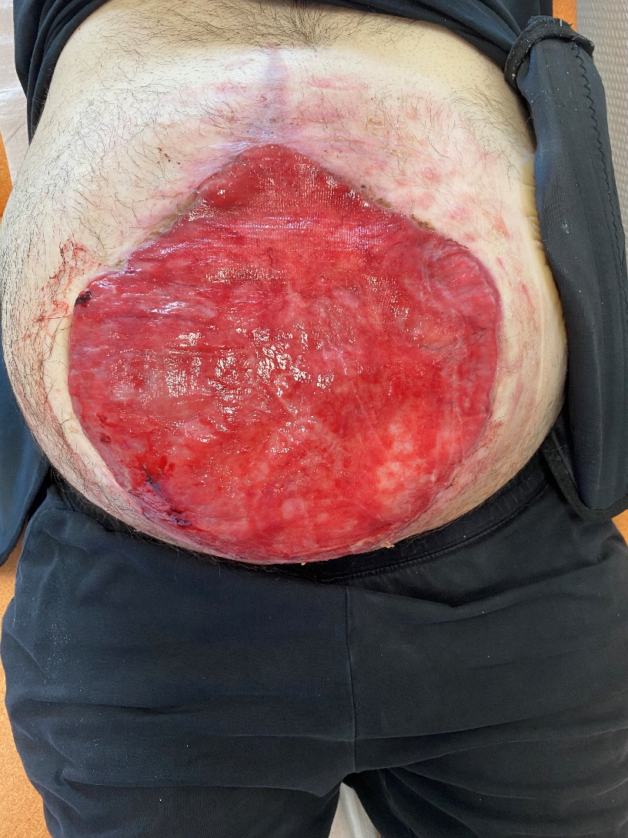
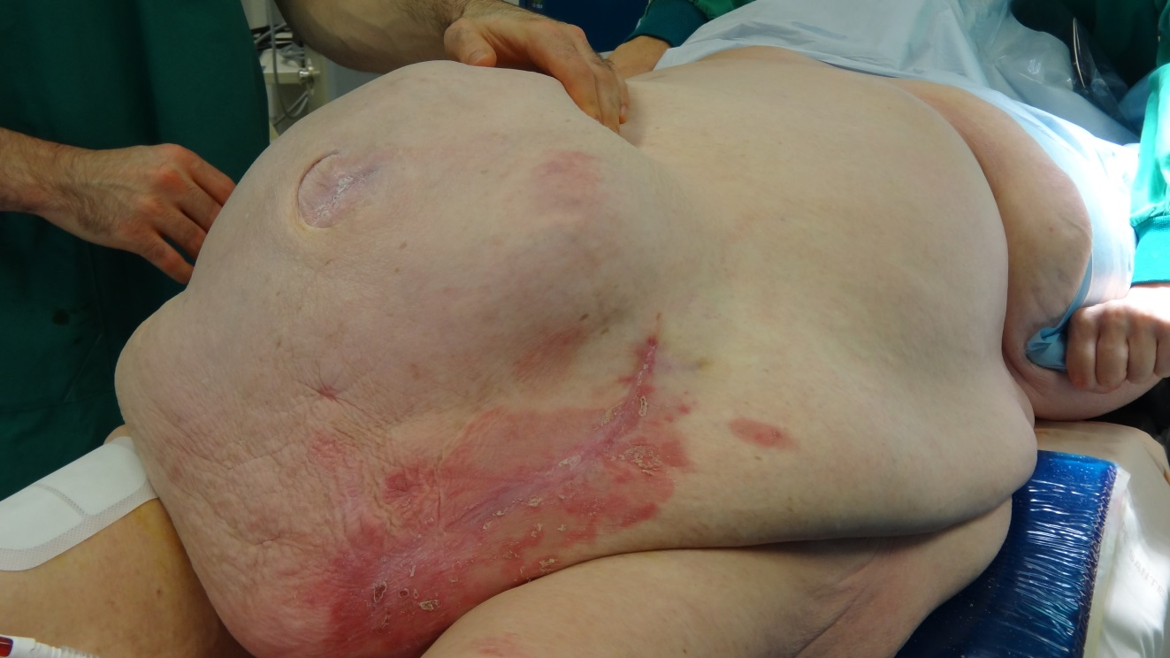
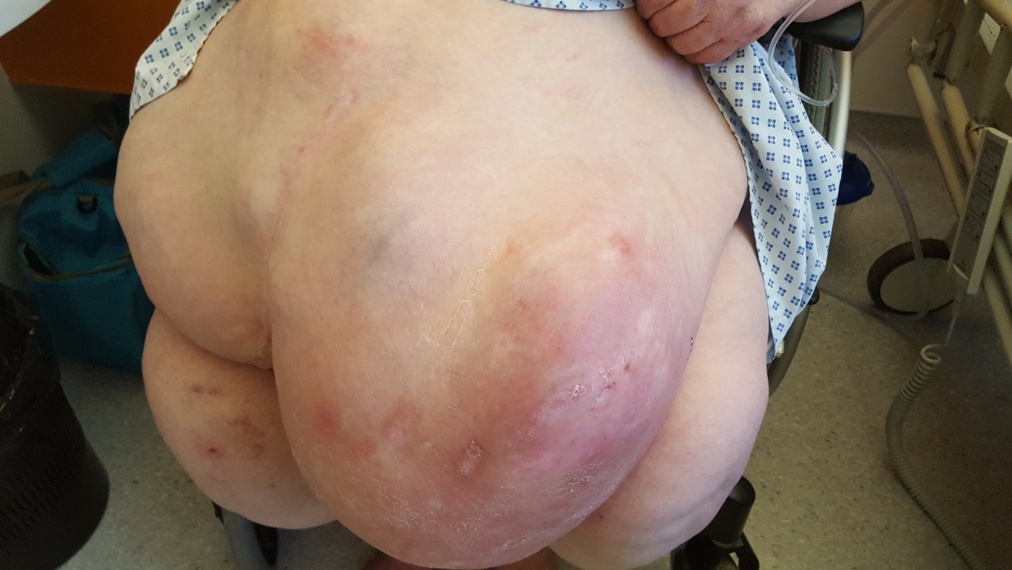
1

Slide 4
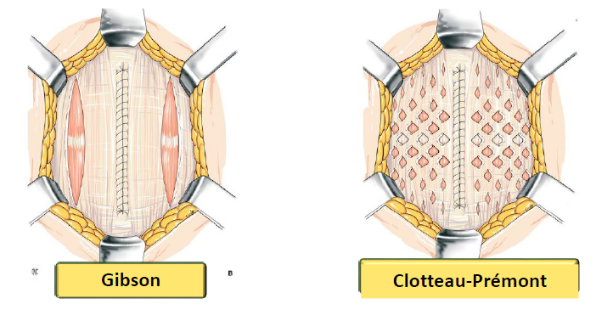
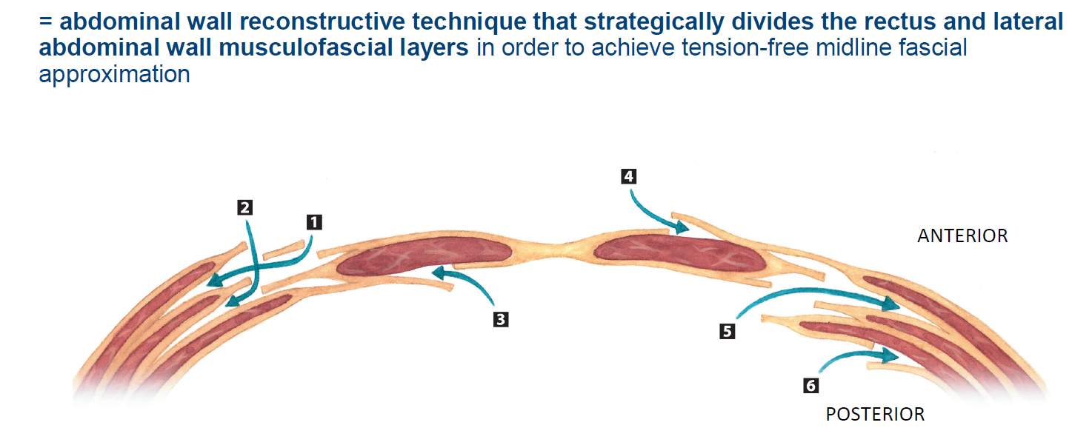
CST: What’s that?

Slide 5
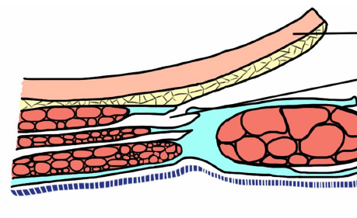
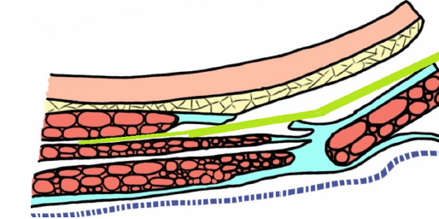
Anterior CST (Ramirez)

Slide 6
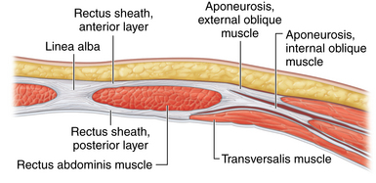
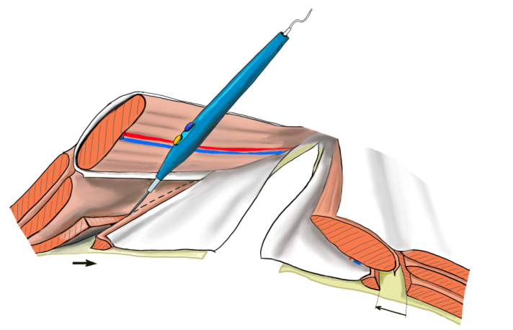
Posterior CST (Transversus Abdominis Release)

Slide 7
Techniques

Slide 8


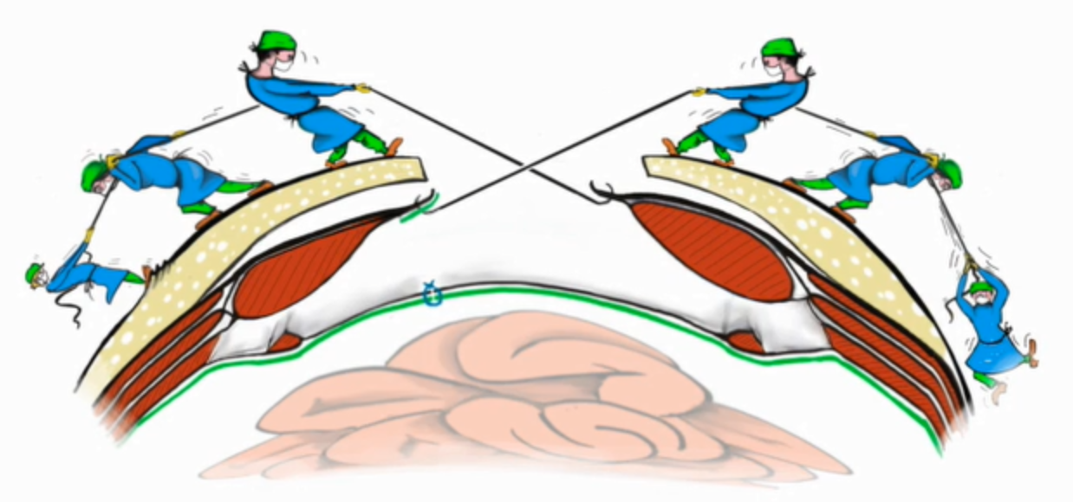
Why?
Thanks to Pr Romain, Strasbourg

Slide 9

Midline closure… without abdominal compartment syndrome!
Preoperative
Intraoperative
Botulinum toxin
Progressive pneumoperitoneum (Goñi-Moreno)
CST
  Anterior (Ramirez)
  Posterior (TAR)
Peritoneal flap
Staged-closure + NWPT
Fasciotens®

Slide 10
Hernia 2020; 24: 333-340

Slide 11
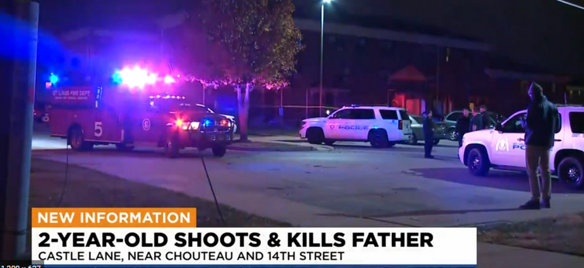


Slide 12
Which one? My practice
Avoid (prevent) CST as much as possible: Botox, Goñi-Moreno, peritoneal flap
Difficulties in the posterior plane and willing to avoid the peritoneal flap TAR
Difficulties in the anterior midline closure RAMIREZ
No experience with Fasciotens
Staged-closure + NPWT only as rescue surgery

Slide 13
Conclusions
CST are measured injuries to the abdominal-wall
Used whenever strictly necessary
In order to close the midline
Both (ant & post) CST are effective
Particularly in open surgery
Need to be compared to other preop and intraop strategies

