Slide 1
﻿Quality management, patient expectations and perspectives, acceptance for the surgeon
Gabriel Paiva de Oliveira, MD
General Surgeon - Portugal

Slide 2
Works in
Experience
Hospital Garcia de Orta,
Almada - Portugal
Clinical Audit Comitte
2022
Email Address:
gp.oliveira@outlook.com
2014
Physician Attending (since 2014)
2007
Residency in General Surgery
Gabriel Paiva de Oliveira
Department of Surgery of Hospital Garcia de Orta
2005
Medical Officer in Portuguese Navy
Education
From 2005 to 2014
General Surgeon
42 years old.
Lives with Cristiana Gonçalves, a gynecologist and breast surgeon.
Has a 5 year old son, Miguel and a 11 month old very loud baby called Diana.
Practices Shorinji Kempo and scuba diving
Post Graduation in Management of Healthcare Institutions
Skills
2021
2014
Specialist in General Surgery
30%
30%
2005
Graduated in Medicine
Faculty of Medicine – Lisbon University
Upper GI
Abdominal Wall
Emergency
Notes:
I’d like to thank the organization, in particular to Dr. Marc Soler and Dr. Jean-François Gillion for the invitation to be here. It is truly na honour. I am a general surgeon from a médium resource country and I work in a médium resource institution. I dedicate myself to upper GI surgery, abdominal Wall surgery and emergency care. All I want is to provide the best quality care to my patients

Slide 3
Works in
Experience
Argentina
Clinical Audit Comitte
2022
2014
Physician Attending
2007
Residency in General Surgery
XXXXXXX
General Surgeon
Education
YY years old.
Lives with ZZZZZZZZZZ.
Post Graduation in Management of Healthcare Institutions
Skills
2021
2014
Specialist in General Surgery
30%
30%
2005
Graduated in Medicine
Faculty of Medicine – Lisbon University
Upper GI
Abdominal Wall
Emergency
Notes:
. Many of you are not that diferente from me, you have two or three áreas of interest, you perform emergency dutty and you have resource limitations. But I’m betting you all can relate with this desire. Actually, I bet all surgeons across the globe can relate to that goal.

Slide 4
Works in
Experience
Guinea Bissau
Clinical Audit Comitte
2022
2014
Physician Attending
2007
Residency in General Surgery
XXXXXXX
General Surgeon
Education
YY years old.
Lives with ZZZZZZZZZZ.
Post Graduation in Management of Healthcare Institutions
Skills
2021
2014
Specialist in General Surgery
30%
30%
2005
Graduated in Medicine
Faculty of Medicine – Lisbon University
Upper GI
Abdominal Wall
Emergency
Notes:
. Many of you are not that diferente from me, and you all can relate with this desire. Actually, I bet all surgeons across the globe can relate to that goal.

Slide 5
Works in
Experience
Phillipines
Clinical Audit Comitte
2022
2014
Physician Attending
2007
Residency in General Surgery
XXXXXXX
General Surgeon
Education
YY years old.
Lives with ZZZZZZZZZZ.
Post Graduation in Management of Healthcare Institutions
Skills
2021
2014
Specialist in General Surgery
30%
30%
2005
Graduated in Medicine
Faculty of Medicine – Lisbon University
Upper GI
Abdominal Wall
Emergency
Notes:
. Many of you are not that diferente from me, and you all can relate with this desire. Actually, I bet all surgeons across the globe can relate to that goal.

Slide 6
Works in
Experience
World!!!
Clinical Audit Comitte
2022
2014
Physician Attending
2007
Residency in General Surgery
XXXXXXX
General Surgeon
Education
YY years old.
Lives with ZZZZZZZZZZ.
Post Graduation in Management of Healthcare Institutions
Skills
2021
2014
Specialist in General Surgery
30%
30%
2005
Graduated in Medicine
Faculty of Medicine – Lisbon University
Upper GI
Abdominal Wall
Emergency
Notes:
. Many of you are not that diferente from me, and you all can relate with this desire. Actually, I bet all surgeons across the globe can relate to that goal.

Slide 8
﻿”Everyone is in favour of quality as desideratum and most recognize it when they see it; however, defining it especially in healthcare is much more difficult.”
Kapoor, P. (2011). Why quality in healthcare. Medical Journal Armed Forces India, 67(3), 206–208. https://doi.org/10.1016/S0377-1237(11)60040-3

Slide 9
Quality… what’s that again?
﻿High-quality health services involve the right care, at the right time, responding to the service users’ needs and preferences, while minimizing harm and resource waste.
World Health Organization, World Bank Group, & OECD. (2018). Delivering Quality Health Services: A Global Imperative for Universal Health Coverage. Geneva: World Health Organization.
https://doi.org/10.1596/978-92-4-151390-6

Slide 10
Quality… what’s that again?
﻿Right Care
Needs and preferences
Minimizing harm and resource waste
﻿Effectiveness
People-centredness
﻿Equity
Timeliness
Efficiency
Integration of care
﻿Safety
World Health Organization, World Bank Group, & OECD. (2018). Delivering Quality Health Services: A Global Imperative for Universal Health Coverage. Geneva: World Health Organization.
https://doi.org/10.1596/978-92-4-151390-6

Slide 11
How does this relate to hernia surgery, particularly inguinal hernia repair?

Slide 12
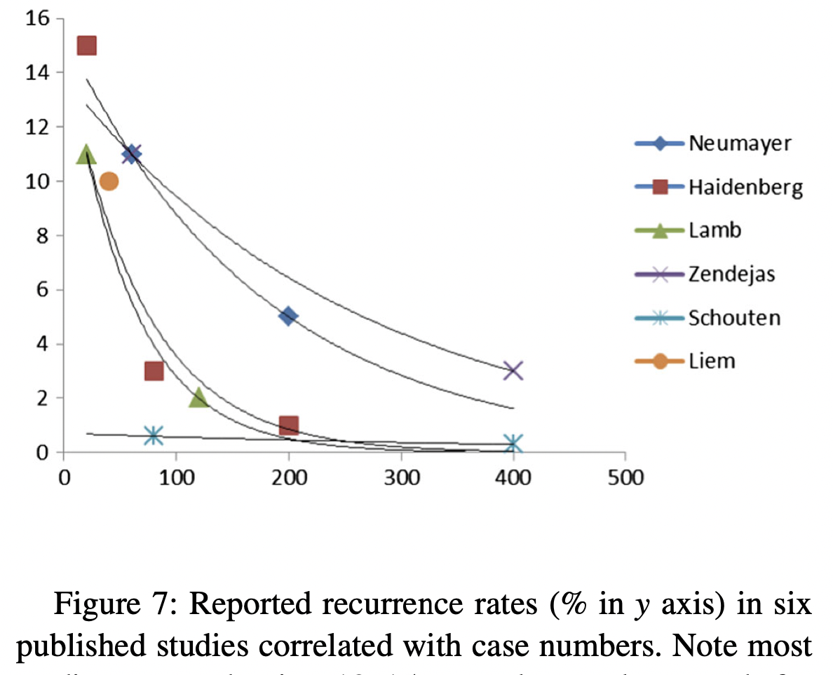
Right Care
Laparo-endoscopic techniques demonstrated better results concerning pain, return to normal activities and cost-effectiveness, but…How well does that apply to my context?
Learning curve
Complications / Recurrence
(The HerniaSurge Group, 2018)

Slide 13
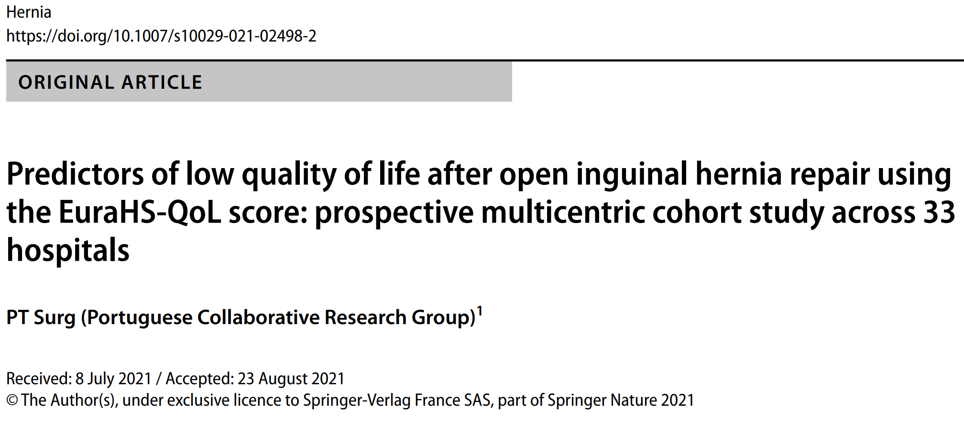
Right Care
15 000 procedures
1% recurrence
Low chronic pain and sexual dysfunction
33 public hospitals, 14 days period, 893 consecutive patient sample
> 90% open mesh (52% Lichtenstein and 38% plug & mesh)

Slide 14
Right Care
9 goals scored out of 12 expected
?
https://one-versus-one.com/pt/jogadores/cristiano-ronaldo

Slide 15
Patient’s need and preferences
“Medical professionals deal mainly with individuals. Public health officials deal with populations. Both groups are valued for their expertise in their fields. Neither has been trained to involve their respective subjects in decisions about the solution to the problem.”
Rifkin, S. B. (2020). Paradigms, policies and people: The future of primary health care. BMJ
Global Health, 5(2), e002254.
https://doi.org/10.1136/bmjgh-2019-002254
Notes:
We don’t (really) know what are patient’s views on hernia surgery
We know even less of people’s views on that matter

Slide 16
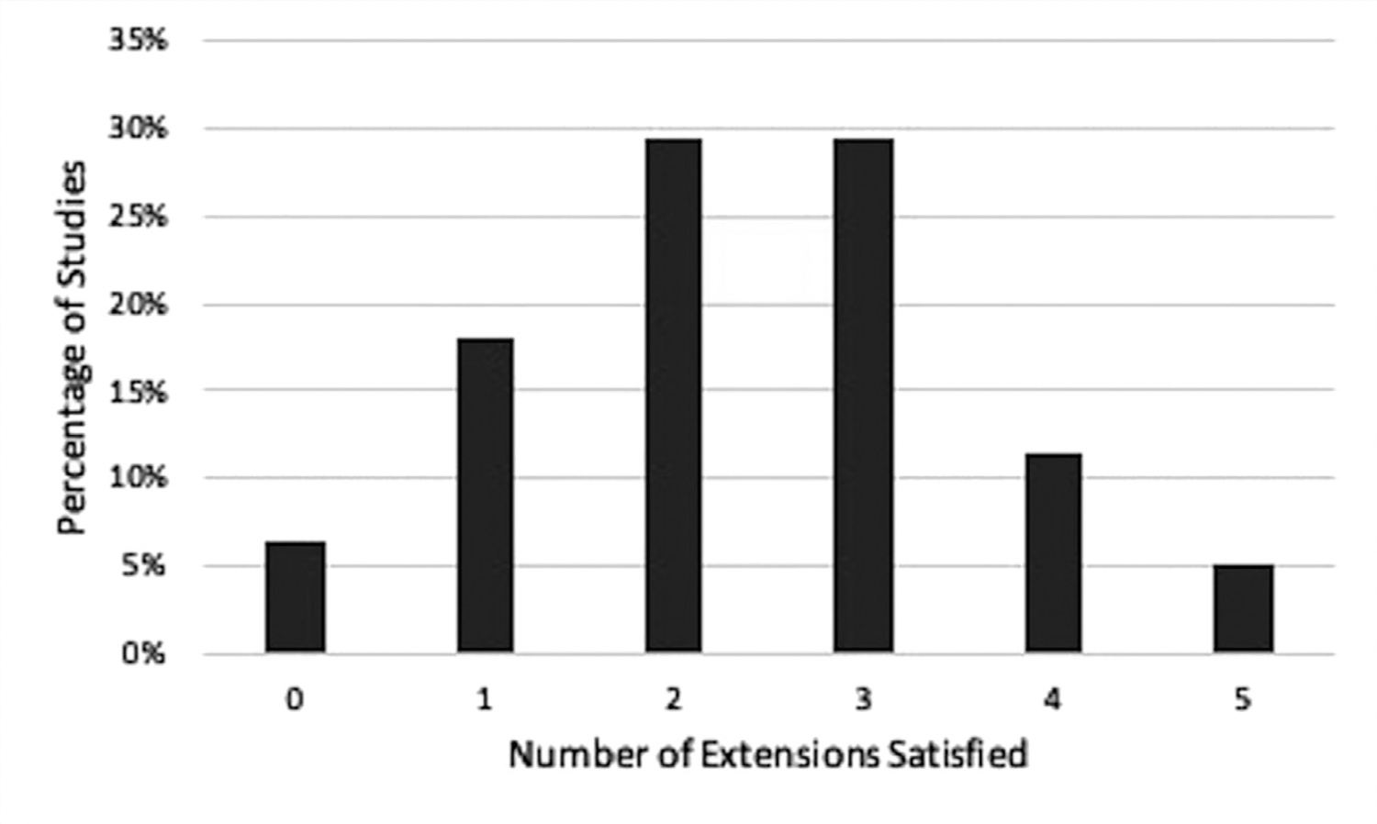
Patient’s need and preferences
PROMs – Patient-Reported Outcome Measures
CONSORT PRO (2013)
Poor adherence to PROM reporting guidelines
Wilcox, A. R., Trooboff, S. W., & Wong, S. L. (2019). Evaluating Patient-Reported Outcomes in Inguinal Hernia Clinical Trials. Journal of Surgical Research, 244, 430–435.
https://doi.org/10.1016/j.jss.2019.06.055
Notes:
In response to the growing concern about ﻿importance in evaluating results, and quote, “that matter to patients in addition to other measured outcomes such as laboratory values and indications of disease recurrence”...
I﻿n 2013, CONSORT (Consolidated Standards of Reporting Trials) added 5 guidelines for reporting PROs in randomized controlled trials, the PRO extensions. Adherence to the extensions among inguinal hérnia trials is unknown.
PRO extension #1 The PRO should be identified in the abstract as a primary or secondary outcome
PRO extension #2 The PRO hypothesis should be stated and relevant domains identified
PRO extension #3 Evidence of PRO instrument validity and reliability should be provided or cited
PRO extension #4 Statistical approaches for dealing with missing data should be explicitly stated for PROs prespecified as primary or important secondary outcomes PRO extension #5 PRO-specific limitations and implications for generalizability of study findings and clinical practice
PROMs - ”still only ask questions to patients that the doctor wants to be answered”

Slide 17
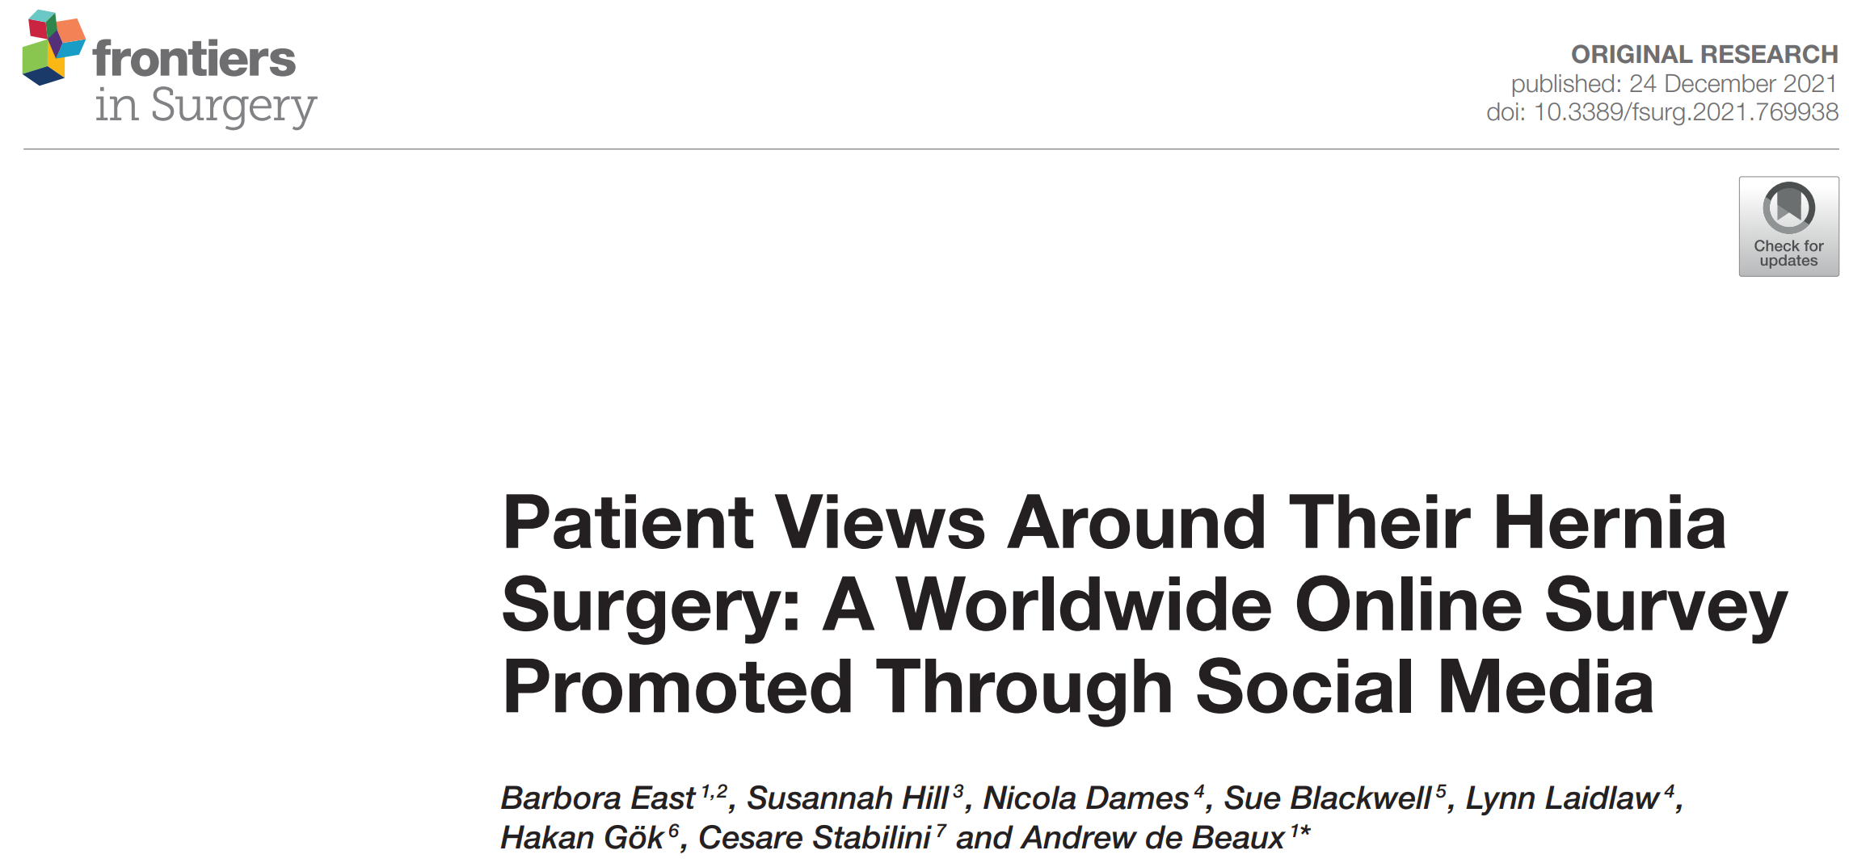
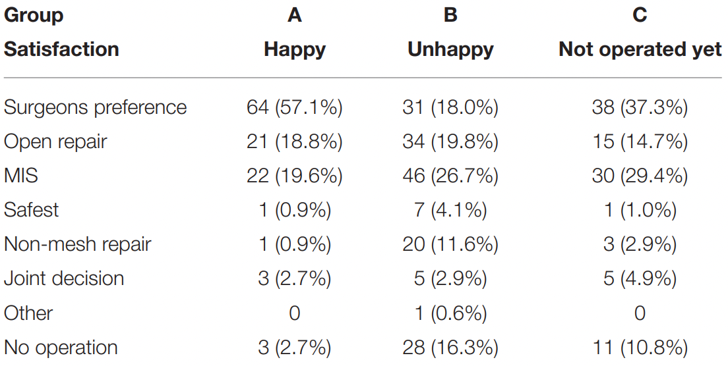
Patient’s need and preferences
Need for an improved surgeon – patient communication throughout the entirety of the process
East, B., Hill, S., Dames, N., Blackwell, S., Laidlaw, L., Gök, H., Stabilini, C., & de Beaux, A. (2021). Patient Views Around Their Hernia Surgery: A Worldwide Online Survey Promoted Through Social Media. Frontiers in Surgery, 8, 769938. https://doi.org/10.3389/fsurg.2021.769938
Notes:
﻿Such questions may not reflect the priorities of the patient, or indeed address elements of the patient experience or barriers to their treatment or what best leads to satisfying outcomes.

Slide 18
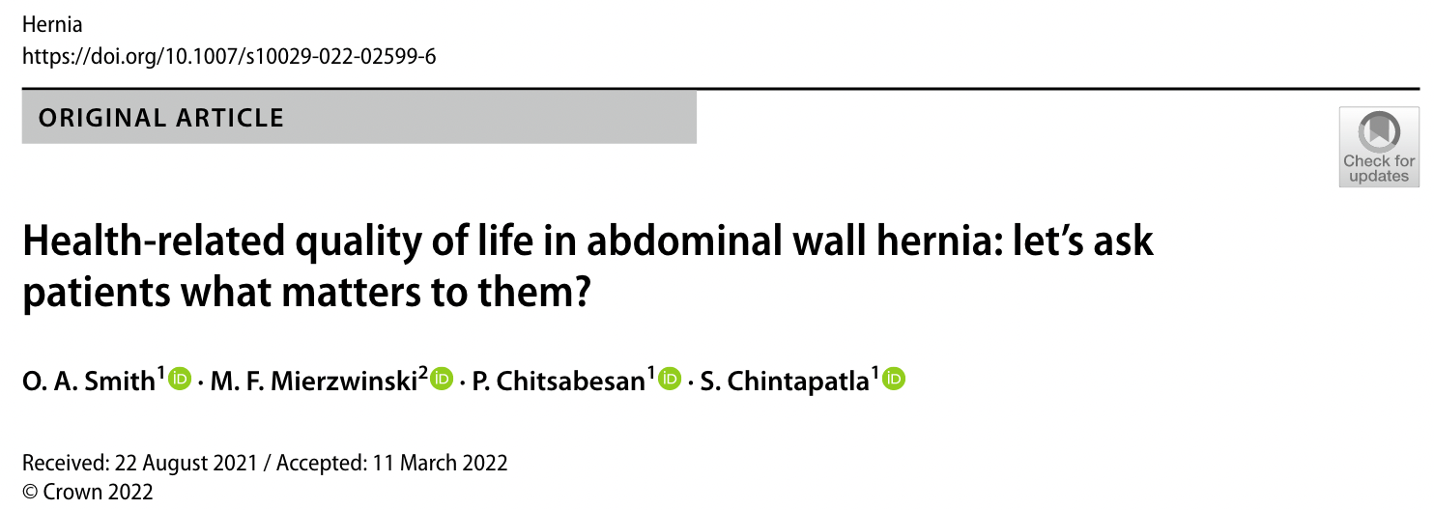
Patient’s need and preferences
Smith, O. A., Mierzwinski, M. F., Chitsabesan, P., & Chintapatla, S. (2022). Health-related quality of life in abdominal wall hernia: Let’s ask patients what matters to them? Hernia. https://doi.org/10.1007/s10029-022-02599-6
Notes:
﻿Such questions may not reflect the priorities of the patient, or indeed address elements of the patient experience or barriers to their treatment or what best leads to satisfying outcomes.

Slide 19
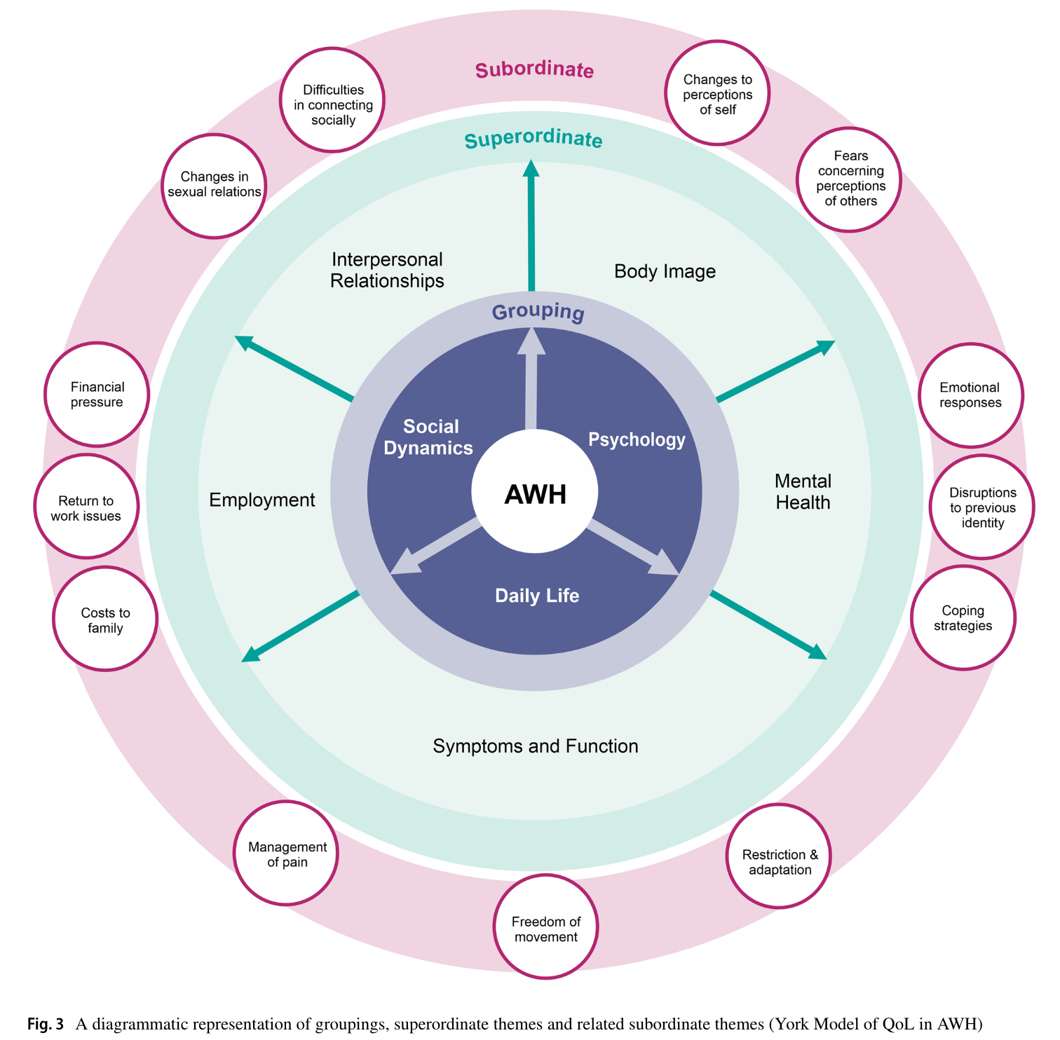
Patient’s need and preferences
“This demonstrates that, if as a society, we want to understand how disease processes affect QoL and how interventions can change this, it would need to invest more time and effort into both identifying what makes up QoL for patients and how it is possible to investigate such a complex non-linear interrelated set of issues.”
Smith, O. A., Mierzwinski, M. F., Chitsabesan, P., & Chintapatla, S. (2022). Health-related quality of life in abdominal wall hernia: Let’s ask patients what matters to them? Hernia. https://doi.org/10.1007/s10029-022-02599-6
Notes:
﻿Such questions may not reflect the priorities of the patient, or indeed address elements of the patient experience or barriers to their treatment or what best leads to satisfying outcomes.

Slide 20
Patient’s need and preferences
Expectations matter!
“psychological factors could indeed make surgeries more effective”
Auer, C. J., Glombiewski, J. A., Doering, B. K., Winkler, A., Laferton, J. A. C., Broadbent, E., & Rief, W. (2016). Patients’ Expectations Predict Surgery Outcomes: A Meta-Analysis. International Journal of Behavioral Medicine, 23(1), 49–62. https://doi.org/10.1007/s12529-015-9500-4​
Notes:
It seems like it’s not the perfect experience that increases satisfaction, but the fulllfilment of whatever expectations were created. So, we might improve patient satisfaction more by addressing education and preparation and managing expectations, rather than embarking on a resource scattering rampage, trying to reduce .5% of some outcome (not PROM).

Slide 21
Equity
Ahmed, N., Marriott, A., Dabi, N., Lowthers, M., Lawson, M., & Mugehera, L. (2022). Inequality Kills: The unparalleled action needed to combat unprecedented inequality in the wake of COVID-19. Oxfam. https://doi.org/10.21201/2022.8465

Slide 22
“(…) inequality negatively impacts on almost all aspects of human life, and on all hope for human progress.”
Ahmed, N., Marriott, A., Dabi, N., Lowthers, M., Lawson, M., & Mugehera, L. (2022). Inequality Kills: The unparalleled action needed to combat unprecedented inequality in the wake of COVID-19. Oxfam. https://doi.org/10.21201/2022.8465

Slide 23
Environmental impact and sustainability
Notes:
“Health care facilities represent a significant source of pollution around the world and contribute to environmental changes.”
“In addition, the sheer amount of, and overall toxicity of, medical waste has increased in recent decades. Certain medical products contribute significantly to pollution and contamination of the food chain from bio-accumulative toxins. As a prime example, medical waste incinerators are among the top 5 sources of mercury and dioxin emissions in the United States.”

Slide 24
Environmental impact and sustainability
“Medical waste has increased in recent decades”
“Certain medical products contribute significantly to pollution and contamination of the food chain from bio-accumulative toxins”
“Medical waste incinerators are among the top 5 sources of mercury and dioxin emissions in the United States.”
Guetter, C. R., Williams, B. J., Slama, E., Arrington, A., Henry, M. C., Möller, M. G., Tuttle-Newhall, J. E., Stein, S., & Crandall, M. (2018). Greening the operating room. The American Journal of Surgery, 216(4), 683–688. https://doi.org/10.1016/j.amjsurg.2018.07.021

Slide 25
Environmental impact and sustainability
“Worldwide, more than 20 million patients undergo groin hernia repair annually.”
The HerniaSurge Group. (2018). International guidelines for groin hernia management. Hernia, 22(1), 1–165. https://doi.org/10.1007/s10029-017-1668-x

Slide 26
Environmental impact and sustainability
&
Patient’s need and preferences
Shouldn’t patients be able to choose the surgical approach proposed to them based on its environmental impact?
Theo Wiggers, MD PhD FRCS

Slide 27
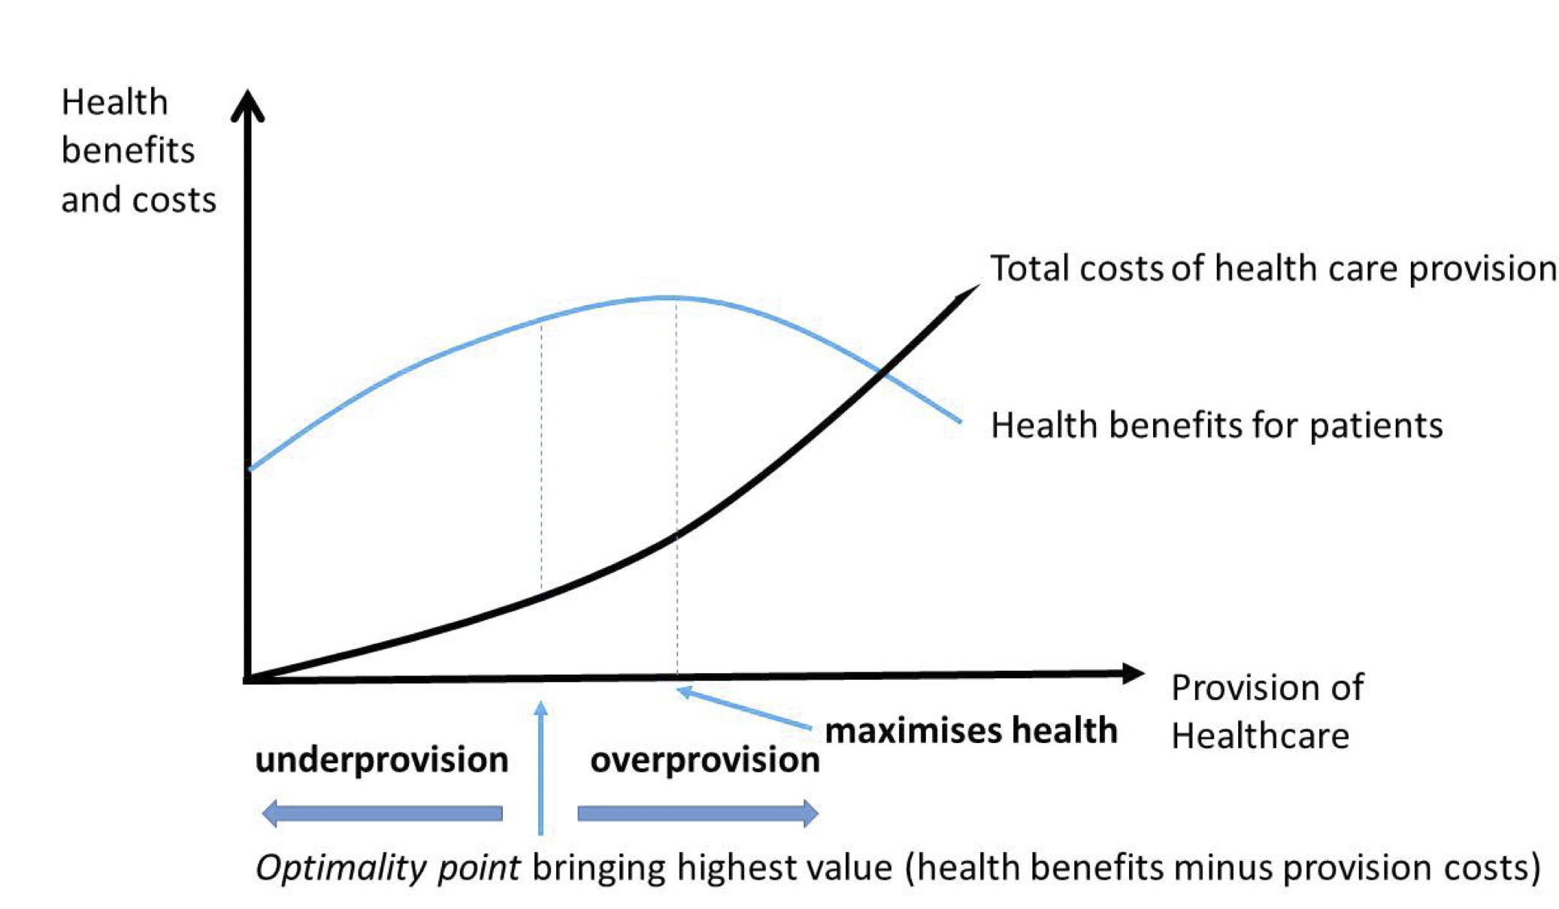
Needs and preferences
European Commission. Directorate General for Health and Food Safety. (2019). Defining value in ‘value-based healthcare’ :report of the Expert Panel on Effective Ways of Investing in Health (EXPH). Publications Office. https://data.europa.eu/doi/10.2875/872343
Notes:
﻿Such questions may not reflect the priorities of the patient, or indeed address elements of the patient experience or barriers to their treatment or what best leads to satisfying outcomes.

Slide 28
My message to you is…
Quality service in surgery is to provide the right care, to respect people’s needs and preferences and minimize harm and waste
We need to know (not guess) what is important for our patients, so that we increase the patient-value of our intervention
As long as we provide high quality standards and respect patient relevant outcomes… keep it simple!

