Slide 1

Updated Guidelines for
Open Preperitoneal
Ralph Lorenz – Berlin - www.3chirurgen.de

Slide 2
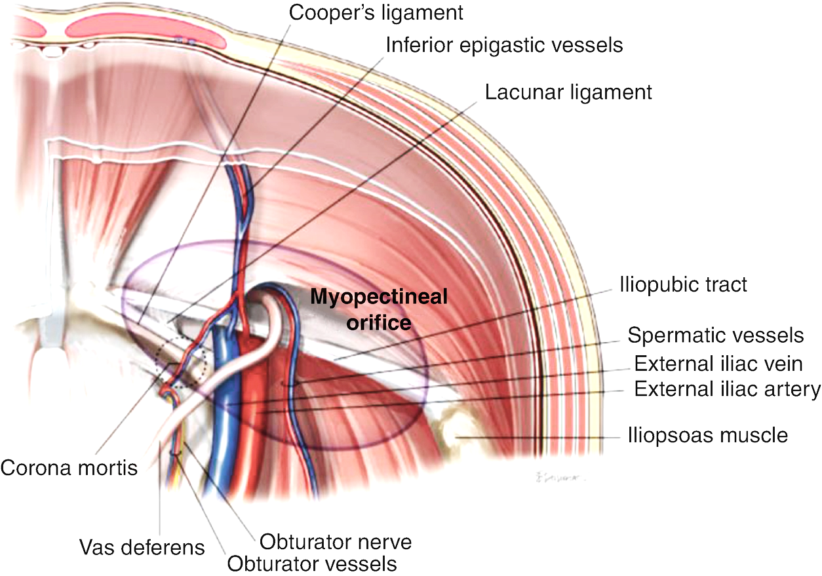

Updated Guidelines for
Open Preperitoneal
Ralph Lorenz – Berlin - www.3chirurgen.de

Slide 3
Ralph Lorenz – Berlin - www.3chirurgen.de
Financial disclosures:
Speakers Bureau BD/ Bard

Slide 4
Guidelines 2018
New Evidence
Guidelines 2022

Slide 5
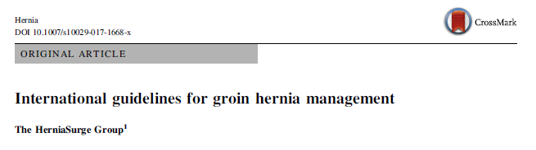
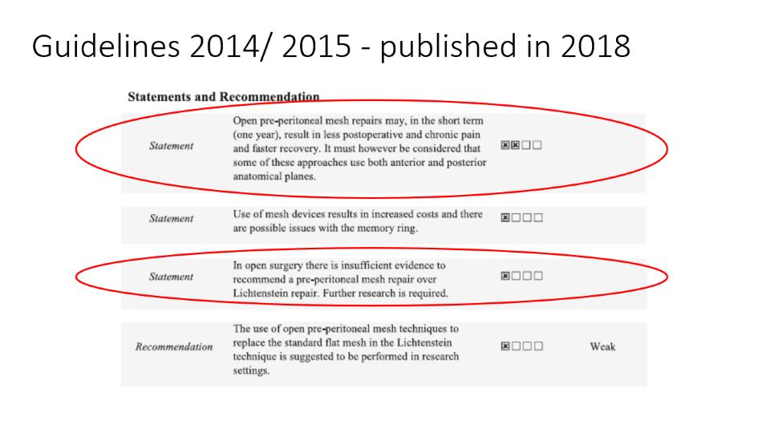
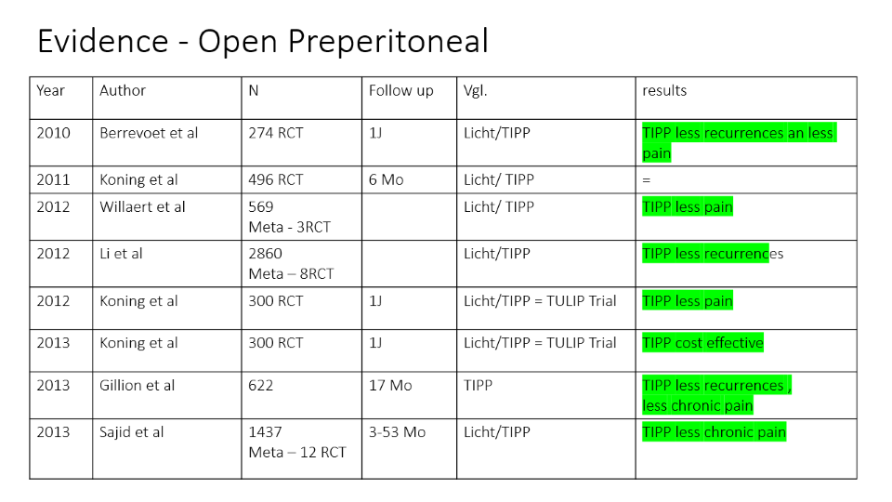

Guidelines
2018

Slide 6
Evidence - Open Preperitoneal
Year | Author | N | Follow up | Vgl. | results
2010 | Berrevoet et al | 274 RCT | 1J | Licht/TIPP | TIPP less recurrences an less pain
2011 | Koning et al | 496 RCT | 6 Mo | Licht/ TIPP | =
2012 | Willaert et al | 569 Meta - 3RCT |  | Licht/ TIPP | TIPP less pain
2012 | Li et al | 2860 Meta – 8RCT |  | Licht/TIPP | TIPP less recurrences
2012 | Koning et al | 300 RCT | 1J | Licht/TIPP = TULIP Trial | TIPP less pain
2013 | Koning et al | 300 RCT | 1J | Licht/TIPP = TULIP Trial | TIPP cost effective
2013 | Gillion et al | 622 | 17 Mo | TIPP | TIPP less recurrences , less chronic pain
2013 | Sajid et al | 1437 Meta – 12 RCT | 3-53 Mo | Licht/TIPP | TIPP less chronic pain

Slide 7
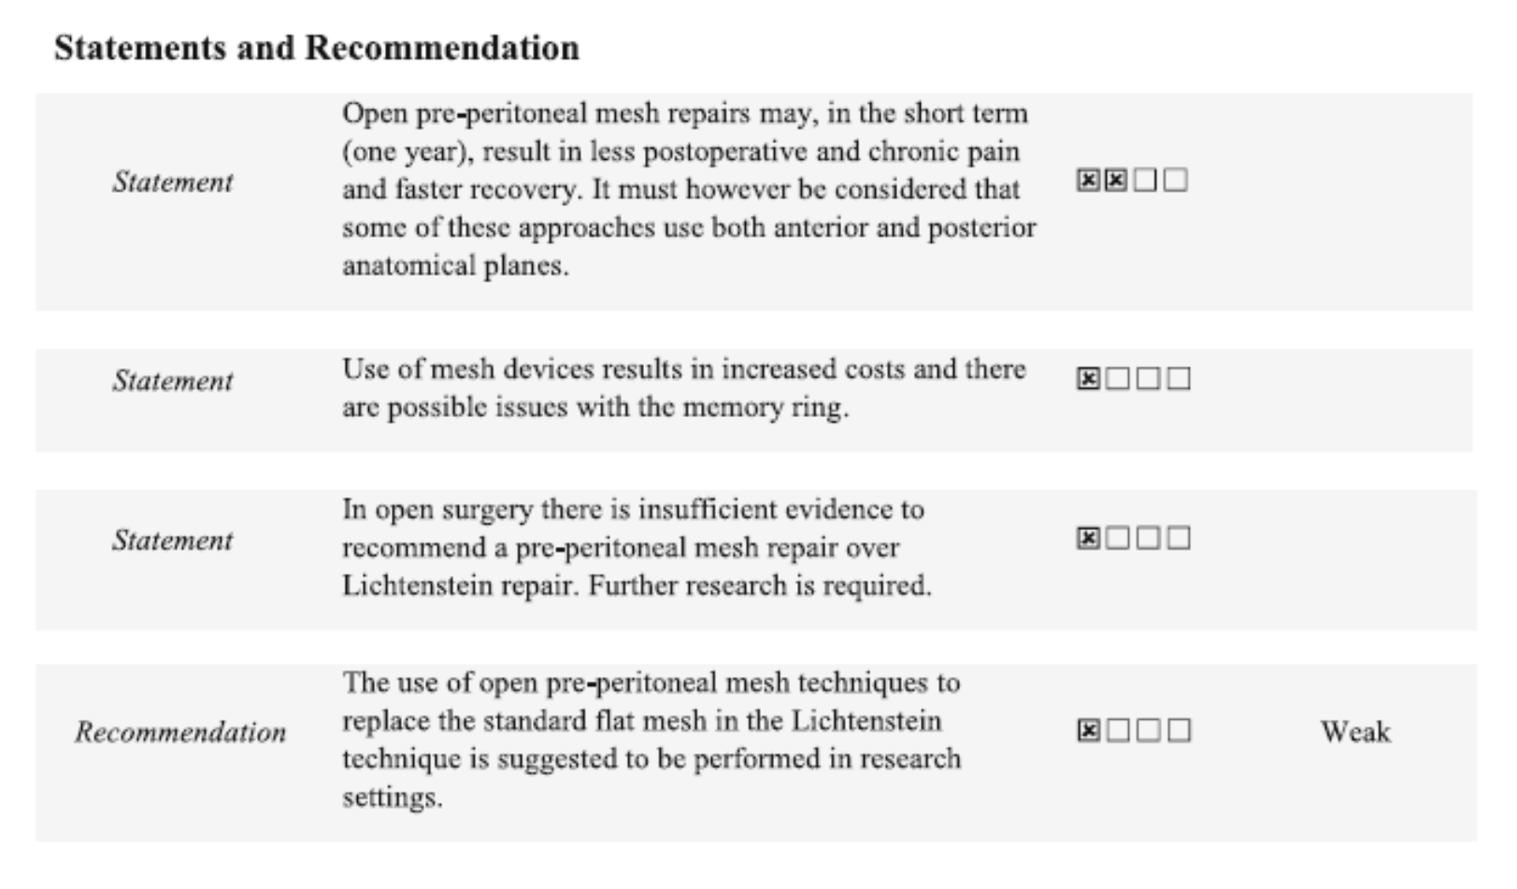
Guidelines 2014/ 2015 - published in 2018

Slide 8
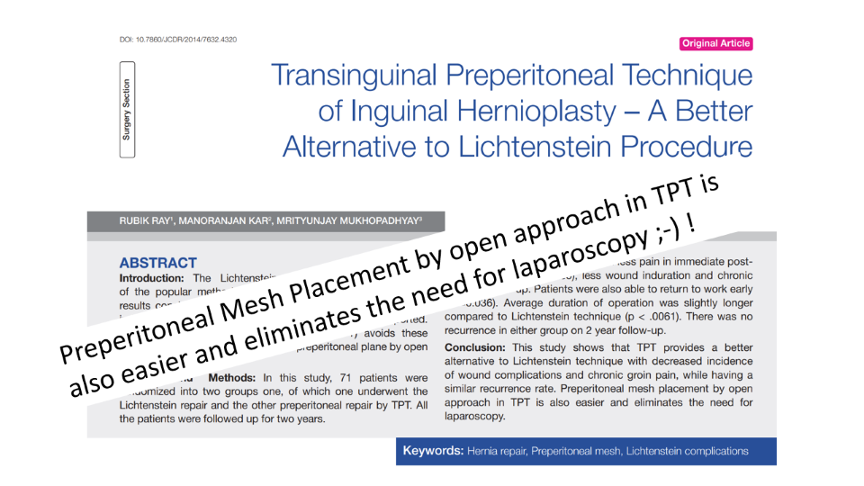
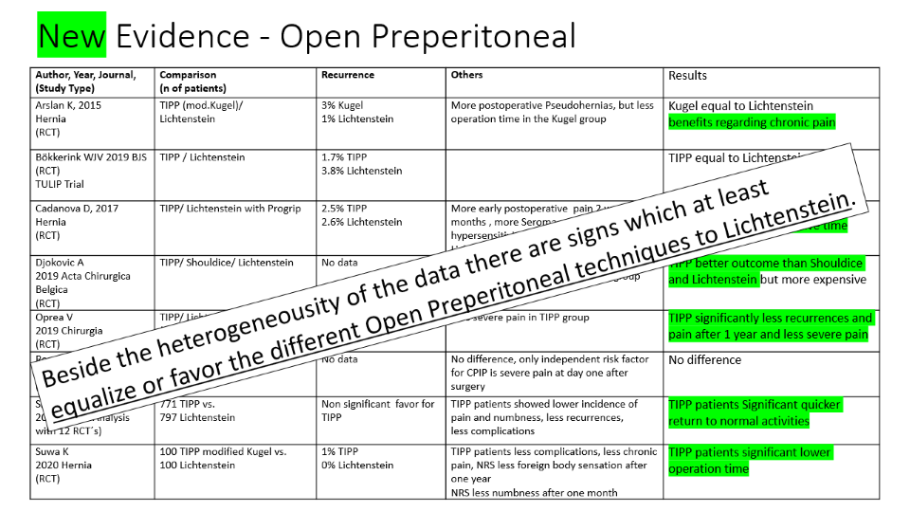
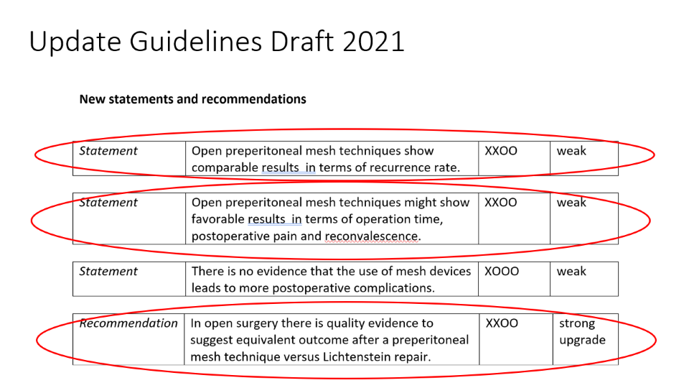

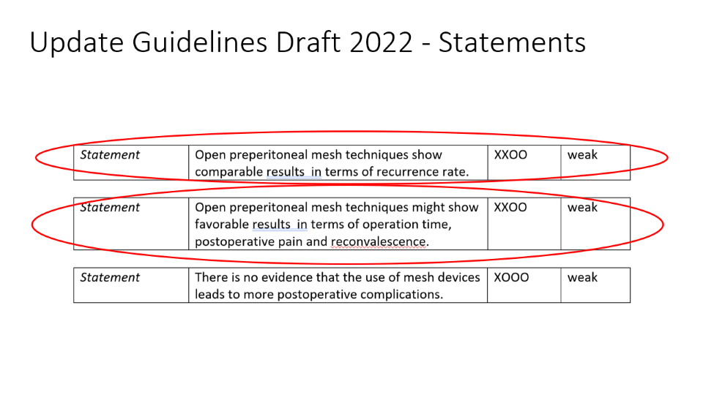
International Guidelines 2018
TIPP not yet recommended because of not enough Evidence!
Females everytime laparo-endoscopic with mesh!
Update of Guidelines
in preparation
2018 → 2022?

Slide 9
New Evidence - Open Preperitoneal
Author, Year, Journal, (Study Type) | Comparison (n of patients) | Recurrence | Others | Results
Arslan K, 2015 Hernia (RCT) | TIPP (mod.Kugel)/ Lichtenstein | 3% Kugel 1% Lichtenstein | More postoperative Pseudohernias, but less operation time in the Kugel group | Kugel equal to Lichtenstein benefits regarding chronic pain
Bökkerink WJV 2019 BJS (RCT) TULIP Trial | TIPP / Lichtenstein | 1.7% TIPP 3.8% Lichtenstein |  | TIPP equal to Lichtenstein
Cadanova D, 2017 Hernia (RCT) | TIPP/ Lichtenstein with Progrip | 2.5% TIPP 2.6% Lichtenstein | More early postoperative pain 2 weeks 3 months , more Seroma, more hypersensitivity more scrotal pain in Lichtenstein group | TIPP equal to Lichtenstein, benefits early postoperative time
Djokovic A 2019 Acta Chirurgica Belgica (RCT) | TIPP/ Shouldice/ Lichtenstein | No data | Less acute pain Higher patients satisfaction in TIPP group | TIPP better outcome than Shouldice and Lichtenstein but more expensive
Oprea V 2019 Chirurgia (RCT) | TIPP/ Lichtenstein (Recurrences, large hernias, femoral only) | 2% TIPP 3% Lichtenstein | Less severe pain in TIPP group | TIPP significantly less recurrences and pain after 1 year and less severe pain
Romain B 2018 Hernia (Database Study) | TIPP/ Lichtenstein/ TEP / TAPP | No data | No difference, only independent risk factor for CPIP is severe pain at day one after surgery | No difference
Sharma P 2015 (Meta-Analysis with 12 RCT´s) | 771 TIPP vs. 797 Lichtenstein | Non significant favor for TIPP | TIPP patients showed lower incidence of pain and numbness, less recurrences, less complications | TIPP patients Significant quicker return to normal activities
Suwa K 2020 Hernia (RCT) | 100 TIPP modified Kugel vs. 100 Lichtenstein | 1% TIPP 0% Lichtenstein | TIPP patients less complications, less chronic pain, NRS less foreign body sensation after one year NRS less numbness after one month | TIPP patients significant lower operation time
Beside the heterogeneousity of the data there are signs which at least equalize or favor the different Open Preperitoneal techniques to Lichtenstein.

Slide 10
Open Preperitoneal
MOPP
TREPP
ONSTEP
TIPP
TPT
Pelissier
Stoppa
Wantz
Nyhus

Slide 11

There are not any Comparative Studies
 | TIPP | TREPP | MOPP | ONSTEP
Recurrences | ? | ? | ? | ?
Pain | ? | ? | ? | ?
Complications | ? | ? | ? | ?

Slide 12
* Bökkerink WJV, Koning GG, Vriens PWHE, Mollen RMHG, Harker MJR, Noordhof RK, Akkersdijk WL, van Laarhoven CJHM. Open Preperitoneal Inguinal Hernia Repair, TREPP versus TIPP in a Randomized Clinical Trial: Abstract provisionally accepted for ESA congress May 2021 Cologne, titled 'Chronic inguinal pain after the TransREctus sheath preperitoneal method compared to the TransInguinal preperitoneal technique. A randomized clinical trial'. Ann Surg. 2021 Aug 2. doi: 10.1097/SLA.0000000000005130. Epub ahead of print. PMID: 34342299.
RCT 800 patients
Baseline characteristics were comparable in both groups. Pain was less often present after TREPP at 2 weeks and 6 months, but CPIP at rest at 1 year was comparable: 1.9% after TREPP vs 1.4% after TIPP, p=0.535). The overall recurrence rate was higher in the TREPP group, 8.9% vs 4.6%, p=0.022). Corrected for a learning curve for TREPP, no significant difference could be assessed (TREPP 5.7% and TIPP 4.8%, p=0.591).
both the TREPP and TIPP technique resulted in a low incidence of CPIP after 1 year follow up. The TREPP method can be considered a solid method for inguinal hernia repair if expertise is present. The learning curve of the TREPP techniques needs further evaluation.
TREPP and TIPP are mostly equal
TREPP less pain, more recurrences!

Slide 13
*van Silfhout L, van Hout L, Jolles M, Theeuwes HP, Bökkerink WJV, Vriens PWHE. Treatment of recurrent inguinal hernia after TransInguinal PrePeritoneal (TIPP) surgery: feasibility and outcomes in a case series. Hernia. 2021 Oct 20. doi: 10.1007/s10029-021-02517-2. Epub ahead of print. PMID: 34668109.
33 patients with recurrences after TIPP
These results indicate that after TIPP it is feasible and safe to perform re-surgery for recurrent inguinal hernia with an anterior approach again.
For these recurrences, a Lichtenstein repair can be performed, or a "re-TIPP if possible" strategy can be applied by experienced TIPP surgeons, tailored to the intraoperative findings.
Whether a re-TIPP has advantages over Lichtenstein should be evaluated in a prospective manner.
re-TIPP is feasible and safe!

Slide 14
*Gillion JF, Soler M, Chollet JM; Club-Hernie members. A registry-based 2-year follow-up comparative study of two meshes used in transinguinal preperitoneal (TIPP) groin hernia repair. Langenbecks Arch Surg. 2021 Feb;406(1):197-208. doi: 10.1007/s00423-020-01993-x. Epub 2020 Sep 30. PMID: 32997233.
Database Study from Club Hernie with 2-year Follow-up after TIPP
181 Onflex cases versus 182 Polysoft cases
Equal results
Material doesn´t matter!

Slide 15
*Djokovic A, Delibegovic S. Tipp versus the Lichtenstein and Shouldice techniques in the repair of inguinal hernias - short-term results. Acta Chir Belg. 2021 Aug;121(4):235-241. doi: 10.1080/00015458.2019.1706323. Epub 2019 Dec 25. PMID: 31856675.
300 patients with TIPP, Shouldice and Lichtenstein
TIPP technique has advantages in comparison with the Lichtenstein and Shouldice techniques.
This method takes a shorter time, the skin incision is smaller, the VAS score is lower and the patient satisfaction level is higher.
These advantages are in balance with the higher costs of this procedure.
TIPP has less pain and has better patient satisfaction!

Slide 16
*Corthals S, van Cleven S, Uyttebroek O, Abreu de Carvalho L, Vanlander A, Berrevoet F. Quality of life after open versus laparoscopic preperitoneal mesh repair for unilateral inguinal hernias. Asian J Surg. 2021 Oct;44(10):1266-1273. doi: 10.1016/j.asjsur.2021.03.014. Epub 2021 Apr 19. PMID: 33888373.
135 TIPP vs. 69 TEP patients
TIPP and TEP show equivalent results considering postoperative quality of life.
Compared to existing literature on mesh repair for unilateral inguinal hernias, we may conclude that the preperitoneal location of the mesh probably is a more decisive factor for quality of life than the surgical approach used.
TIPP and TEP are equal!

Slide 17
*Zwols TLR, Slagter N, Veeger NJGM, Möllers MJW, Hess DA, Jutte E, Brandsma HT, Veldman PHJM, Koning GG, Eker HH, Pierie JPEN. Transrectus sheath pre-peritoneal (TREPP) procedure versus totally extraperitoneal (TEP) procedure and Lichtenstein technique: a propensity-score-matched analysis in Dutch high-volume regional hospitals. Hernia. 2021 Oct;25(5):1265-1270. doi: 10.1007/s10029-020-02291-7. Epub 2020 Oct 16. PMID: 33067735; PMCID: PMC8514342.
3285 TREPP, TEP, Lichtenstein-patients after propensity score matching
compares TREPP with Lichtenstein and TEP in the presence of postoperative pain, recurrences and other adverse outcomes.
After propensity-score matching, no statistically significant difference in postoperative pain or recurrences remained between either TREPP compared to Lichtenstein, or TREPP compared to TEP.
Based on these results, TREPP, Lichtenstein and TEP showed comparable results in postoperative pain, recurrences and other surgical site complications.
TREPP and TEP and Lichtenstein are equal!

Slide 18
*Yamamoto K, Koda K. Favorable outcomes of transabdominal compared with transinguinal preperitoneal inguinal hernia repair. Minim Invasive Ther Allied Technol. 2022 Mar 18:1-7. doi: 10.1080/13645706.2022.2050258. Epub ahead of print. PMID: 35301932.
177 TAPP vs. 177 TIPP patients after propensity score matching of 784 patients
Postoperative pain during normal activity was significantly lower in the TAPP group than in the TIPP group on day 1 (2.75 ± 1.67 versus 3.59 ± 1.86, p < 0.01), at 1 week (0.98 ± 1.11 versus 1.75 ± 1.51, p < 0.01), and at 1 month (0.11 ± 0.48 versus 0.29 ± 0.78, p = 0.01).
There was no difference in pain at rest on day 1 and at one week, although TAPP was associated with significantly less pain at rest at one month than was TIPP (0.01 ± 0.08 versus 0.1 ± 0.49, p = 0.02).
TAPP less pain than TIPP!

Slide 19
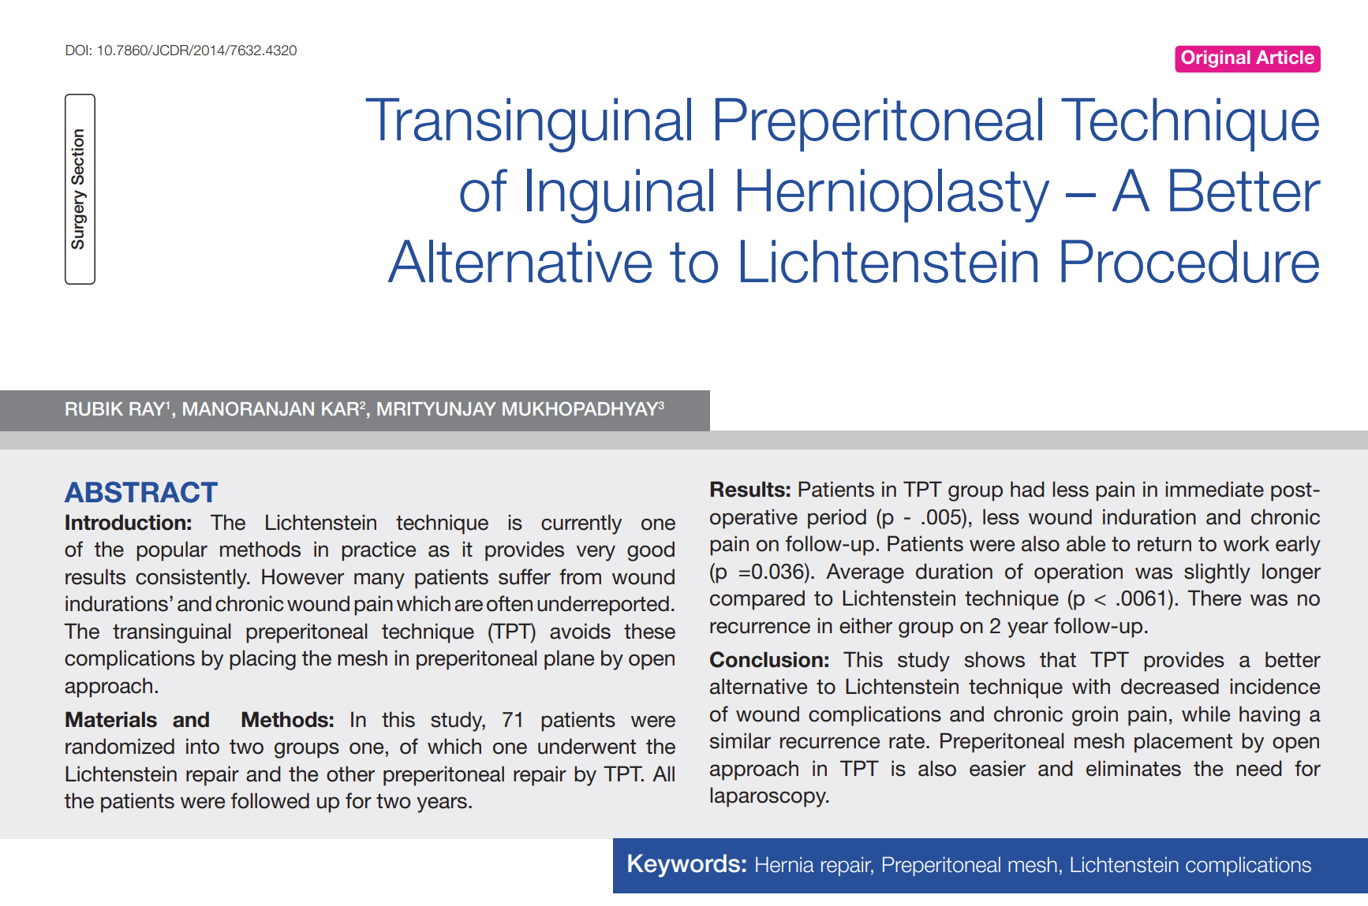
Preperitoneal Mesh Placement by open approach in TPT is also easier and eliminates the need for laparoscopy ;-) !

Slide 20
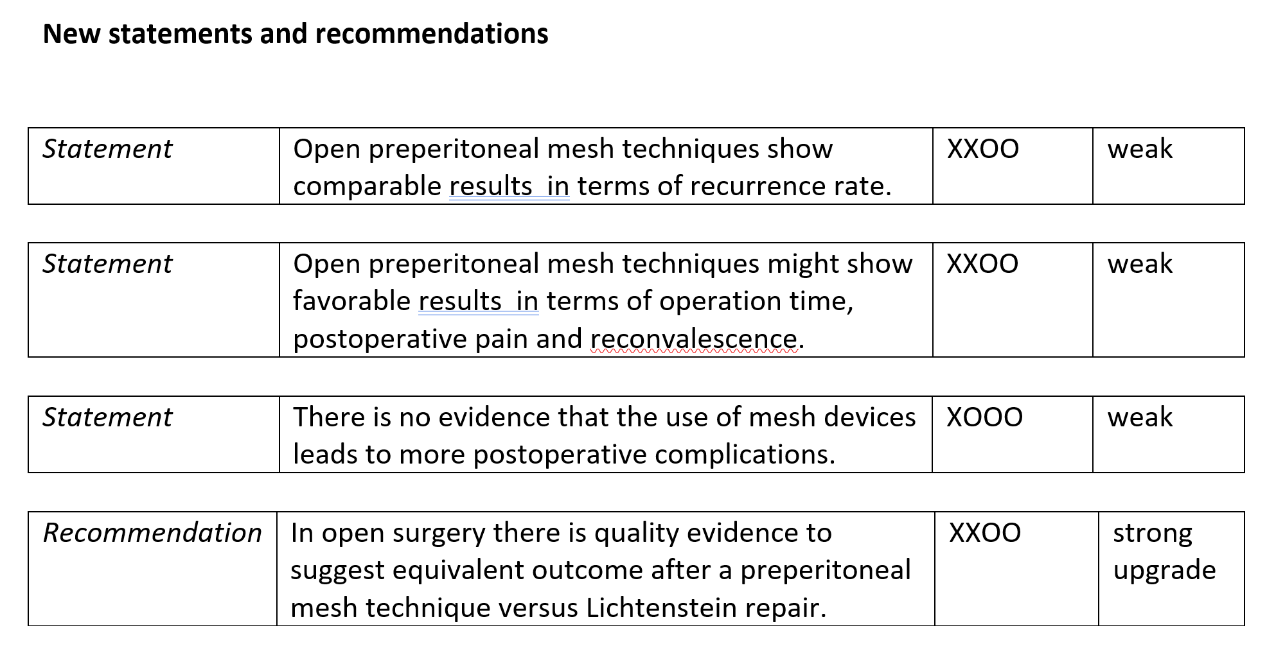
Update Guidelines Draft 2022 - Statements

Slide 21
Update Guidelines Draft 2022 - Recommendation

Slide 22
Open Preperitoneal
Equal or better results
Easy to perform
should be included in guidelines
Quality should be constantly proofed

Slide 23

Merci beaucoup!

